Slide 1
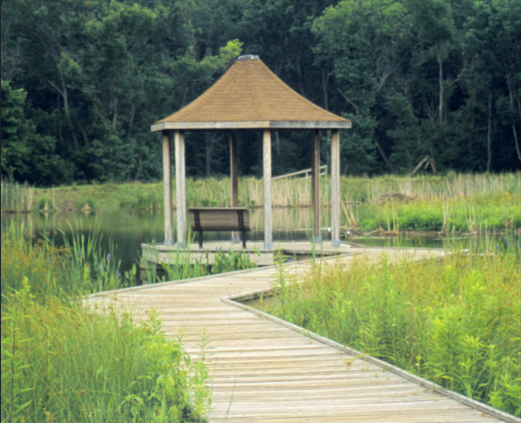
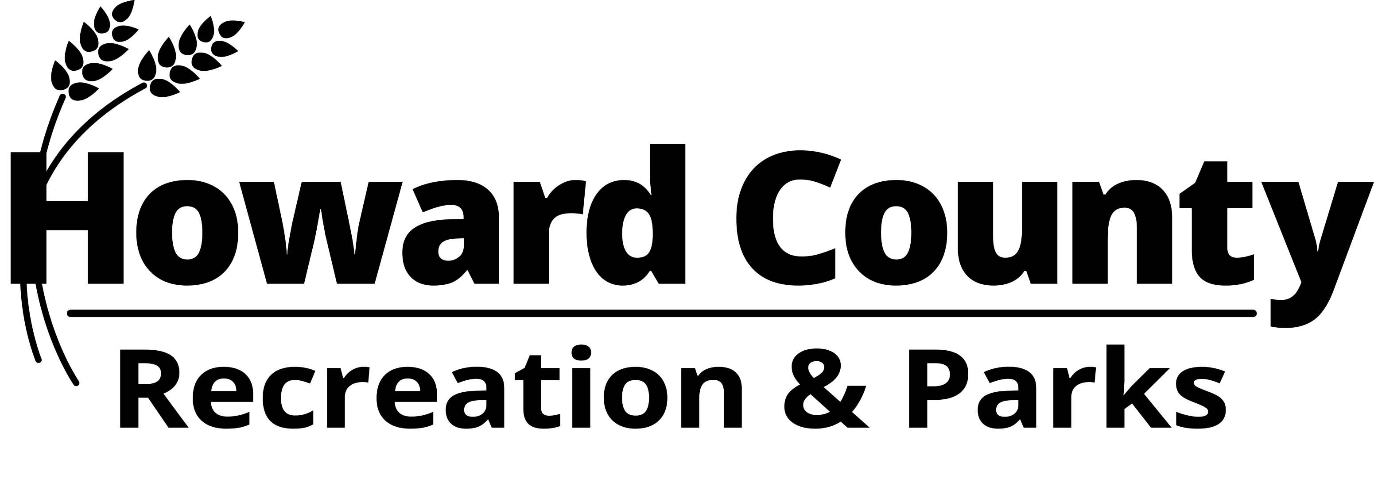
Font Hill Wetlands Park
Bridge, Pathway & Stream Bank Stabilization
Project Informational Meeting
January 2026 Project Updates

Slide 2
Agenda
Introductions
Current Project Overview
  Project Updates as of 1/15/2026
Tree Survey, Tree Impacts and new Tree & Landscape Planting Plan
  Tree Impact Updates as of 1/15/2026
Summary of Impact Minimization as of 1/15/2026
Timeline
Questions

Slide 3
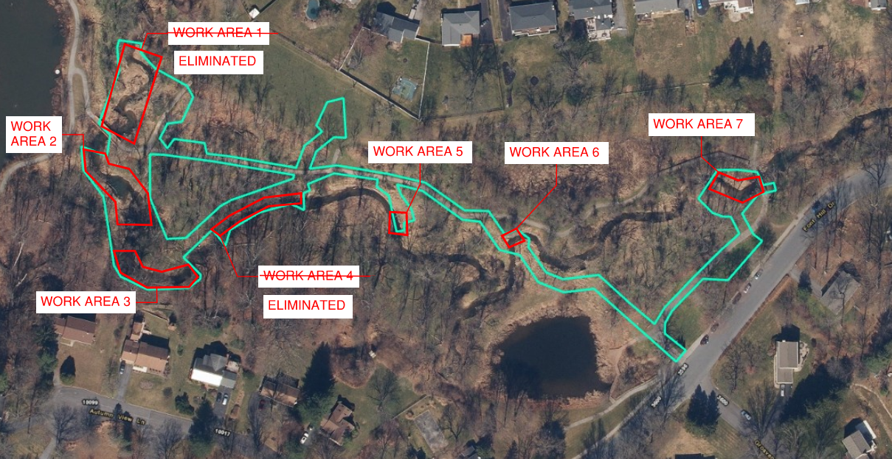
Proposed Streambank Stabilization

Slide 4
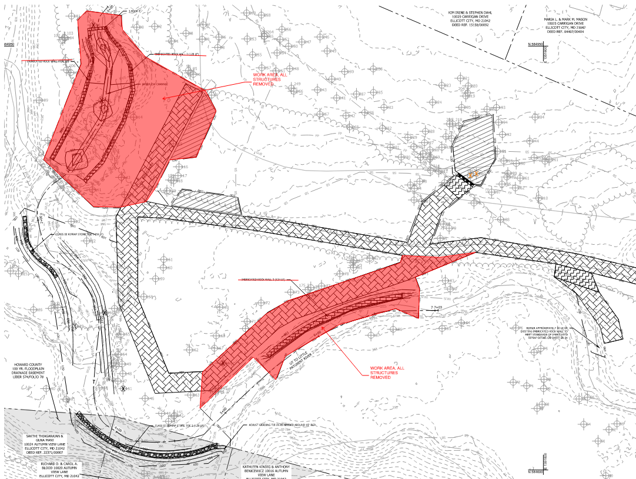
Proposed Streambank Stabilization
Work Area 1:
  2 additional trees saved
  5,000 SF less disturbance due to grading/access
Work Area 4:
  1 additional tree saved
  5,600 SF less disturbance due to grading/access

Slide 5
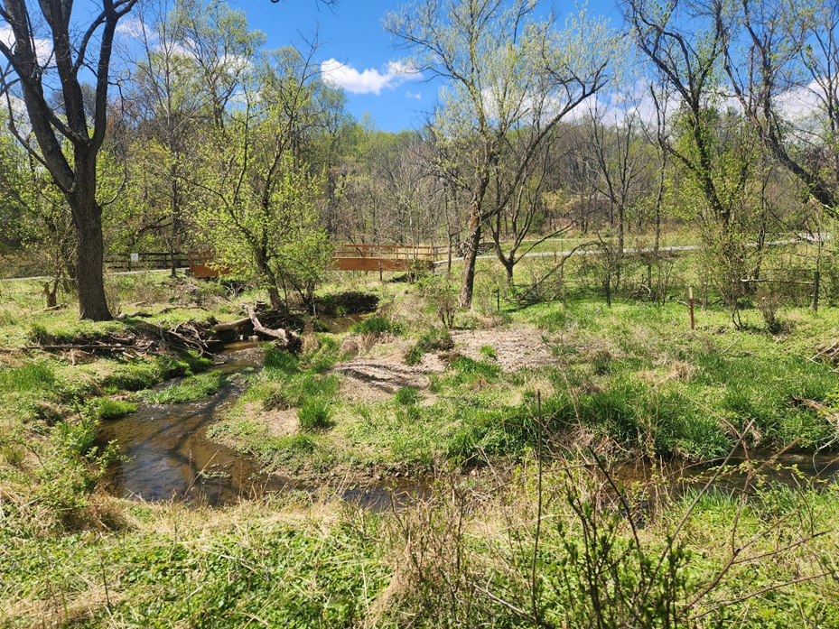
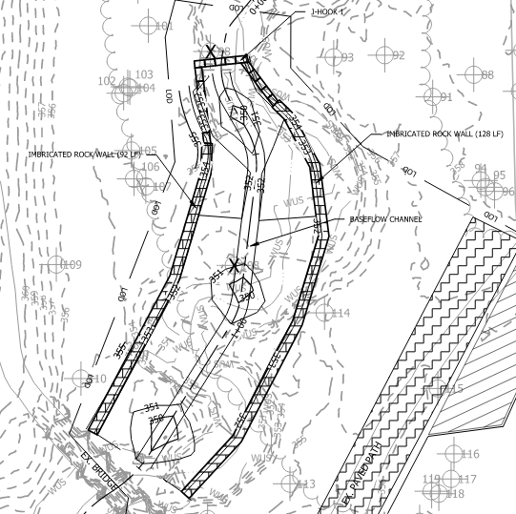
Work Area 1 – Above Laminated Pedestrian Bridge
ELIMINATED
Realign channel, remove excess sediment & reuse on site
Install imbricated rock walls and rock J-hook
Eliminate erosion of bridge abutments, improve channel geometry and sediment transport, prevent future channel migration
If work is not completed – erosion will continue, likely cause additional tree falls and potentially impact bridge abutments

Slide 6
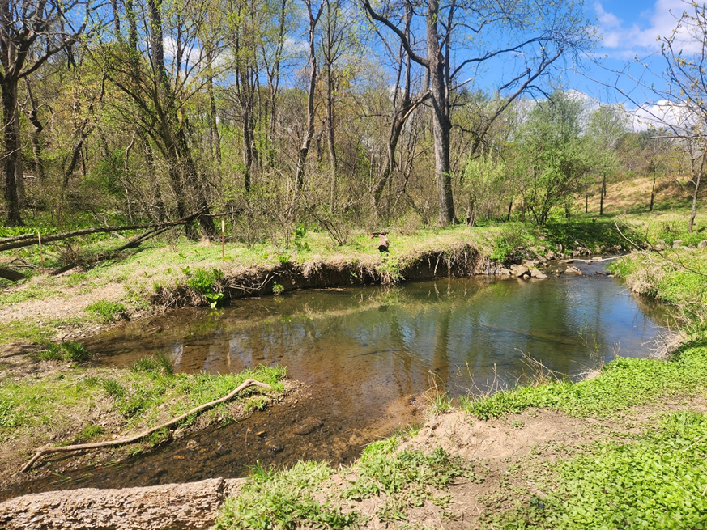
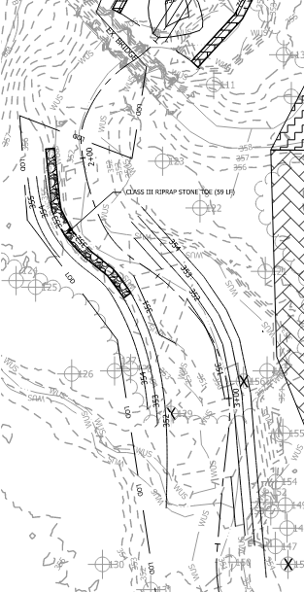
Work Area 2 – Below Laminated Pedestrian Bridge
Realign channel, remove excess sediment & reuse on site
Install rock toe protection, grade and stabilize banks
Improve channel geometry and sediment transport, stabilize bank erosion
If work is not completed – erosion will continue, likely cause additional tree falls

Slide 7
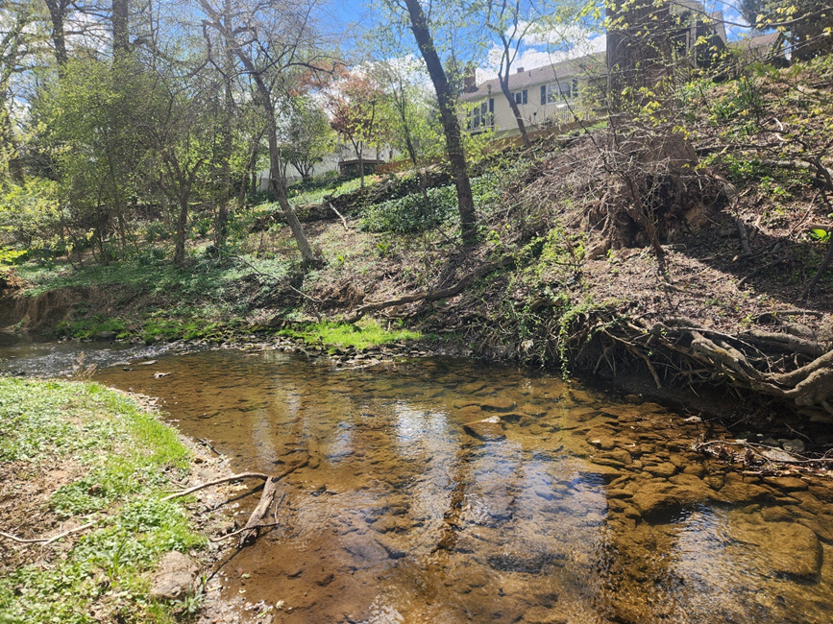
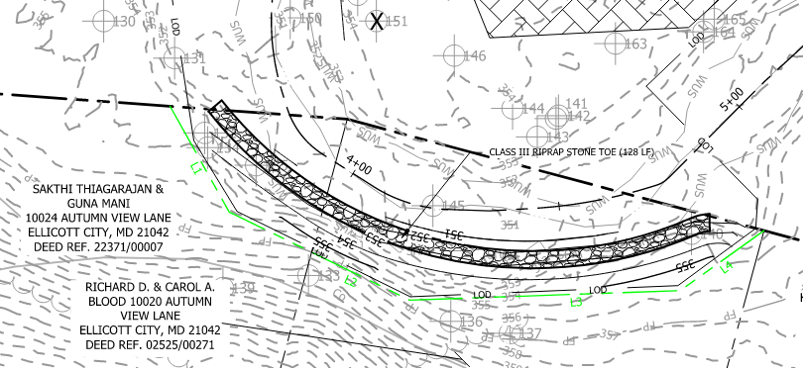
Work Area 3 – Toe of Slope behind Autum View Lane
Install stone toe protection along eroding toe of bank
Grade and stabilize bank
Stabilize bank erosion, prevent future undercutting of toe of slope and tree roots
If work is not completed – erosion will continue, likely cause additional tree falls and continue to undermine hill slope
  Continued erosion could cause two specimen trees to fall which would cause large scale damage to hill slope

Slide 8
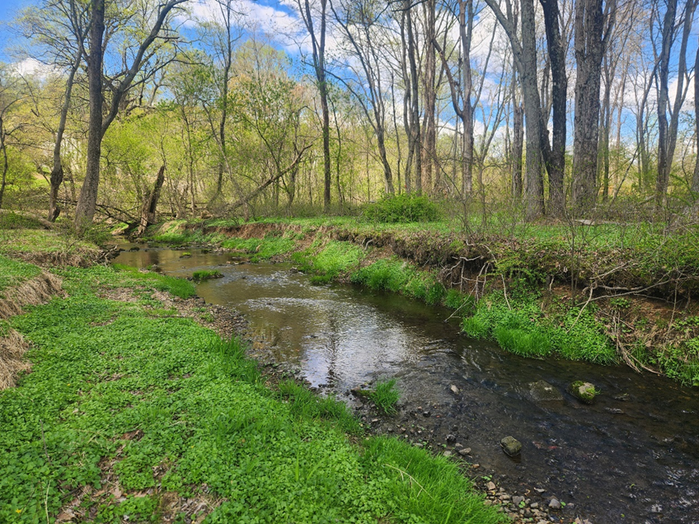
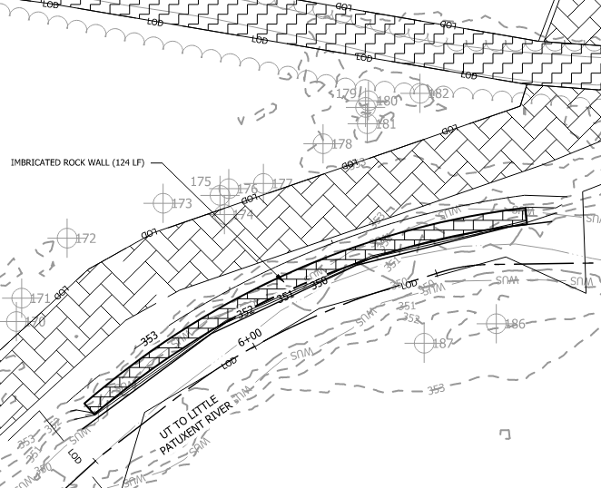
Work Area 4 – Eroded Bank along Park Path
ELIMINATED
Install imbricated rock wall along length of eroded bank
Stabilize bank erosion, prevent further channel migration toward park path
If work is not completed – erosion will continue, likely cause additional tree falls and will migrate toward park path

Slide 9
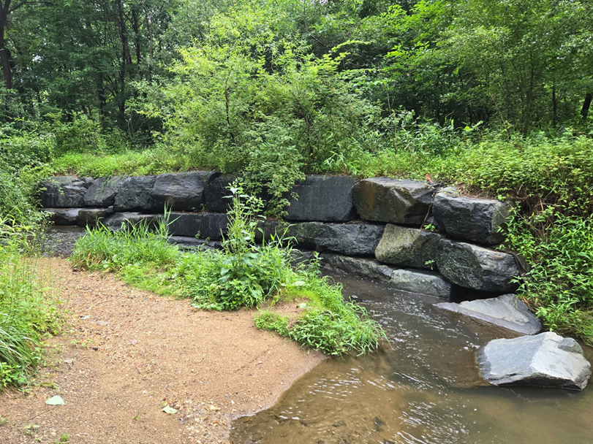
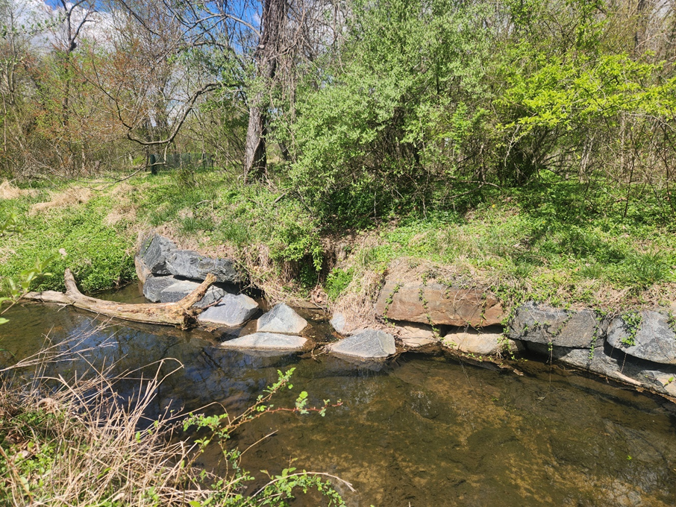
Work Area 5 & 6 – Repair of Existing Imbricated Wall
Repair damage to existing imbricated walls built during original stabilization work
If work is not completed – imbricated walls will continue to unravel

Slide 10
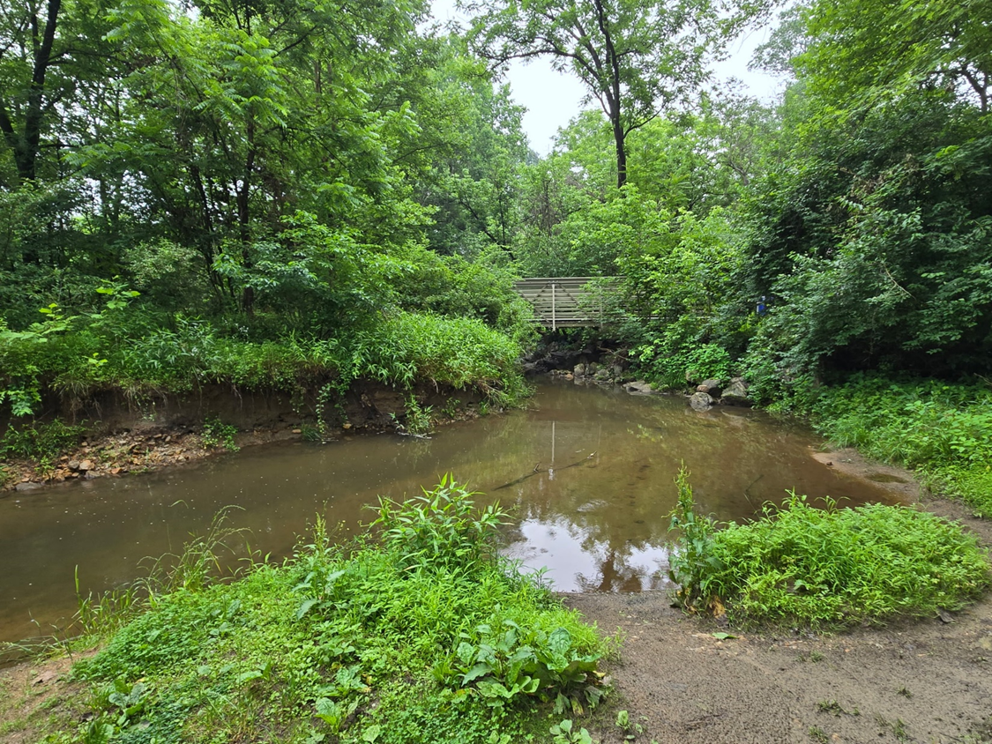
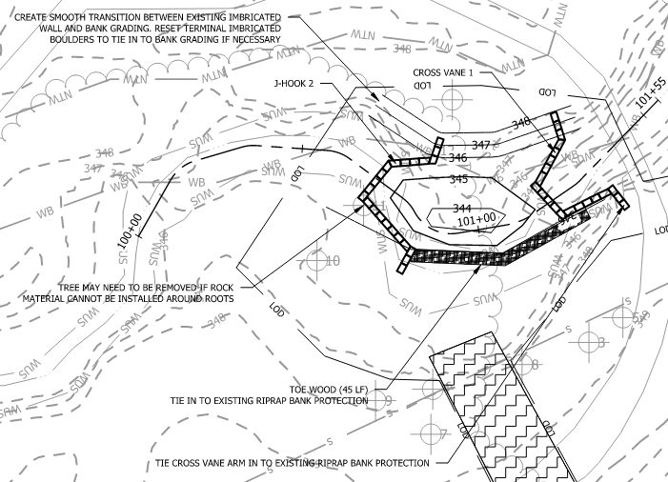
Work Area 7 – Above of FRP Pedestrian Bridge
Realign channel
Install rock j-hook and rock cross vane
Grade and stabilize left bank, install toe wood along right bank
Eliminate erosion of bridge abutments, improve channel geometry and sediment transport, prevent future channel migration
If work is not completed – erosion will continue, likely cause additional tree falls and potentially impact bridge abutments and park path

Slide 11
Proposed Bridge/Pathway/Streambank Stabilization Project
Access – utilizing existing park pathways and open areas
Mulch access road and timber mats installed to prevent damage
Stockpile areas – utilizing existing open spaces within park
Only major material import is rock
Erosion and Sediment Control – installed per MDE, Howard County SCD Standards

Slide 12
Tree Survey & Tree Impacts
Existing Tree Survey – GPS survey of all trees >6” diameter within proposed limit of disturbance, identified species and trunk diameter
Initial Concept Design – proposed removal of 78 trees
Final Design – proposes removal of 8 trees
  Project Scope Updates: Proposes removal of 5 trees
  6 Boxelder, 7-14” diameter
    Project Scope Updates: 4 Boxelder (7”, 10”, 13”, 14” diameter)
  1 Black Walnut (10” diameter) & 1 Black Cherry (9” diameter)
    Project Scope Updates: 1 Black Walnut, 10” diameter
  No specimen trees (30” diameter or greater) to be removed as part of project
Trees proposed for removal will be saved during construction if possible

Slide 13
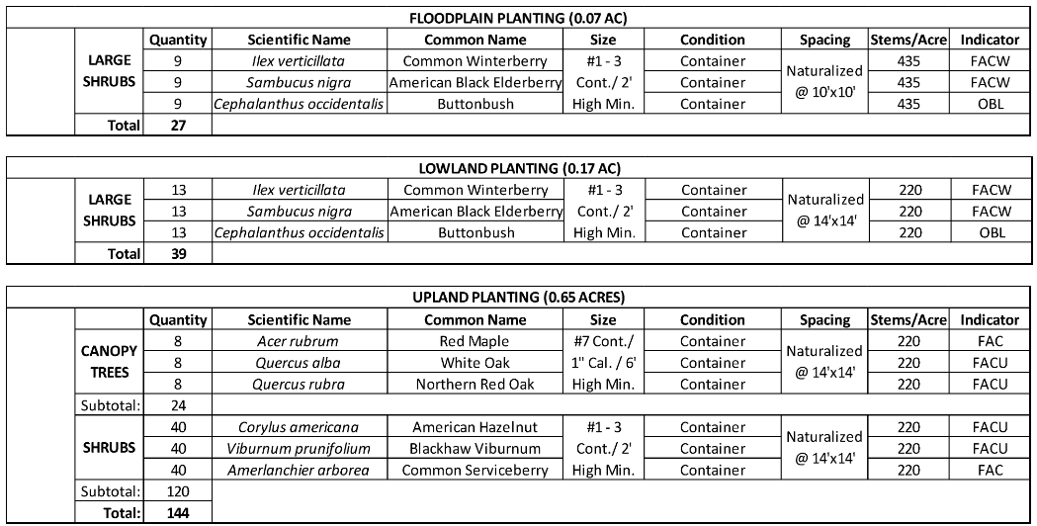
New Plantings
Native species locally grown in Ecotone’s native nursery
24 canopy trees, 186 shrubs
Exceeds MDE/County planting permit requirements based on impacted areas
  Required planting is 1:1 replacement for any trees removed
    Current scope would require 5 trees, no shrubs
  Planting plan exceeds requirements in order to provide ecological uplift & stability to floodplain & forest areas
Native seed mixes throughout disturbed areas
All proposed landscaping will have a minimum 12-month warranty, and the stream will be monitored for a minimum of 3 years post-construction.

Slide 14
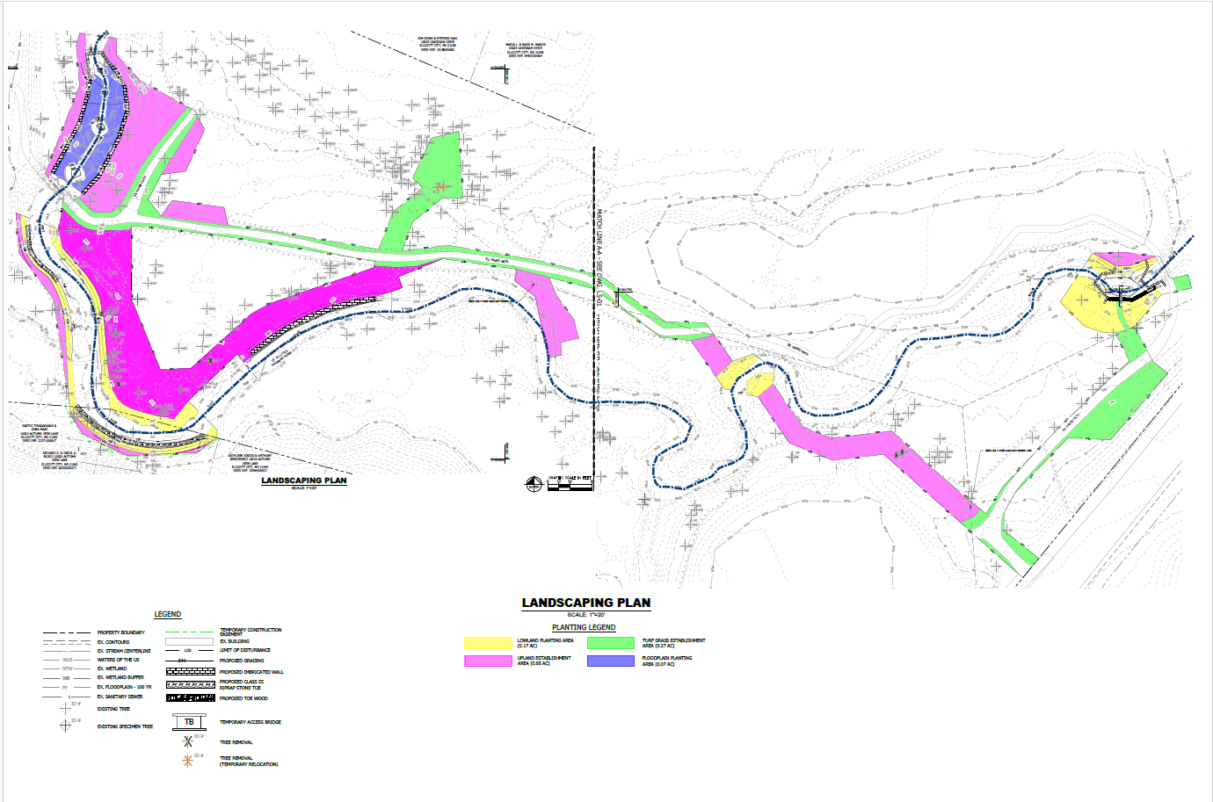
Landscape Plan

Slide 15
Summary of Project Updates
Tree impacts of trees >6” diameter lowered from 8 trees to 5 trees
Elimination of Work Areas 1 & 4
  Stream Grading Clearing area lowered by 8,000 SF
  Access Impact area lowered by 2,600 SF
Work Area | Stream Grading Clearing Area |  | Resource Impacts
Work Area 2 | 1775 | SF | 3 trees >6" diameter impacted
Work Area 3 | 1100 | SF | no trees >6" diameter impacted
Work Area 5 | 0 | SF | no trees >6" diameter impacted
Work Area 6 | 0 | SF | no trees >6" diameter impacted
Work Area 7 | 1500 | SF | no trees >6" diameter impacted, 967 SF of impact to 25' wetland buffer, no impacts to wetlands
Access Impact Area | 9600 | SF | 2 trees >6" diameter impacted
Total Area of Disturbance to Existing Understory Vegetation | ~0.32 | AC

Slide 16
Next Steps
MDE/USACE permit has been approved & issued
Howard County SCD permit has been approved and issued
Howard County Grading permit is in process
Anticipated project start: Early February 2026
Anticipated Construction duration: 6 weeks
Pathway closure information
Hours of work. M- Fri 6:30-6:30
  In-stream work must be complete by 3/1/26 (time-of-year closure)
  Weekend work not expected to be necessary, but is possible if weather delays occur

Slide 17
Closing/Key Points
Highly targeted, limited disturbance project to stabilize stream banks and to protect park infrastructure
Five small, separate work sites, not one large construction site
Total disturbance limited to approximately14,000 square feet
  Across all five sites, five trees over six inches in diameter are impacted.
Replanting exceeds regulatory requirements
  24 trees and 186 shrubs will be planted
  Regulations require replacement of only 5 trees and no shrubs
Not designed for MS4 credits
  County is not pursuing MS4 credits

Slide 18
Closing/Key Points
Sensitive wildlife evaluated
  Known habitat areas for barred owls and leucistic cardinals reviewed
  Buffers are incorporated
  No significant impacts are anticipated
  Howard County Bird Club Statement
  "The Department of Recreation and Parks carefully evaluated known nesting and habitat locations the piebald (partially leucistic) cardinal and the barred owls. The project design incorporates reasonable buffer areas around these locations and includes measures to limit activity in close proximity. Based on this planning, significant disturbance to these birds is not anticipated."

Slide 19
Questions
Please direct questions and
comments to:
fonthillpark@howardcountymd.gov

Slide 20
Thank You

