Slide 1
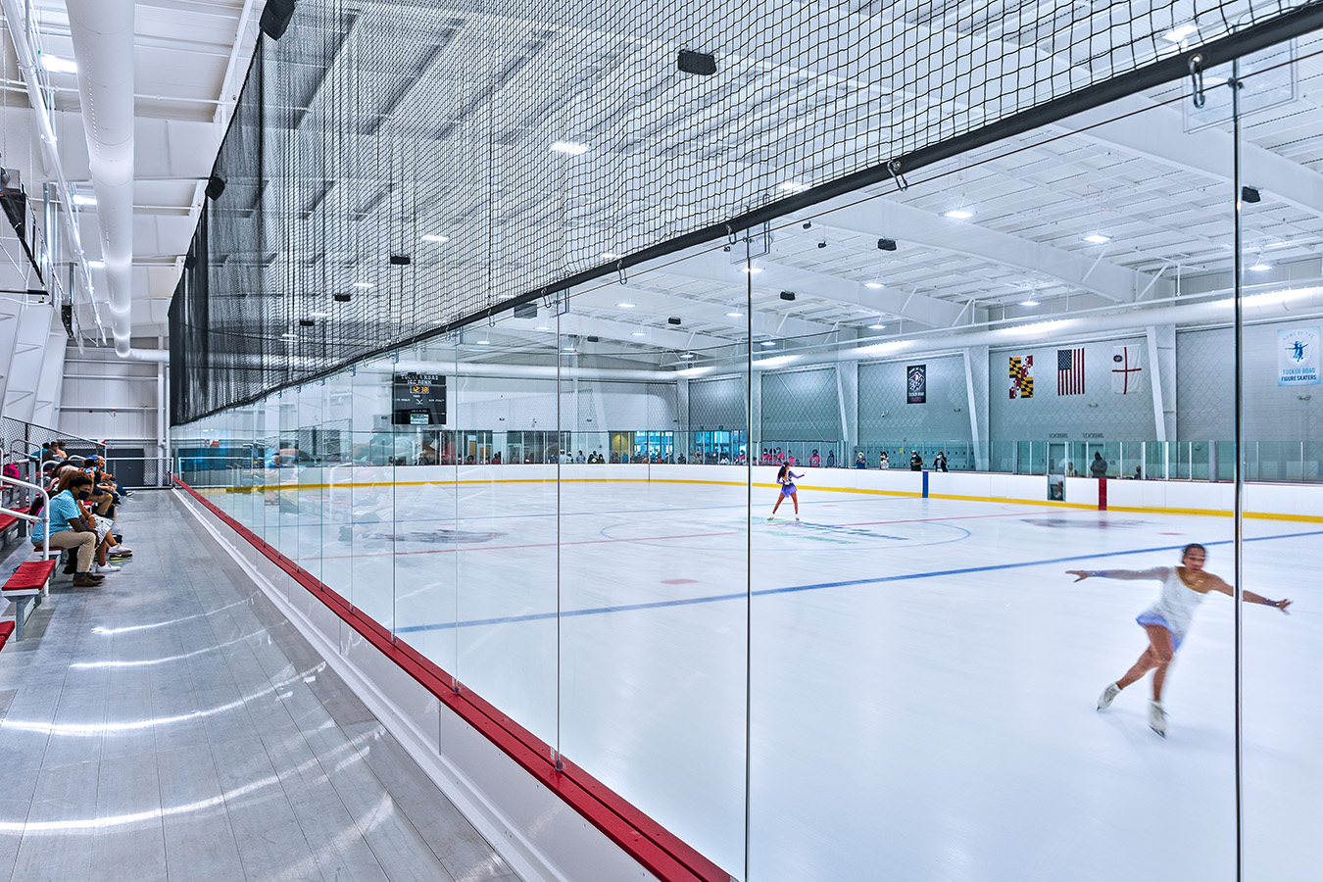


Howard County
Public Ice Rink Facility
Today’s Agenda
Introduction
Site Analysis
Site Matrix Comparisons
Concept Studies
Comments and Discussion
March 4, 2026
Notes:
On this slide, it states “Howard County Public Ice Rink Facility”
The agenda is also on this page and lists Introduction, Site Analysis, Site Matrix Comparisons, Concept Studies, and Comments and Discussion.
It then states the date of the presentation, March 4, 2026.
The Howard County logo and Grimm and Parker logos are in the bottom, right corner

Slide 2
Project Timeline
October 2022 – Shipley property public meeting.
October 2023 – Shipley property feasibility study.
July 2024 – Fiscal Year 2025 Capital Budget $1M design funds approved.
April 2025 – Economic and Market Feasibility Study.
August 2025 – Grimm & Parker selected as architectural firm.
August 2025 – March 2026 - Concepts, site analysis (Shipley & Meadowbrook), traffic studies (5% design).
October 2025 – Economic Impact Analysis.
January 2026 – First focus group meeting.
March 2026 – Public Information Session - Site analysis/Community Feedback.
May 2026 – FY2027 Capital Budget Adoption.
July 2026 – June 2027 – Schematic Design (15% towards total design).
Notes:
This slide is titled Project Timeline.
It then reads the following in bullet format
October 2022 – Shipley property public meeting.
October 2023 – Shipley property feasibility study.
July 2024 – Fiscal Year 2025 Capital Budget $1M design funds approved.
April 2025 – Economic and Market Feasibility Study.
August 2025 –Grimm & Parker selected as architectural firm.
August 2025 – March 2026 - Concepts, site analysis (Shipley & Meadowbrook), traffic studies (5% design).
October 2025 – Economic Impact Analysis.
January 2026 – First focus group meeting.
March 2026 – Public Information Session - Site analysis/Community Feedback.
May 2026 – FY2027 Capital Budget Adoption.
July 2026 – June 2027 – Schematic Design (15% towards total design).

Slide 3
Why Consider an Indoor Ice Rink?
Demonstrated demand: existing local ice sheets are heavily scheduled with limited availability.
Growing participation in youth hockey, figure skating, and learn-to-skate programs.
Keeps families local by reducing travel to out-of-county facilities for practices and tournaments.
Expands structured, year-round recreation and after-school opportunities.
Supports inclusive programming, including adaptive skating and adult leagues.
Creates a community gathering space for events, competitions, and family activities.
Positions the County to host regional tournaments that support local businesses.
Notes:
Title is Why Consider an Indoor Ice Rink?
A bulleted list follows and reads:
Demonstrated demand: existing local ice sheets are heavily scheduled with limited availability.
Growing participation in youth hockey, figure skating, and learn-to-skate programs.
Keeps families local by reducing travel to out-of-county facilities for practices and tournaments.
Expands structured, year-round recreation and after-school opportunities.
Supports inclusive programming, including adaptive skating and adult leagues.
Creates a community gathering space for events, competitions, and family activities.
Positions the County to host regional tournaments that support local businesses.

Slide 4
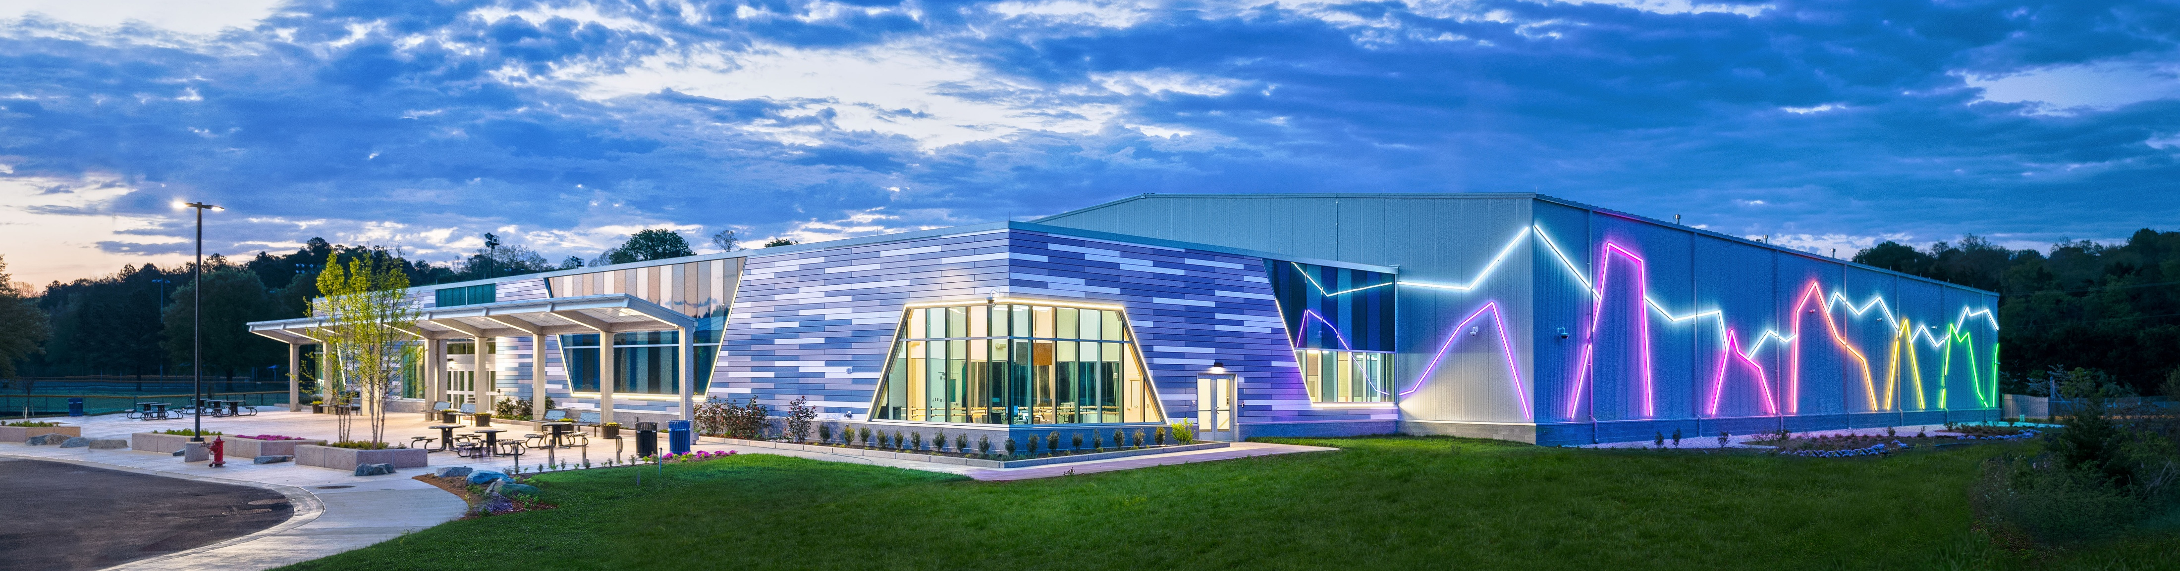
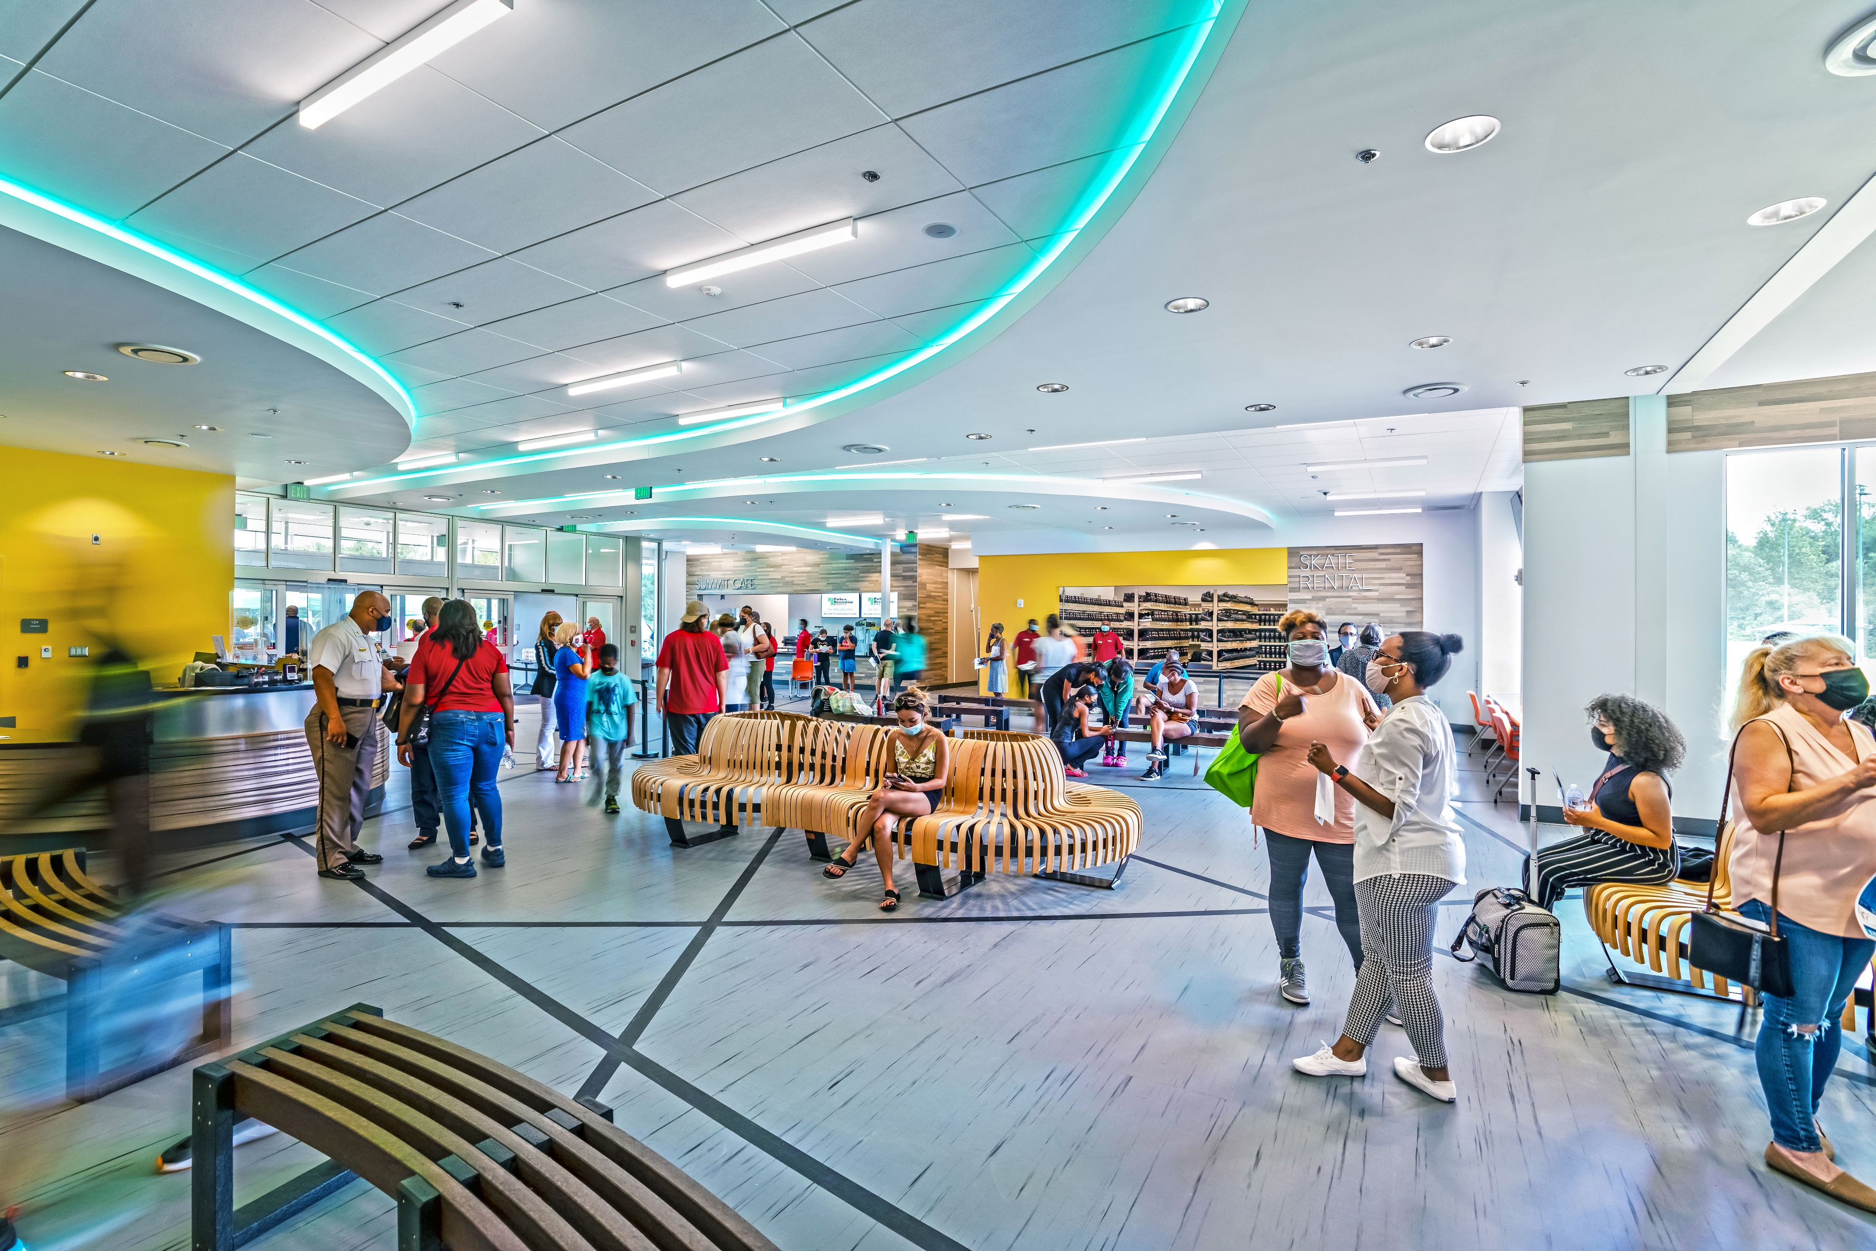
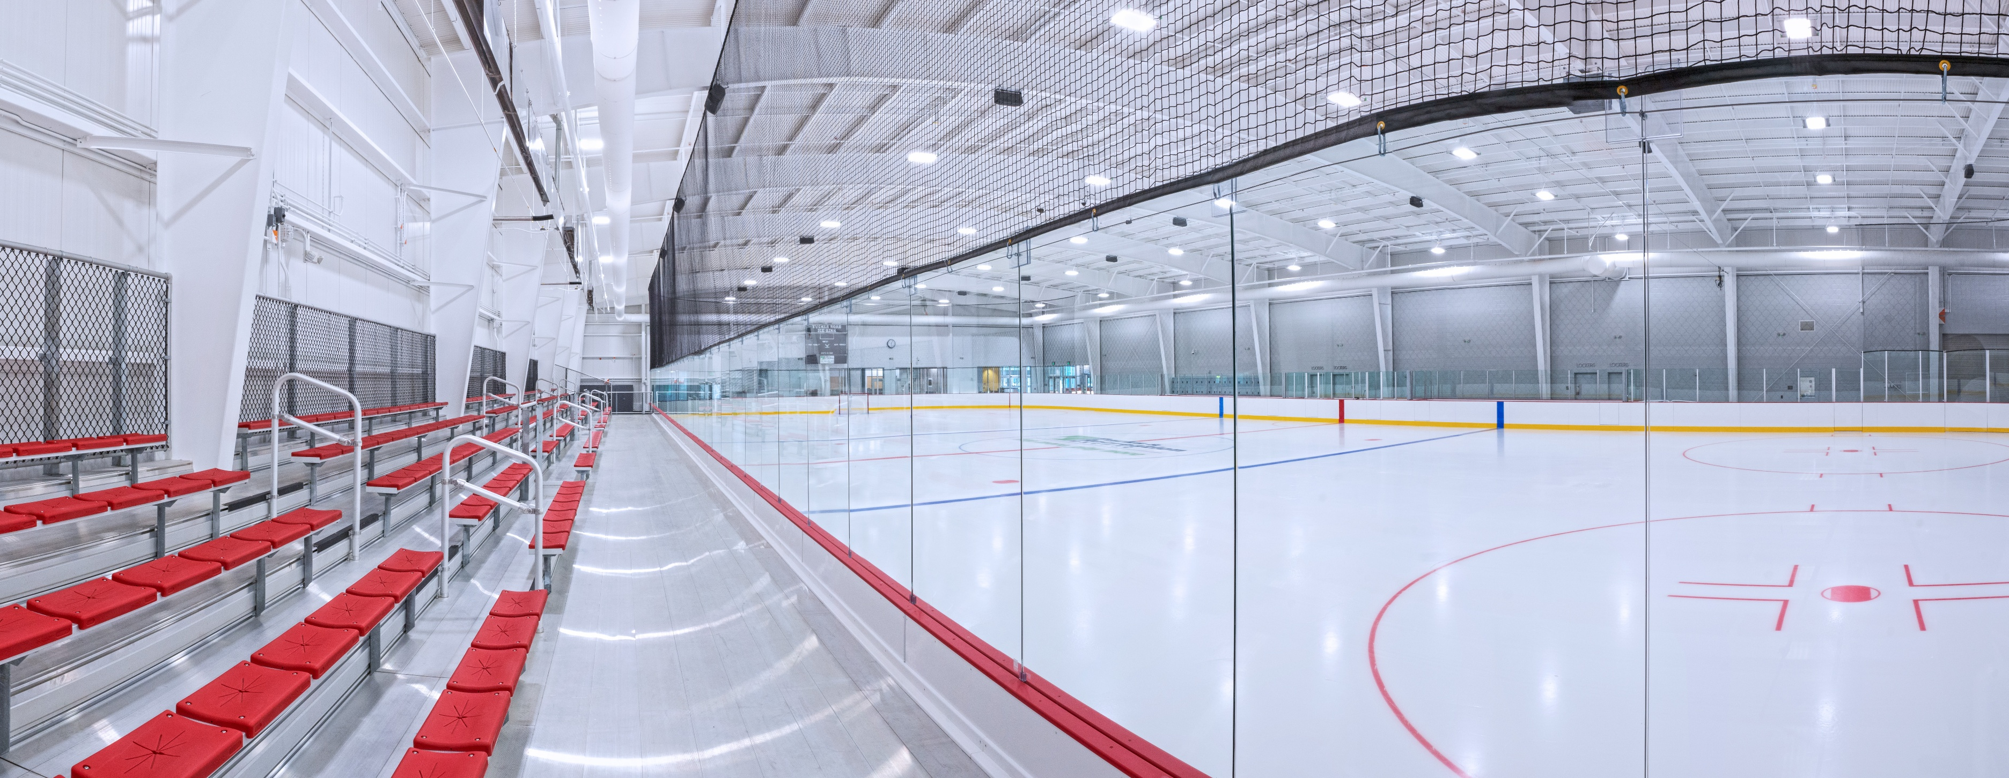
Tucker Road Ice Rink
Notes:
There are three photos on this page that show what the new building and ice rink would look like.

Slide 5
Amenities
Two indoor NHL regulation Ice Rinks (Phase 1 and Phase 2)
Supporting locker rooms and staff spaces.
Grandstand seating for 300-400 people per rink.
A large connecting lobby area joining the existing athletic courts.
Skate rental and Pro Shop vending area.
Café and seating area for snacks, hot food and drinks.
Large dividable multi-purpose room for party rentals and community events.
Dance studio with supporting hardware for dry practices and aerial jumps.
Fitness and weight training room.
Outdoor seating and patio areas with access existing park spaces.
Restrooms for both the new rinks and existing athletic courts.
Additional site parking and improved site access.
Notes:
Title is Amenities
A bulleted list follows: Two indoor NHL regulation Ice Rinks (Phase 1 and Phase 2)
Supporting locker rooms and staff spaces.
Grandstand seating for 300-400 people per rink.
A large connecting lobby area joining the existing athletic courts.
Skate rental and Pro Shop vending area.
Café and seating area for snacks, hot food and drinks.
Large dividable multi-purpose room for party rentals and community events.
Dance studio with supporting hardware for dry practices and aerial jumps.
Fitness and weight training room.
Outdoor seating and patio areas with access existing park spaces.
Restrooms for both the new rinks and existing athletic courts.
Additional site parking and improved site access.

Slide 6
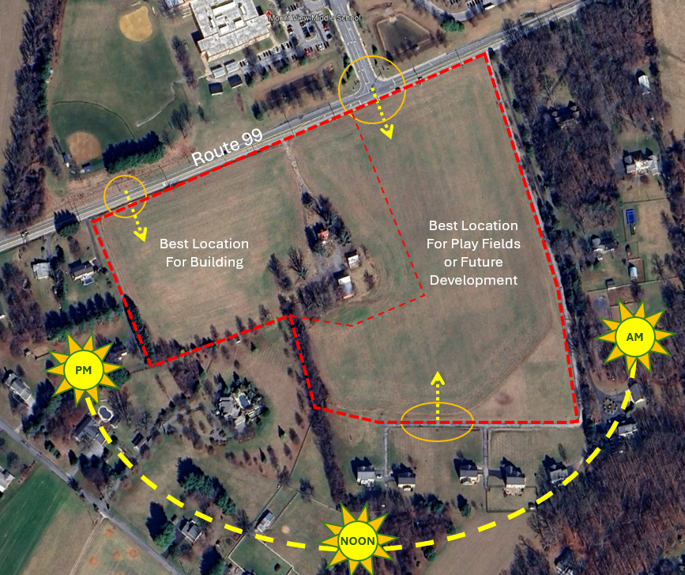
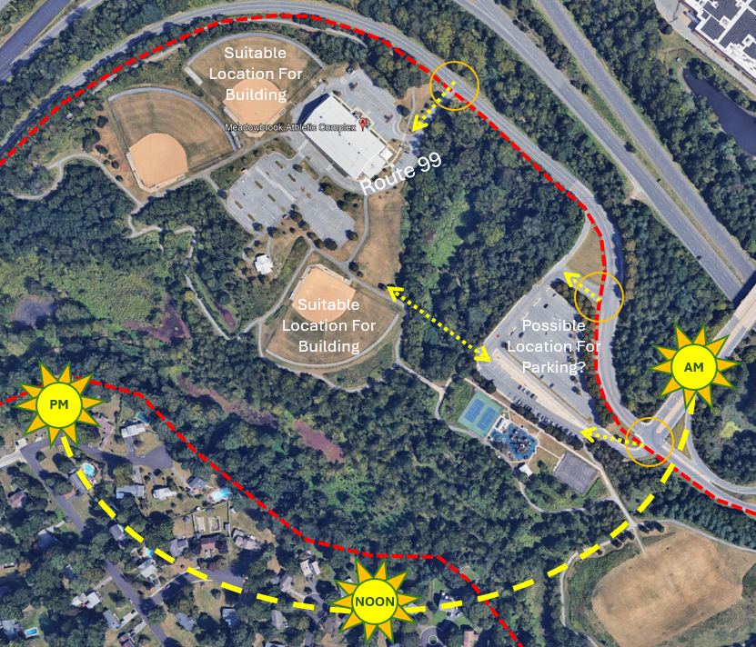
Potential Site Options
Phase 1
SHIPLEY SITE ANALYSIS
MEADOWBROOK SITE ANALYSIS

Slide 7
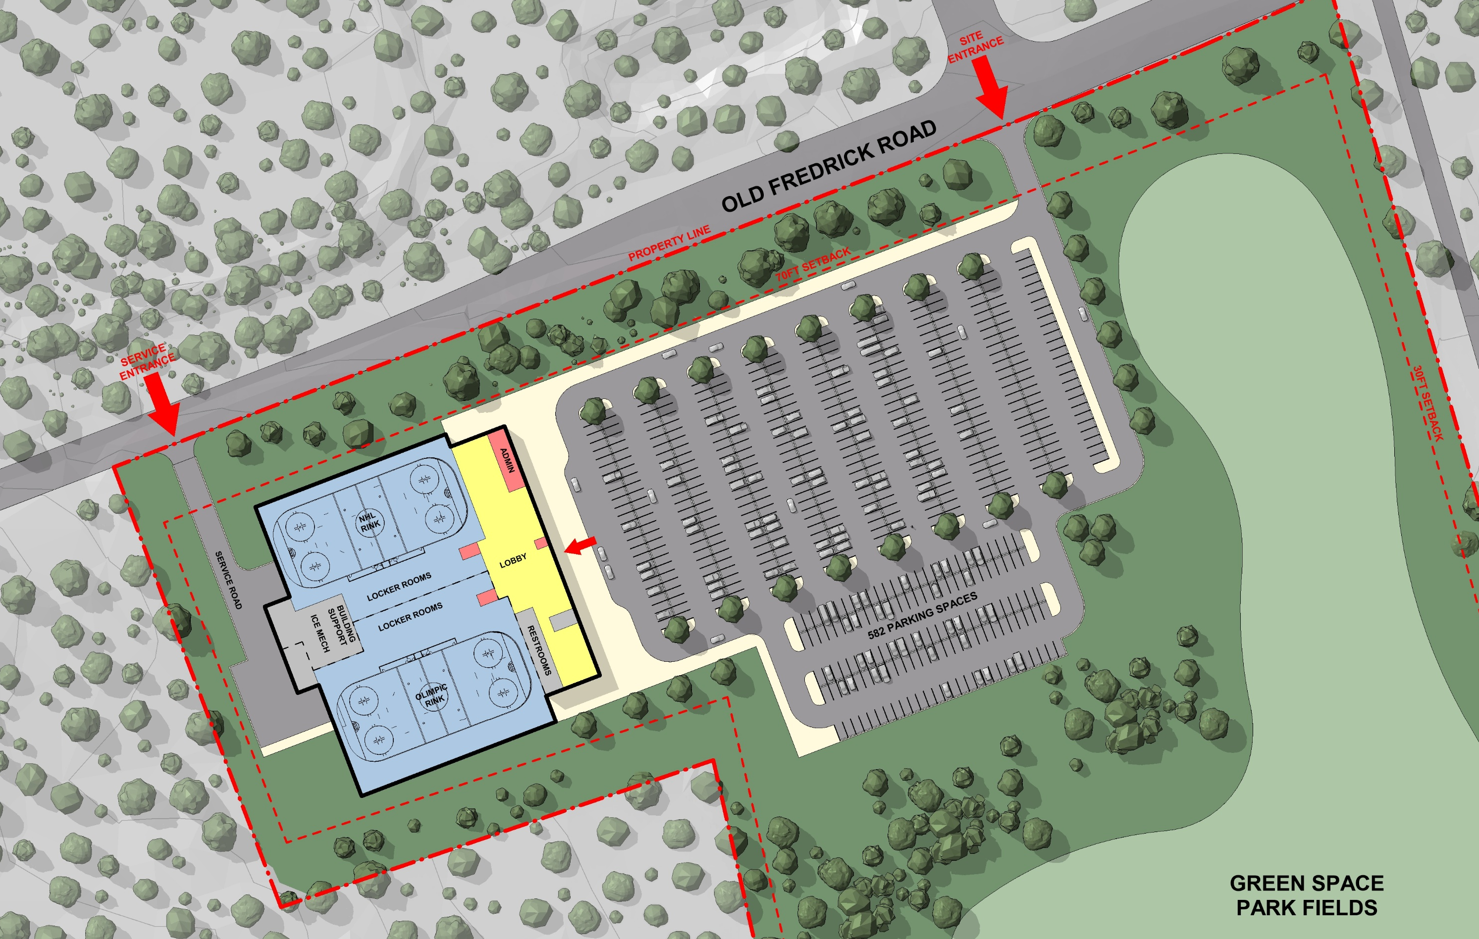
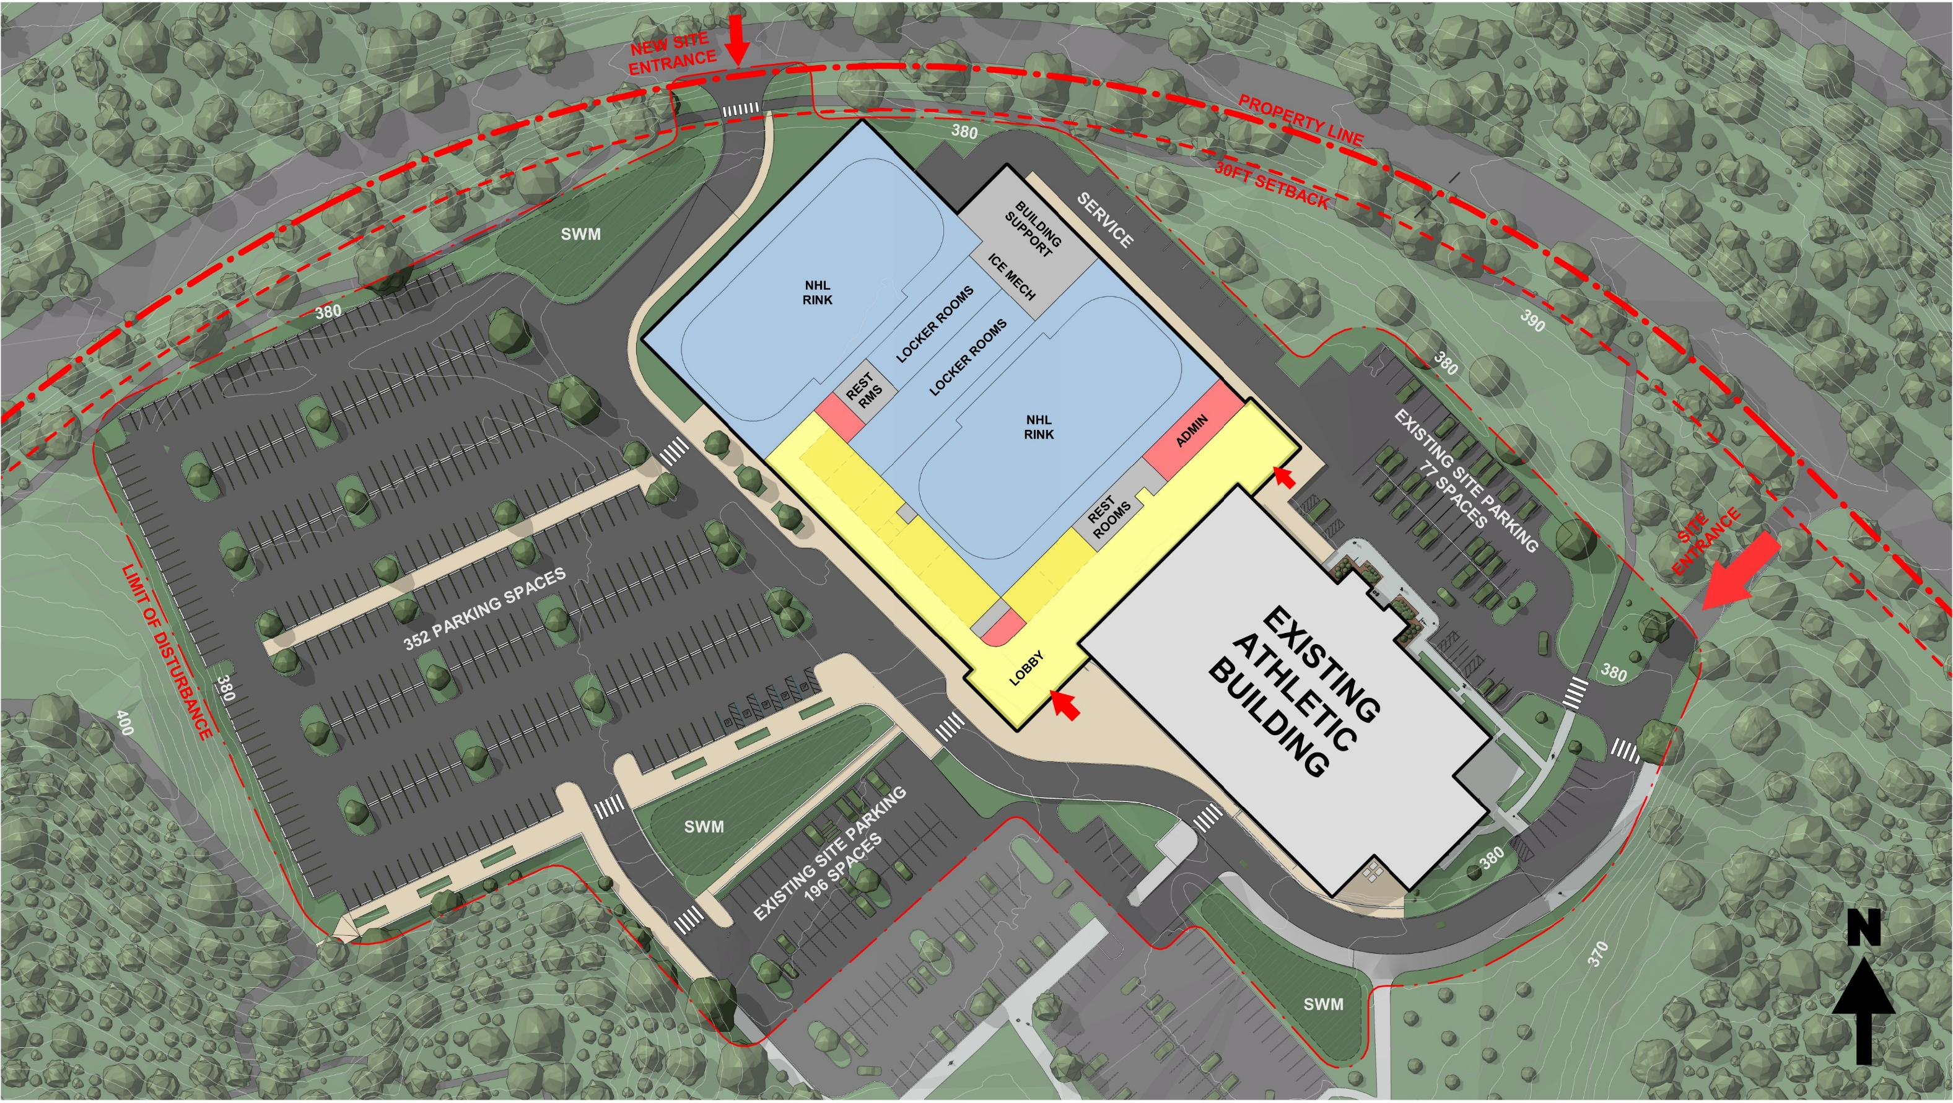
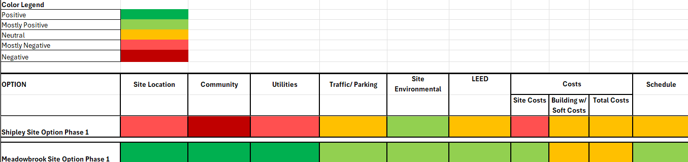
MATRIX SITE COMPARISONS
SHIPLEY SITE
MEADOWBROOK SITE
Notes:
There are two photos at the top. The first is of Shipley site and the second is of Meadowbrook site.
There is then a picture of a chart to explain the comparison between Shipley Site and Meadowbrook site.
The rating is from one to five. one being positive and five being negative.
Shipley Site Location was a four, which is mostly negative
Meadowbrook Location was a one, which is positive
Shipley community was a five which is negative
Meadowbrook community was a three which is neutral
Shipley Utilities was a 4 which is mostly negative
Meadowbrook Utilities was a 1 which is positive
Shipley Traffic and Parking was a 3 which is neutral
Meadowbrook Traffic and Parking was a 2 which is mostly positive
Shipley Environmental was a 2 which is mostly positive
Meadowbrook Environmental was a 2 which is mostly positive
Shipley LEED was neutral
Meadowbrook LEED was mostly positive
Shipley Cost was mostly negative
Meadowbrook cost was mostly positive
Shipley building with soft costs was neutral
Meadowbrook building with soft costs was neutral
Shipley Total Costs was neutral
Meadowbrook Total Costs was neutral
Shipley Schedule was neutral
Meadowbrook Schedule was mostly positive
The bottom of the screen says “MATRIX SITE COMPARISONS”

Slide 8
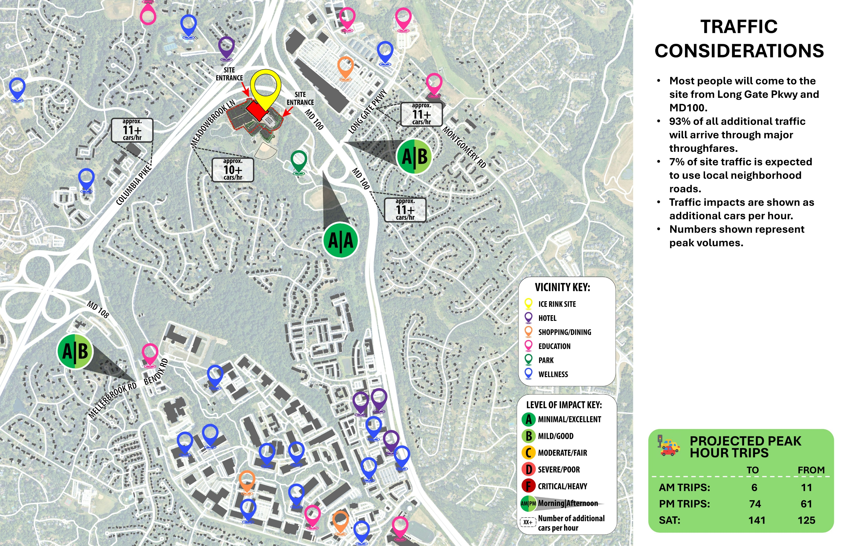
Traffic Considerations
Notes:
Picture of the local streets with the following information listed:
Traffic Considerations
One, Most people will come to the site from Long Gare Parkway MD 100
Second, 93% of all additional traffic will arrive through major through fares
Third, 7% of site traffic is expected to use local neighborhood roads
Fourth, Traffic impacts are shown as additional cars per hour
Fifth, Numbers show represent peak volumes
There is then a box at the bottom that states Projected Peak Hour Trips
Includes AM Trips to 6 from 11
PM Trips to 74 from 61
Saturday Trips to 141 from 125

Slide 9
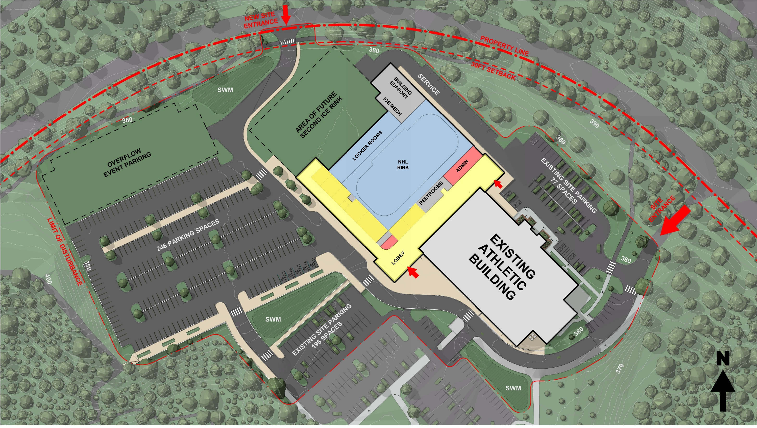
Rendering of Proposed Building and Parking
Notes:
Rendering of the Meadowbrook site with an addition to the existing building. The rendering includes attached to the build a NHL rink and an area for a future second ice rink and more overflow event parking.

Slide 10
Rendering of Proposed Building and Parking.
Notes:
Rendering of the Meadowbrook site with an addition to the existing building. The rendering includes attached to the build a NHL rink and an area for a future second ice rink

Slide 11
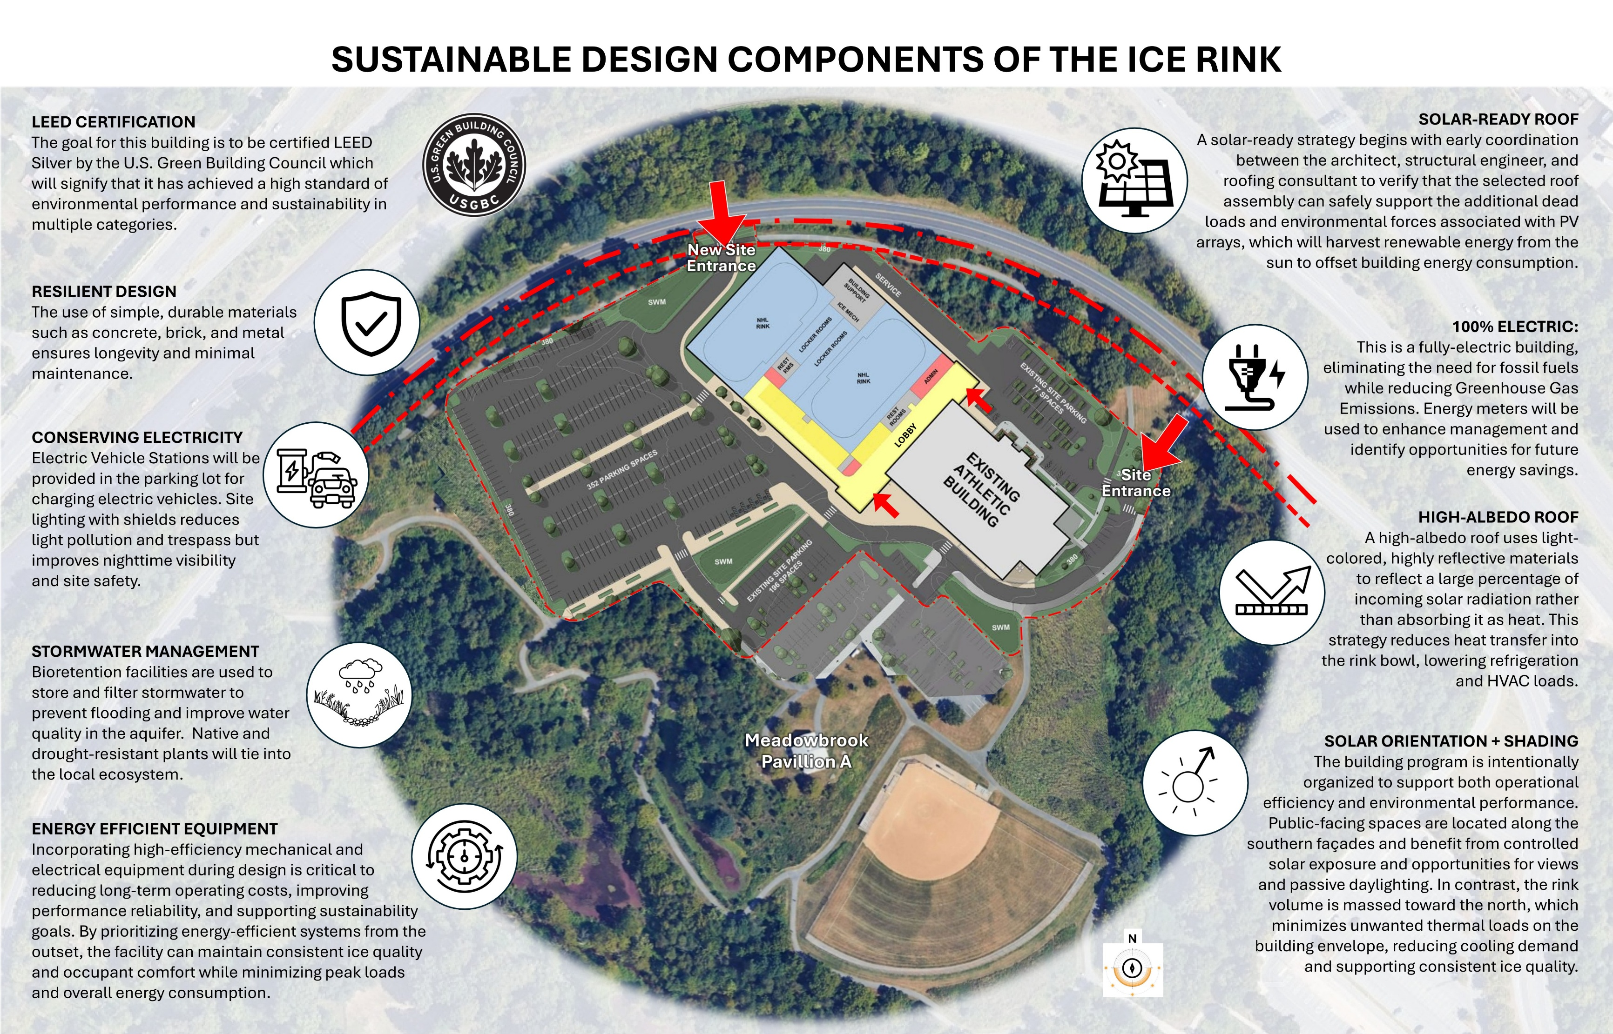
Sustainable Design Components of the Ice Rink
Notes:
Chart that is titled Sustainable Design Components of the Ice Rink
LEED CERTIFICATION: The goal for this building is to be certified LEED Silver by the U S Green Building Council which will signify that it has achieved a high standard of environmental performance and sustainability in multiple categories
RESILIENT DESIGN: The use of simple, durable materials such as concrete, brick, and metal ensures longevity an minimal maintenance
CONSERVING ELECTRICITY: Electric Vehicle Stations will be provided in the parking lot for charging electric vehicles. Site lighting with shields reduces light pollution and trespass but improves nighttime visibility and site safety
STORM WATER MANAGEMENT: Bioretention facilities are used to store and filter stormwater to prevent flooding and improve water quality in the aquifer. Native and drought-resistant plants will tie into the local ecosystem
ENERGY EFFICIENT EQUIPMENT: Incorporating high-efficiency mechanical and electrical equipment during deign is critical to reducing long-term operating costs, improving performance reliability, and supporting sustainability goals. By prioritizing energy-efficient systems from the outset, the facility can maintain consistent ice quality and occupant comfort while minimizing peak loads and overall energy consumption
SOLAR-READY ROOF: A solar-ready strategy begins with early coordination between the architect, structural engineer, and roofing consultant to verify that the selected roof assembly can safety support the additional dead loads and environmental forces associated with PV arrays, which will harvest renewable energy from the sun to offset energy consumption.
100% ELECTRIC: This is a full-electric building, eliminating the need for fossil fuels while reducing Greenhouse Gas Emissions. Energy meters will be used to enhance management and identify opportunities for future energy savings.
HIGH-ALBEDO ROOF: A high-albedo roof uses light-colored, highly reflective materials to reflect a large percentage of incoming solar radiation rather than absorbing it as heat. This strategy reduces heat transfer into the rink bowl, lowering refrigeration and HVAC loads.
SOLAR ORIENTATION + SHADING: The building program is intentionally organized to support both operational efficiency and environmental performance. Public-facing spaces are located along the southern facades and benefit from controlled solar exposure and opportunities for views and passive daylighting. In contrast, the rink volume is massed toward the north, which minimizes unwanted thermal loads on the building envelope, ,reducing colling demand and supporting consistent ice quality

Slide 12
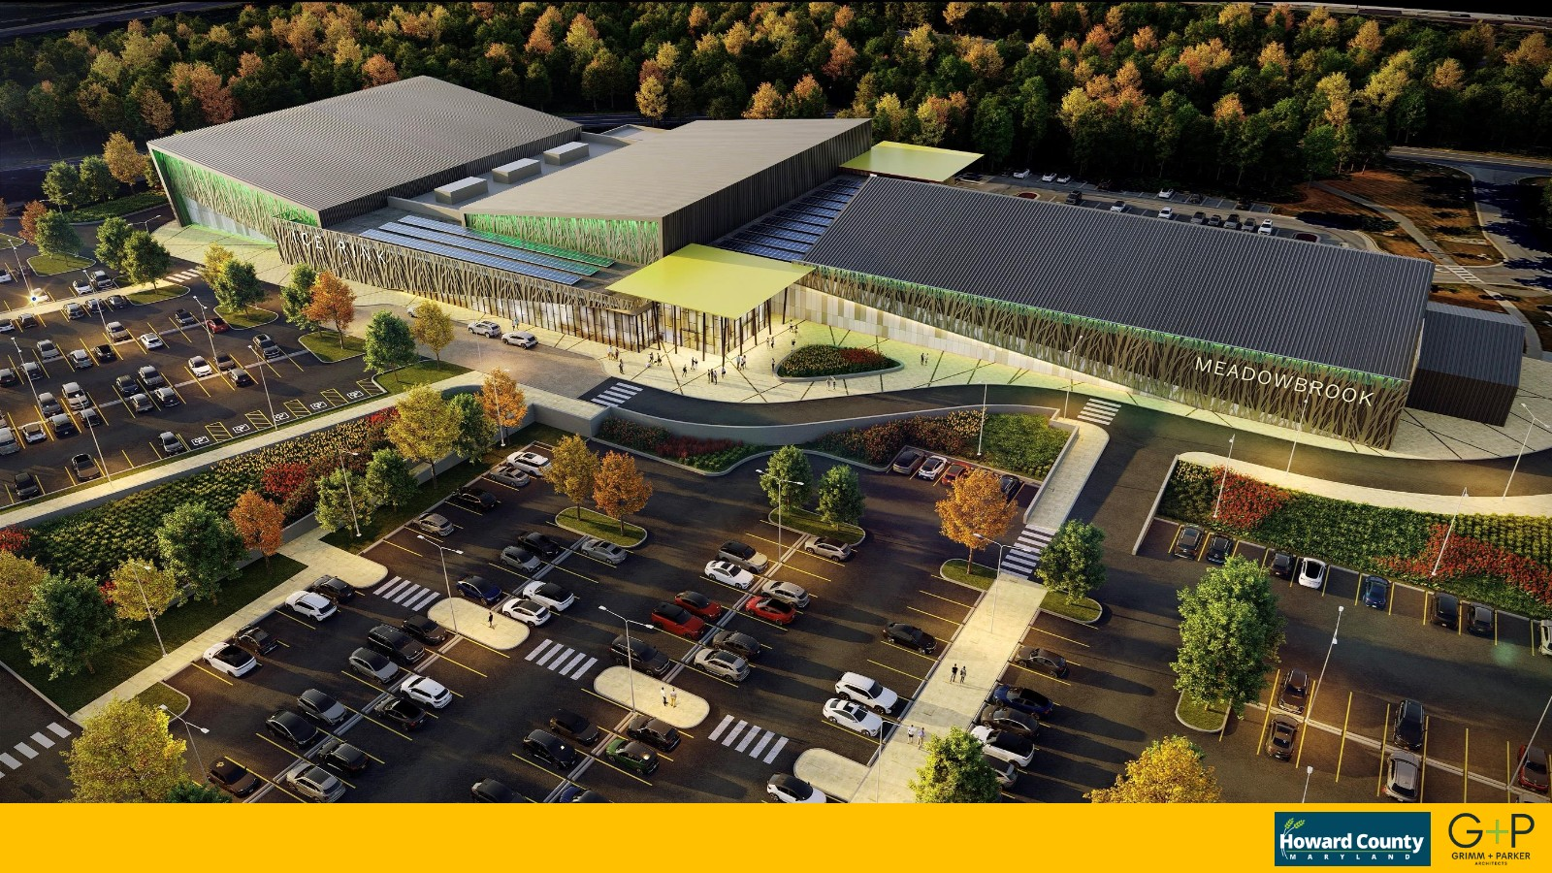
Rendering of Proposed Building and Parking in Color

Slide 13
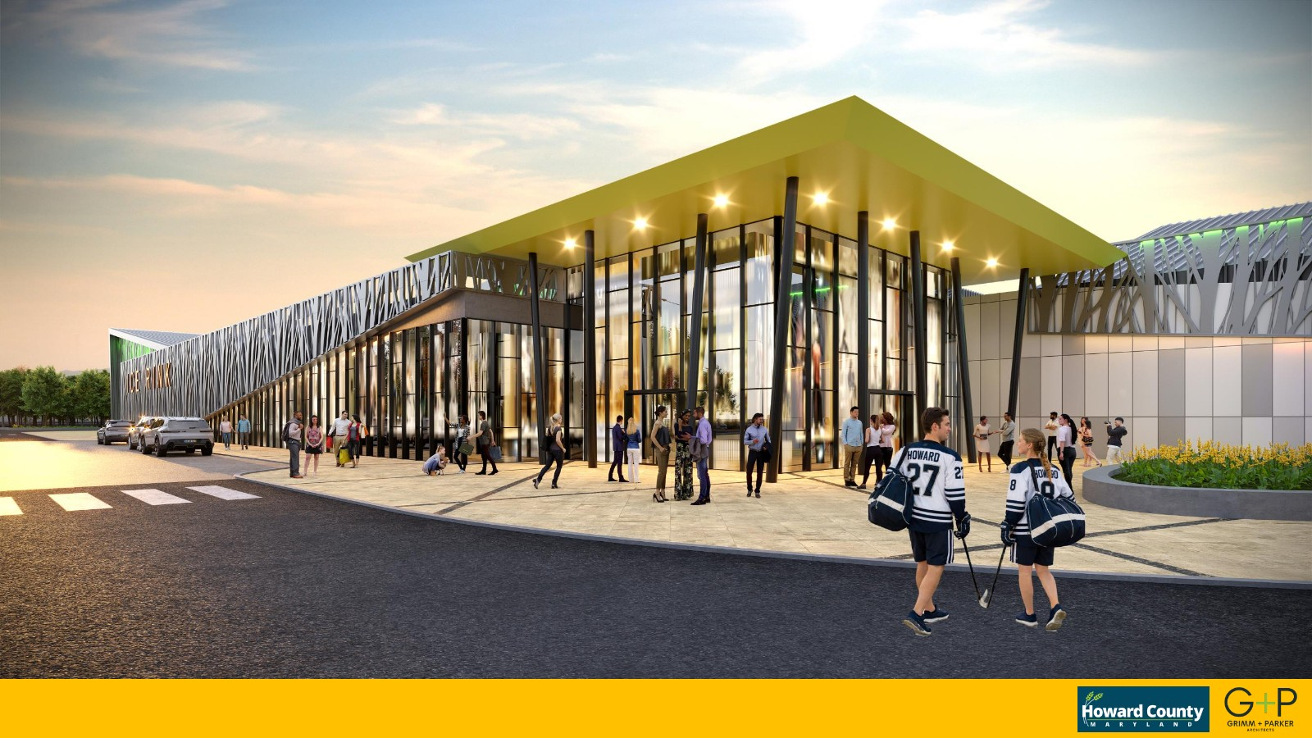
Rendering of Proposed Building

Slide 14
Questions or Comments?
Link for public testimony
apps.howardcountymd.gov/E_RAPTestimony/
Jason L. Thompson, PLA
Park Planner
Department of Recreation and Parks,
Bureau of Capital Projects,
Park Planning and Construction
jthompson@howardcountymd.gov
Notes:
Questions or Comments?
Link for public testimony
apps.howardcountymd.gov/E_RAPTestimony/
Jason L. Thompson, PLA
Park Planner
Department of Recreation and Parks,
Bureau of Capital Projects,
Park Planning and Construction
jthompson@howardcountymd.gov
Background image is of an ice rink

