Slide 1
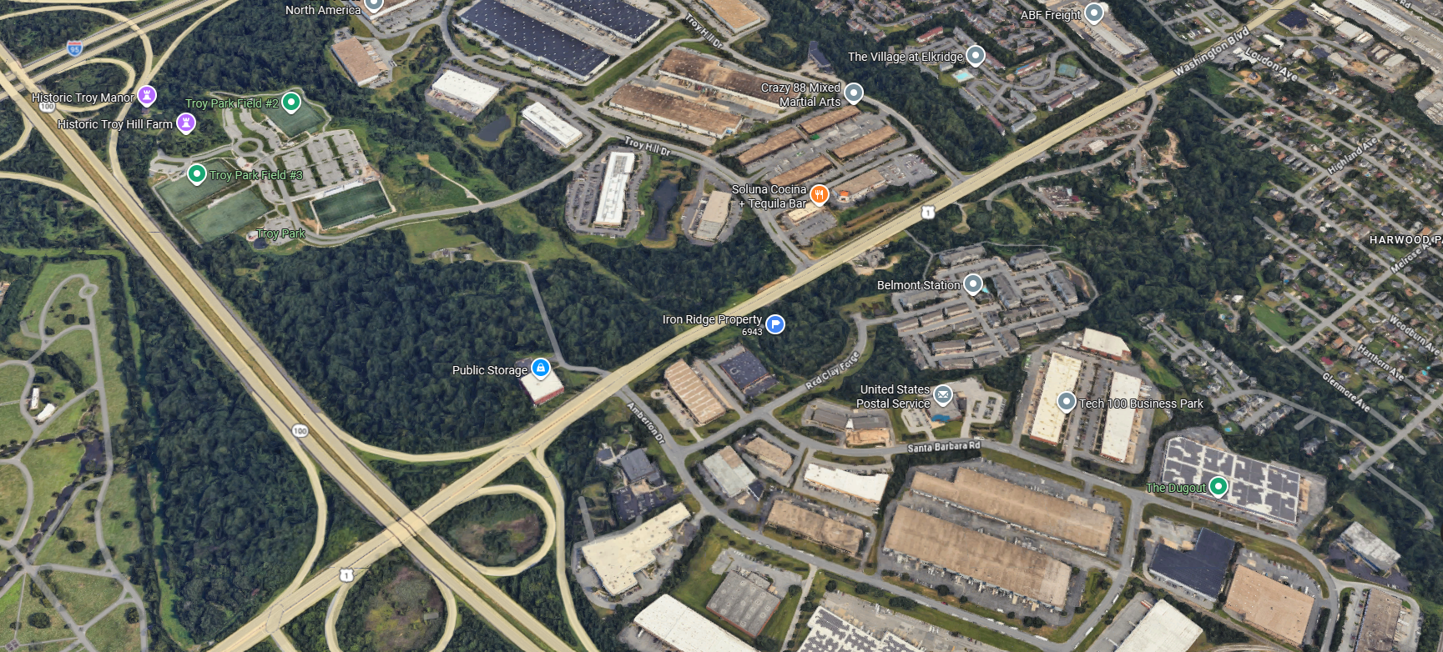


PRESENTATION TO THE HOWARD COUNTY DESIGN ADVISORY PANEL
IRON RIDGE DEVELOPMENT
JULY 23, 2026

Slide 2
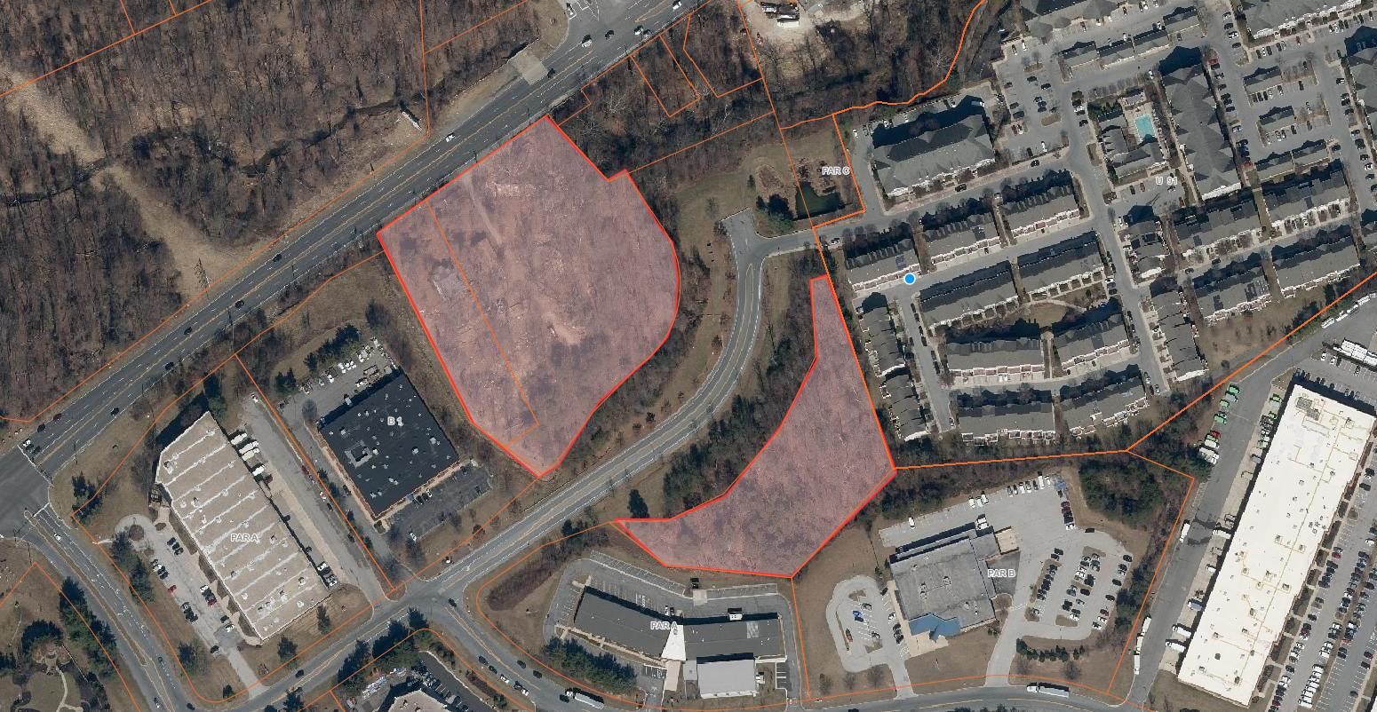
EXISTING LOCATION MAP
IRON RIDGE DEVELOPMENT
N
BELMONT STATION APARTMENTS
SITE
CROSSLIFE COMMUNITY CHURCH
SITE
BUSINESS
CENTER
SELNICK
CORPORATION
POST OFFICE
AGAPE MISSION CHURCH

Slide 3
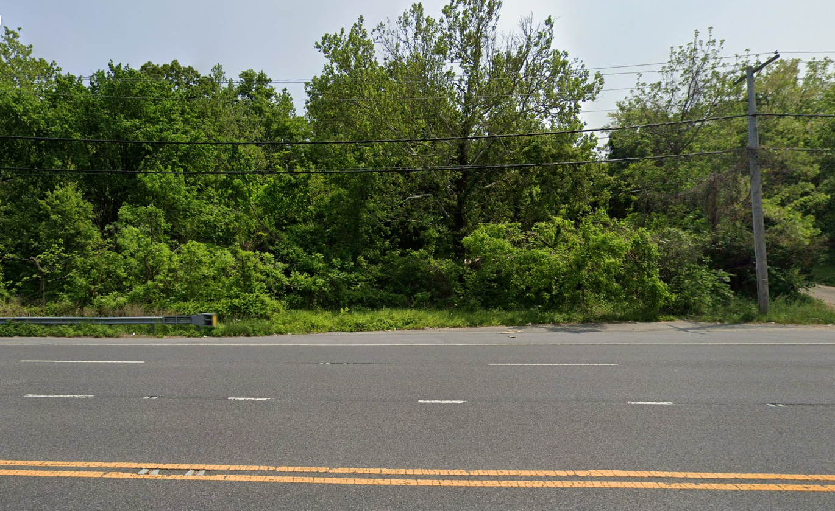
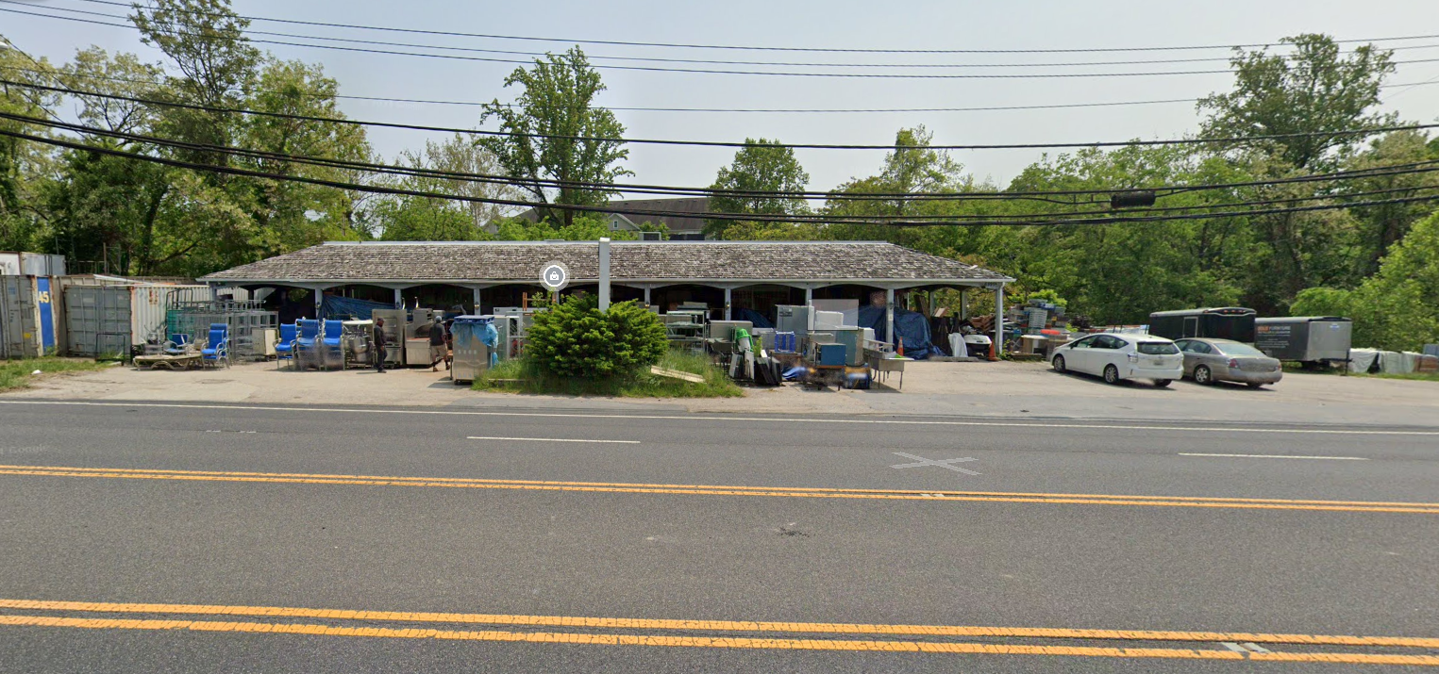
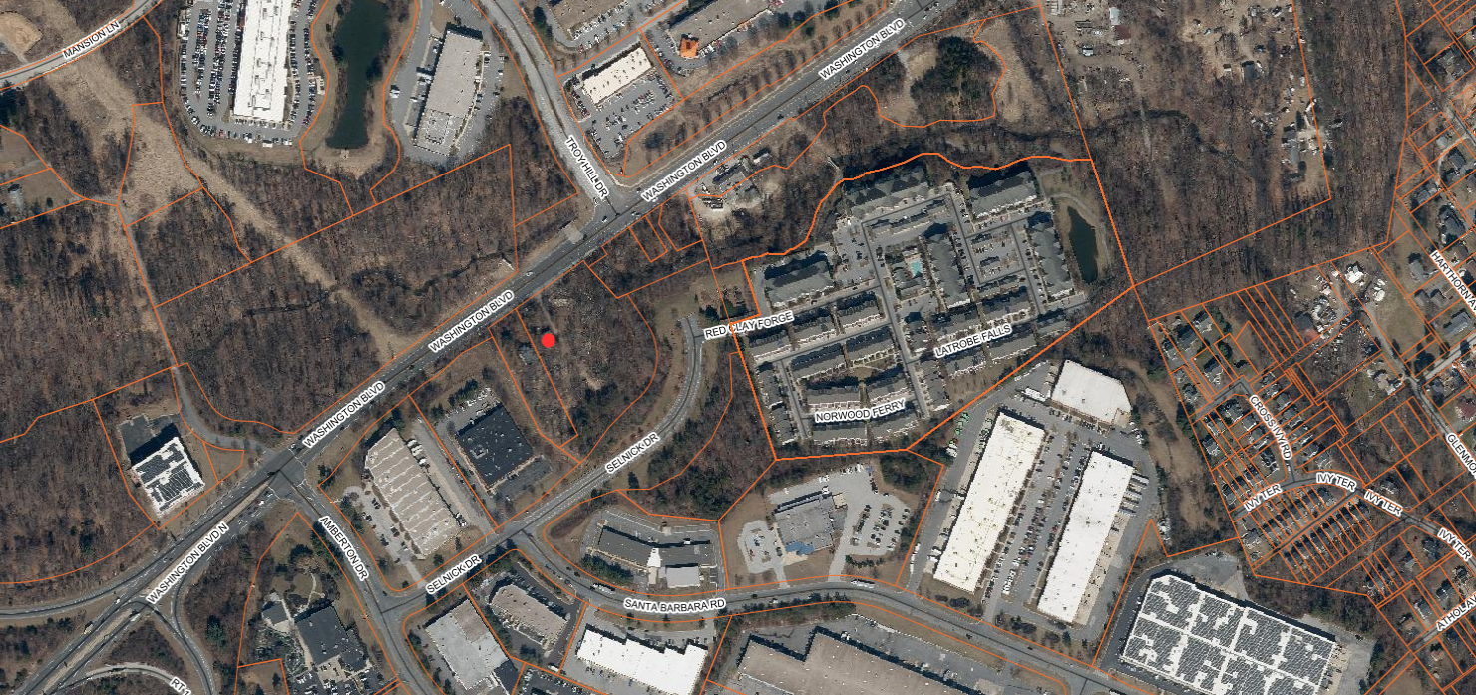
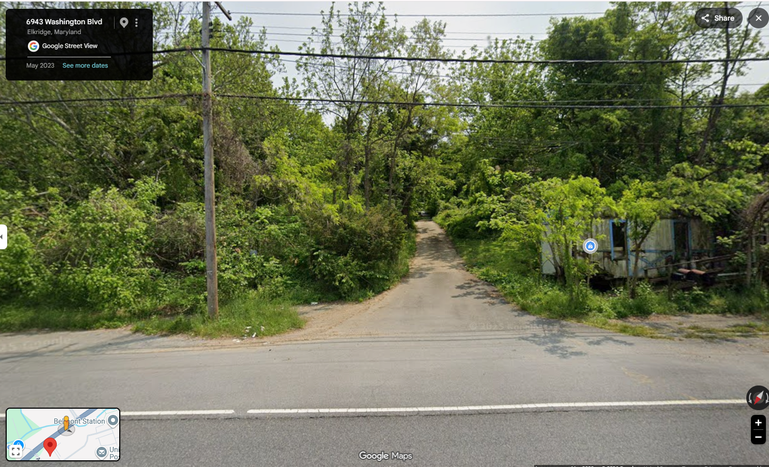
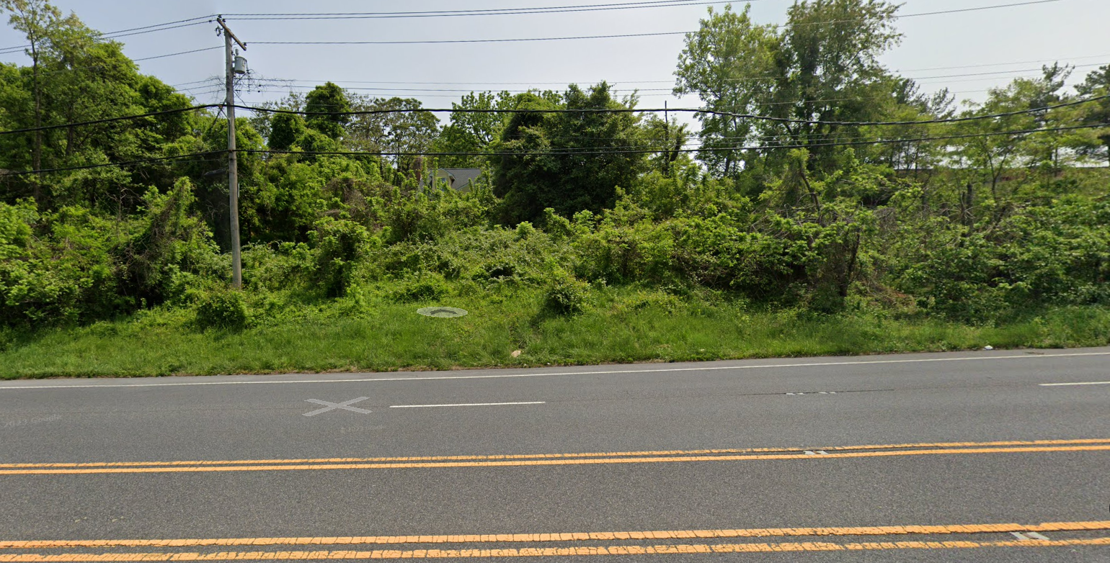
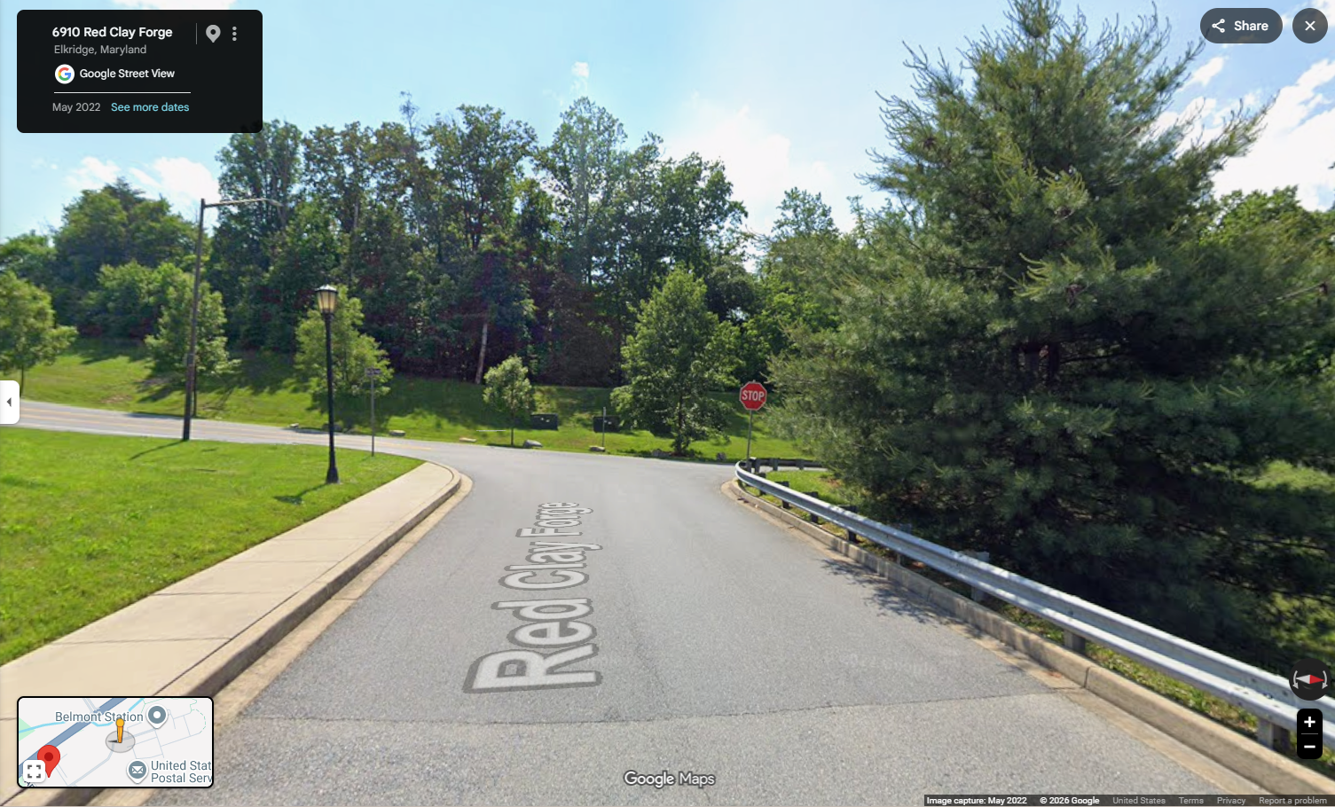
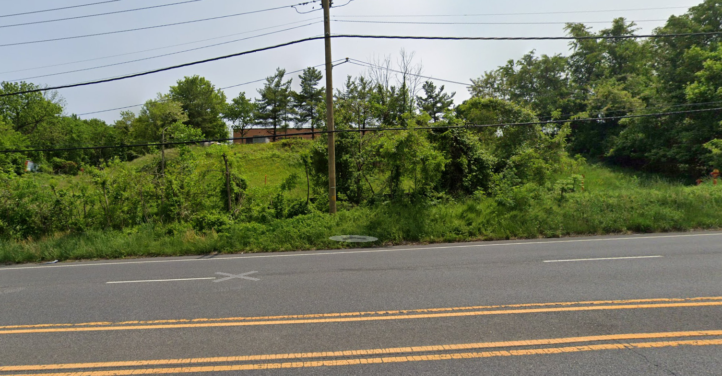
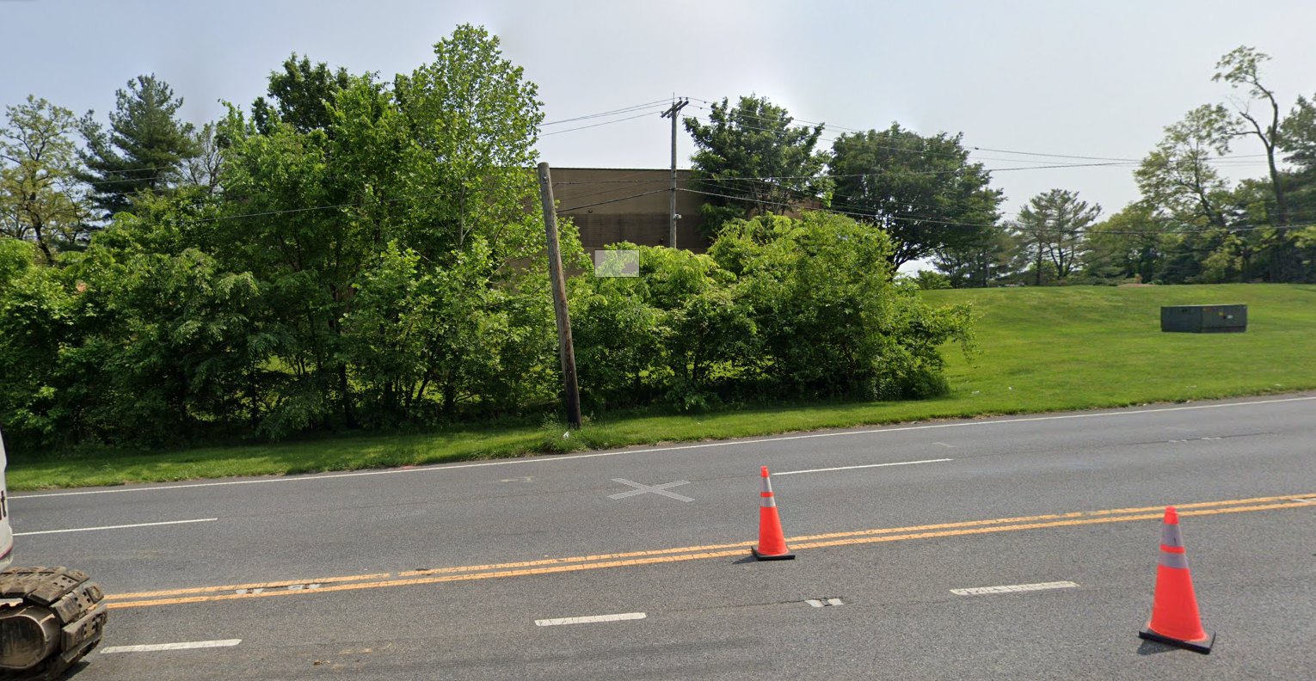
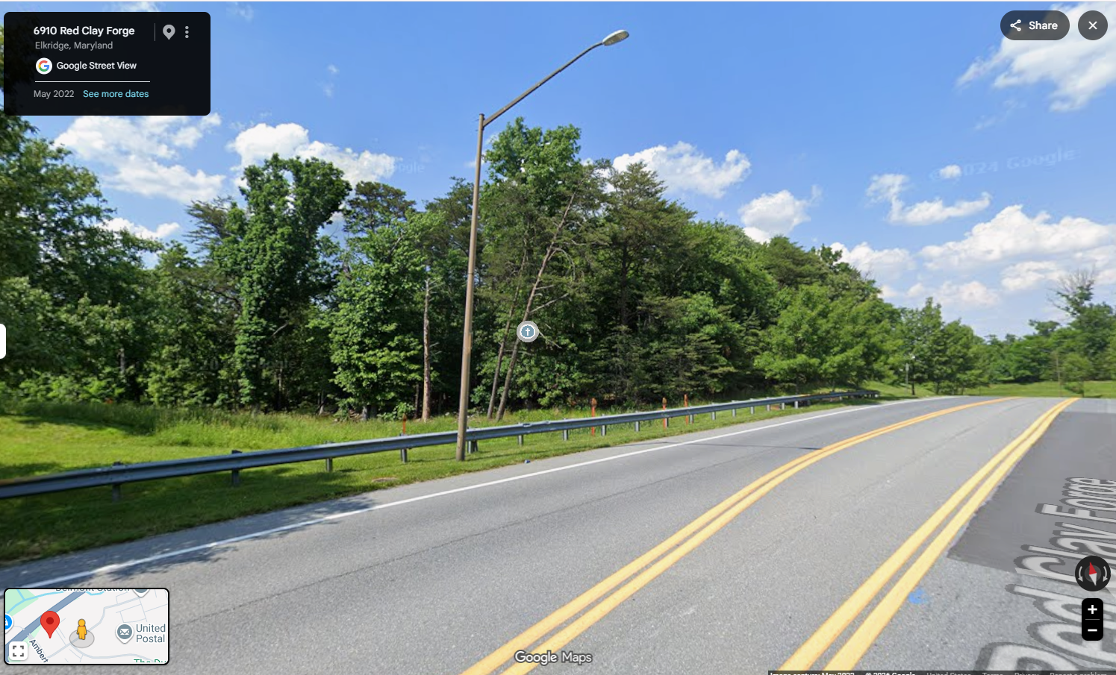
VICINAL PICTURE MAP
IRON RIDGE DEVELOPMENT
N
BELMONT STATION APARTMENTS
SITE
CROSSLIFE COMMUNITY CHURCH
SITE
SELNICK
CORPORATION
BUSINESS
CENTER
POST OFFICE
AGAPE MISSION CHURCH

Slide 4
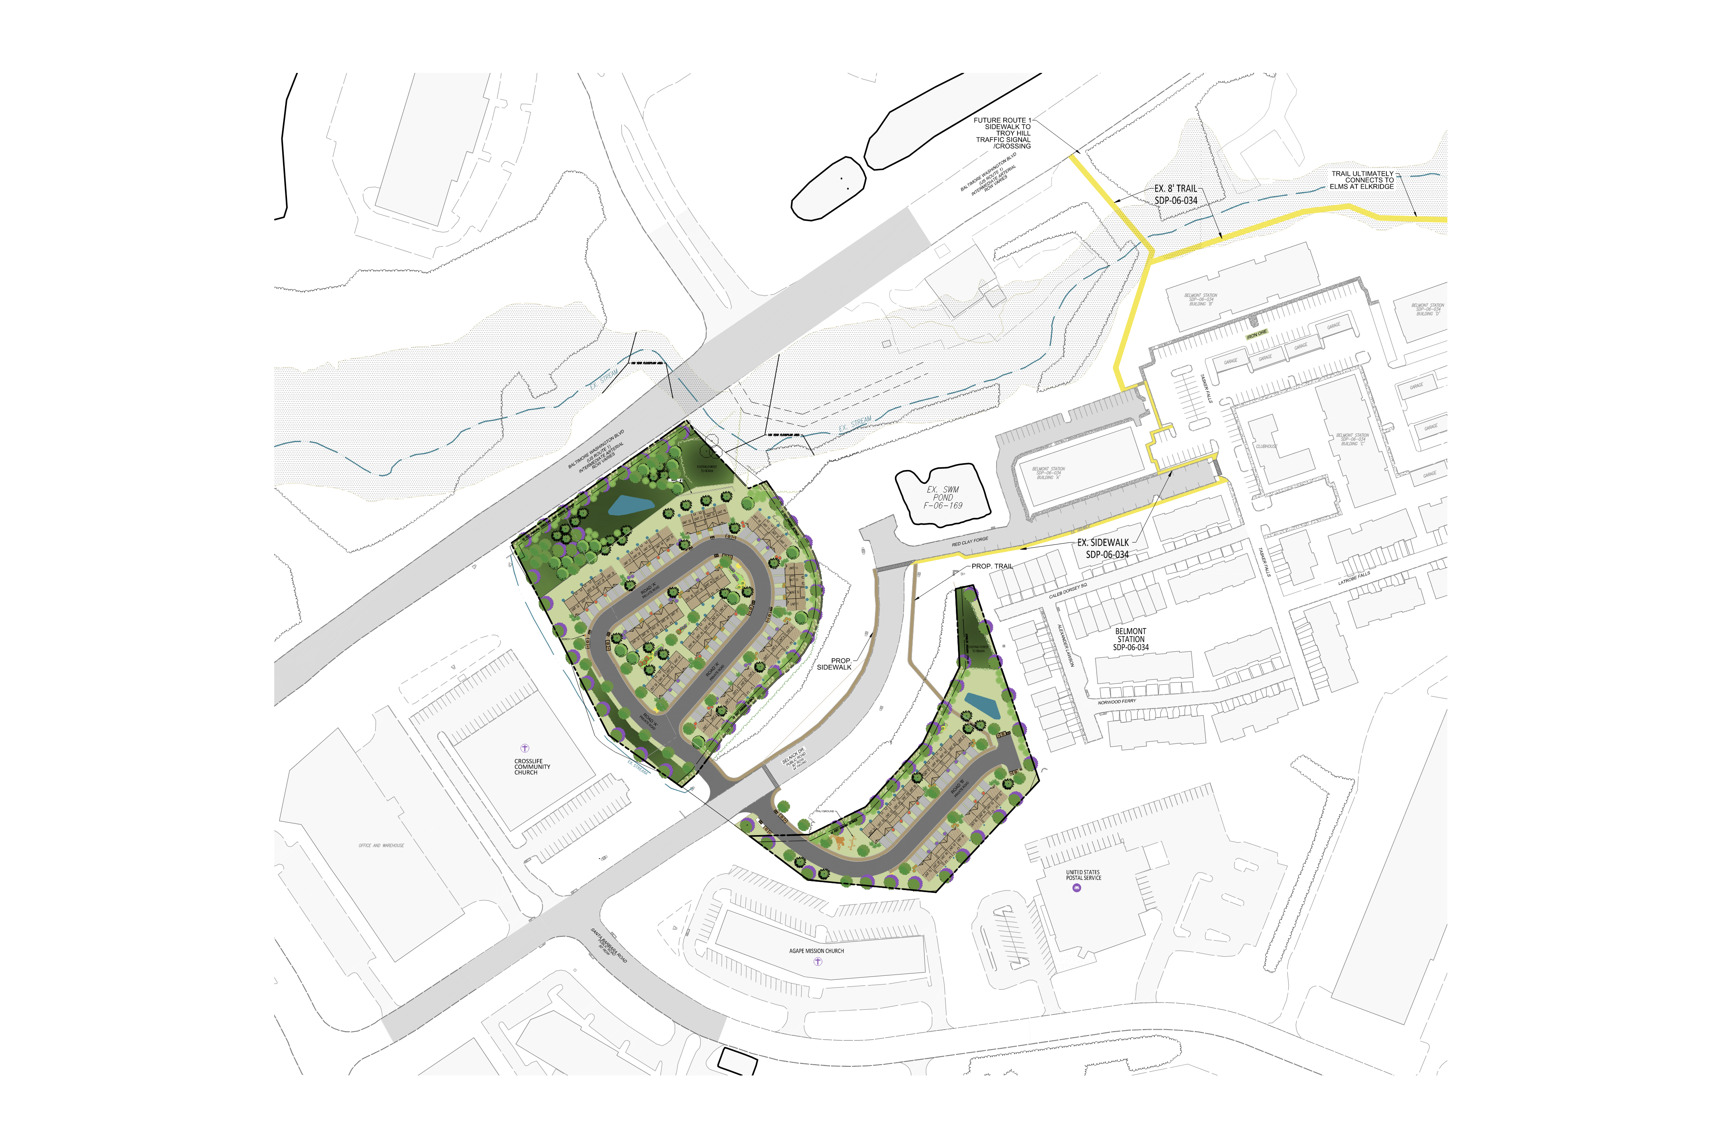

IRON RIDGE DEVELOPMENT
ROUTE 1 CONNECTION

Slide 5
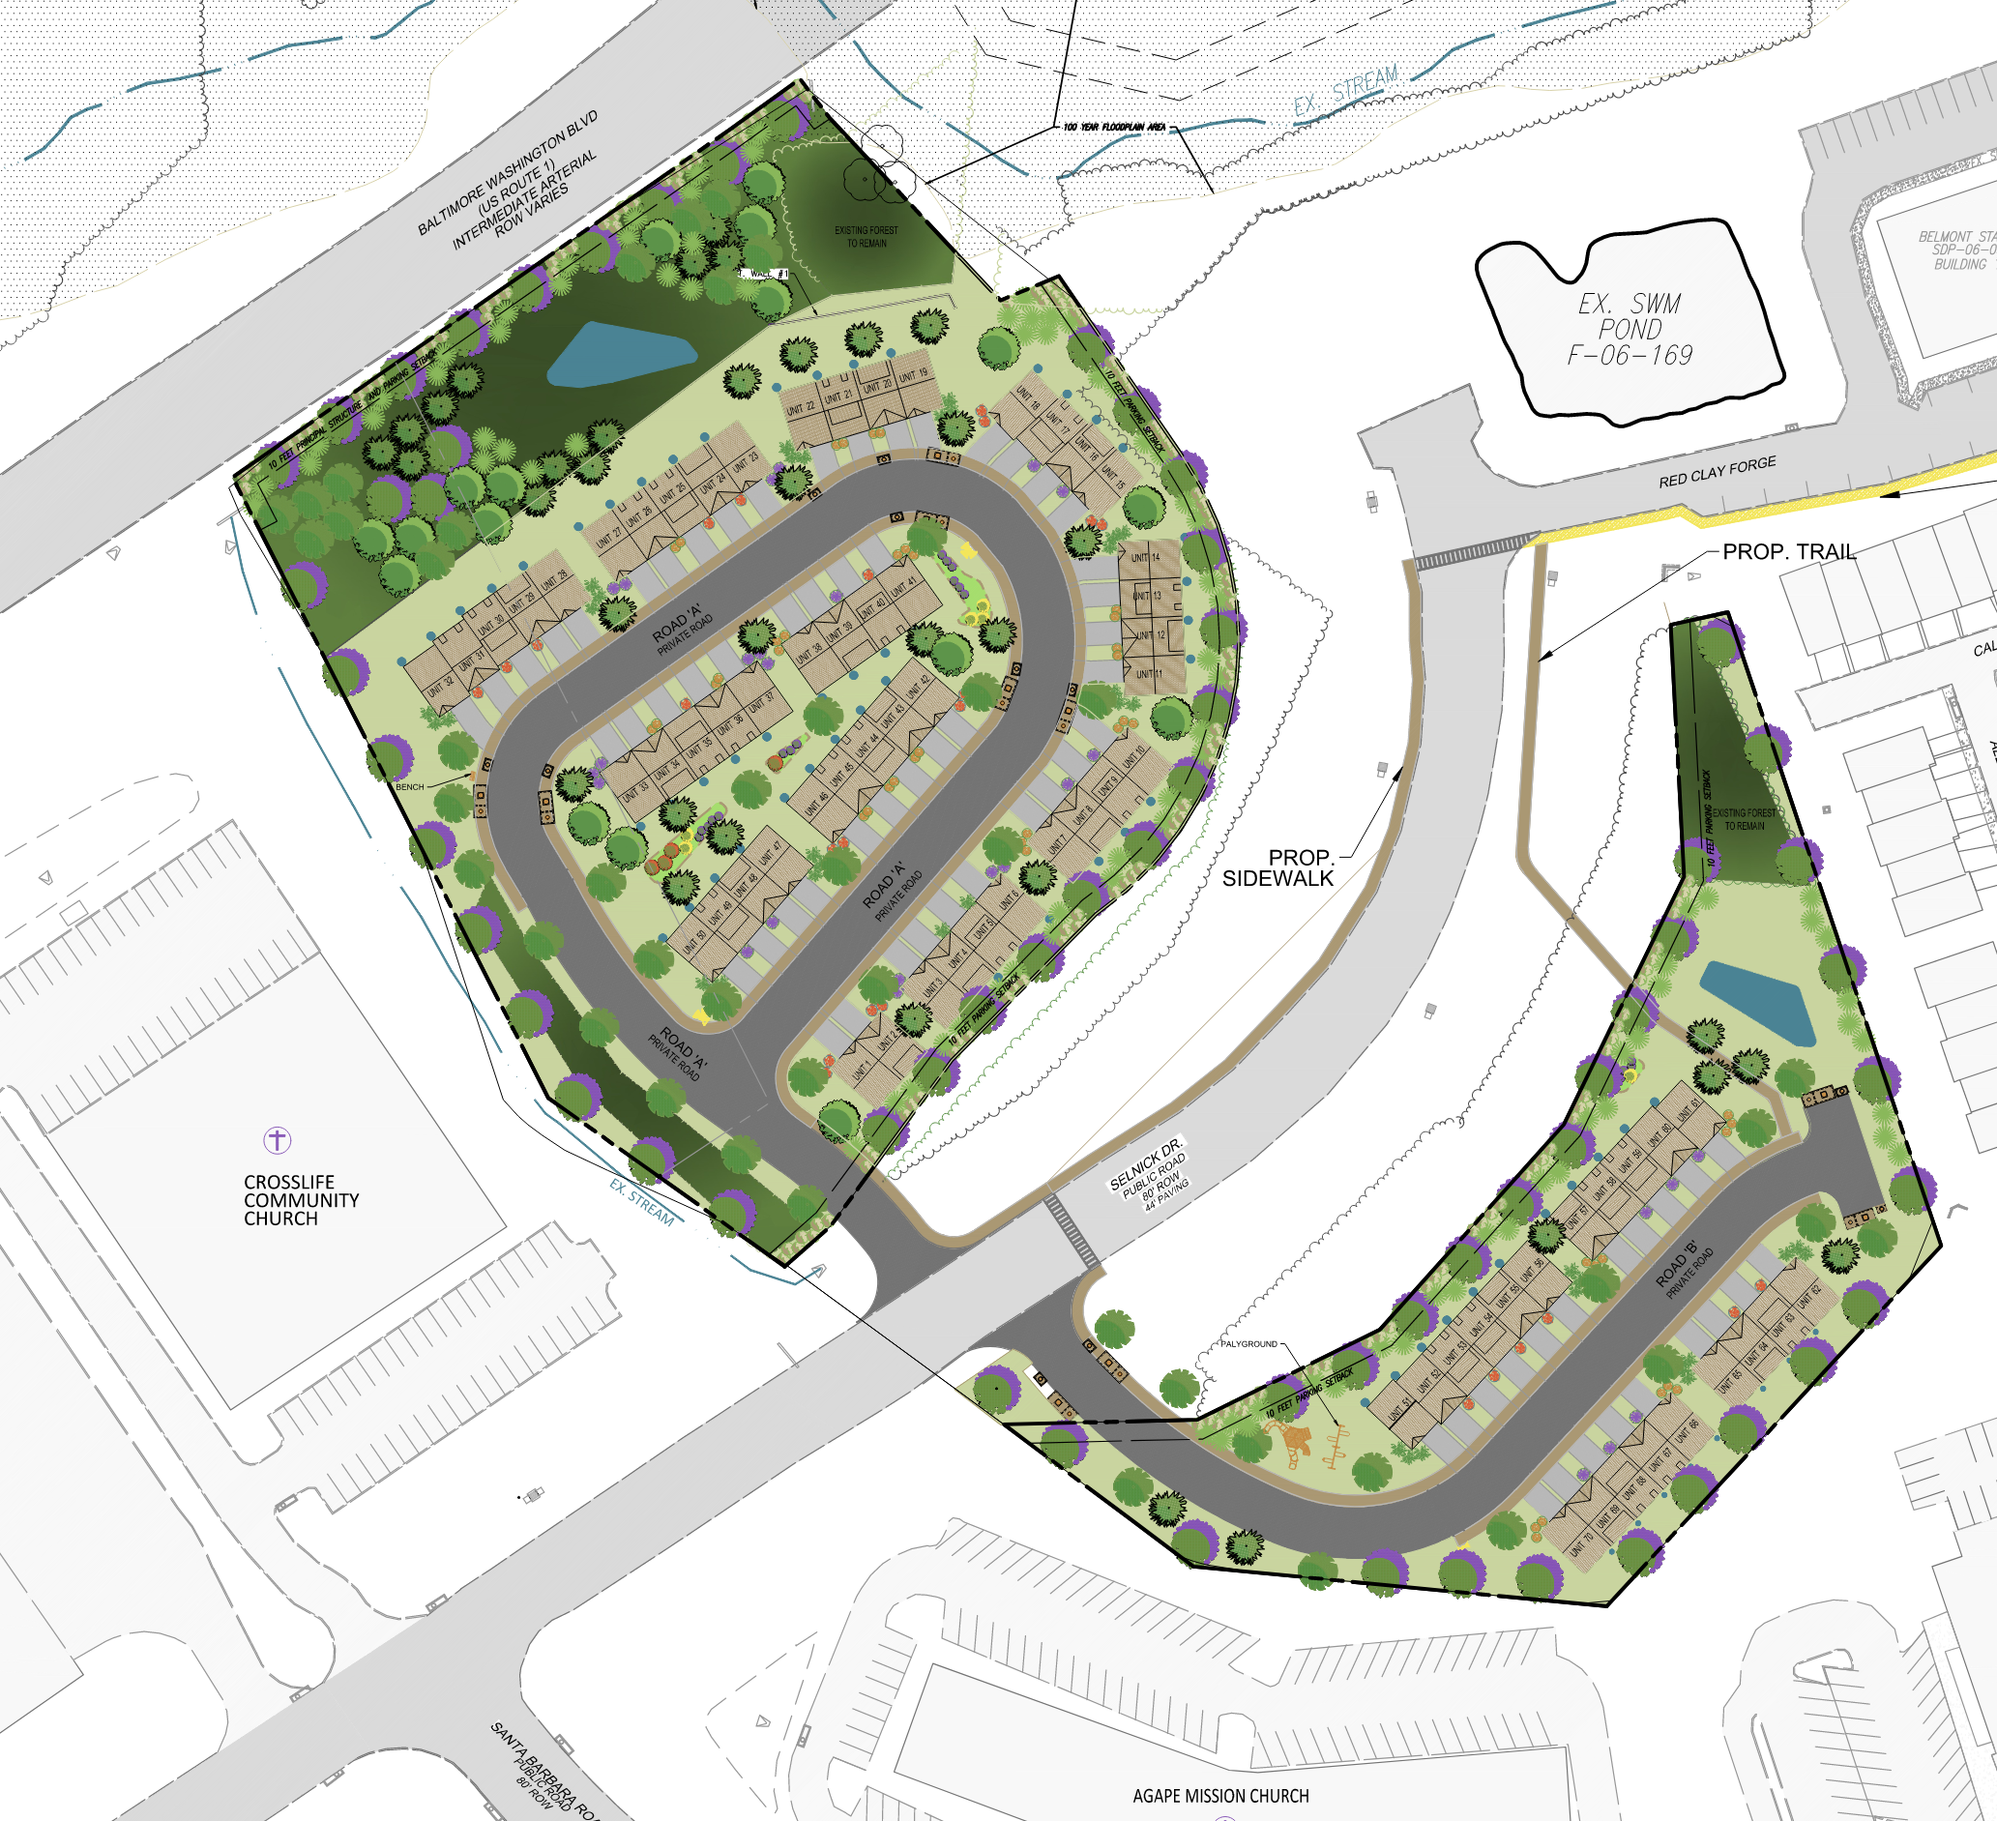
IRON RIDGE DEVELOPMENT
RENDERING OF OVERALL PLAN

Slide 6
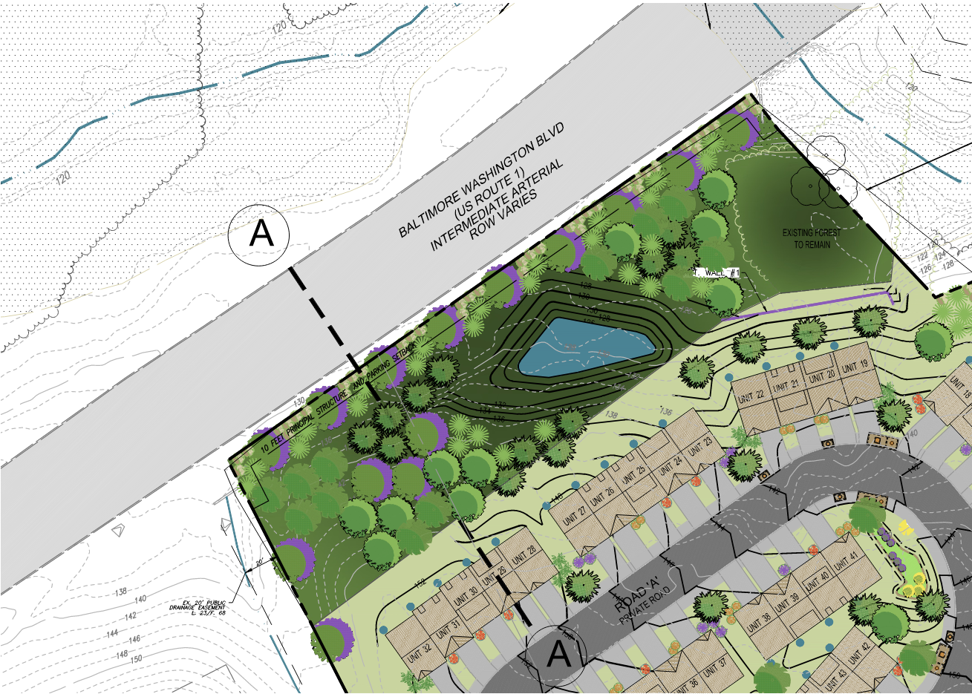
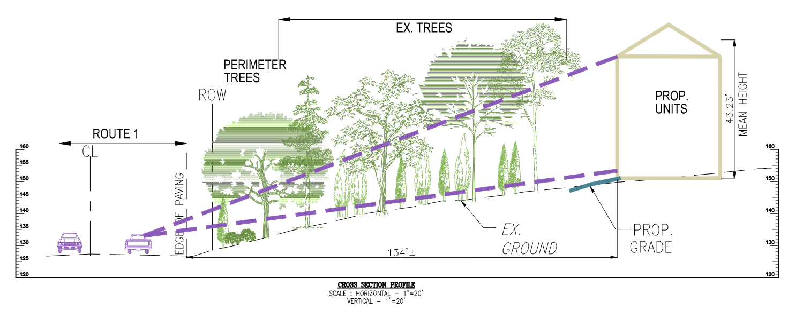
CROSS SECTION FROM ROUTE 1
IRON RIDGE DEVELOPMENT

Slide 7






IRON RIDGE DEVELOPMENT
LIGHT FIXTURES

Slide 8
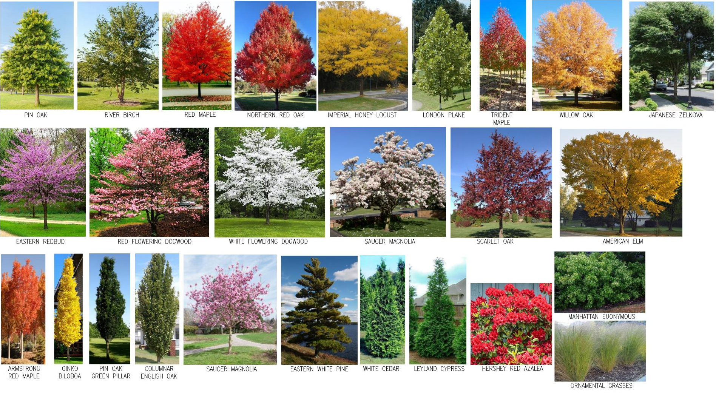
LANDSCAPING AT
IRON RIDGE DEVELOPMENT

Slide 9
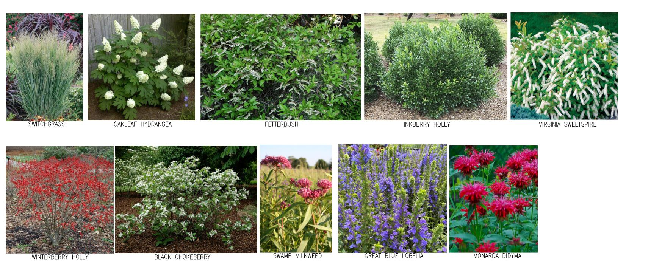
MICRO-BIORETENTION PLANTINGS IRON RIDGE DEVELOPMENT

Slide 10
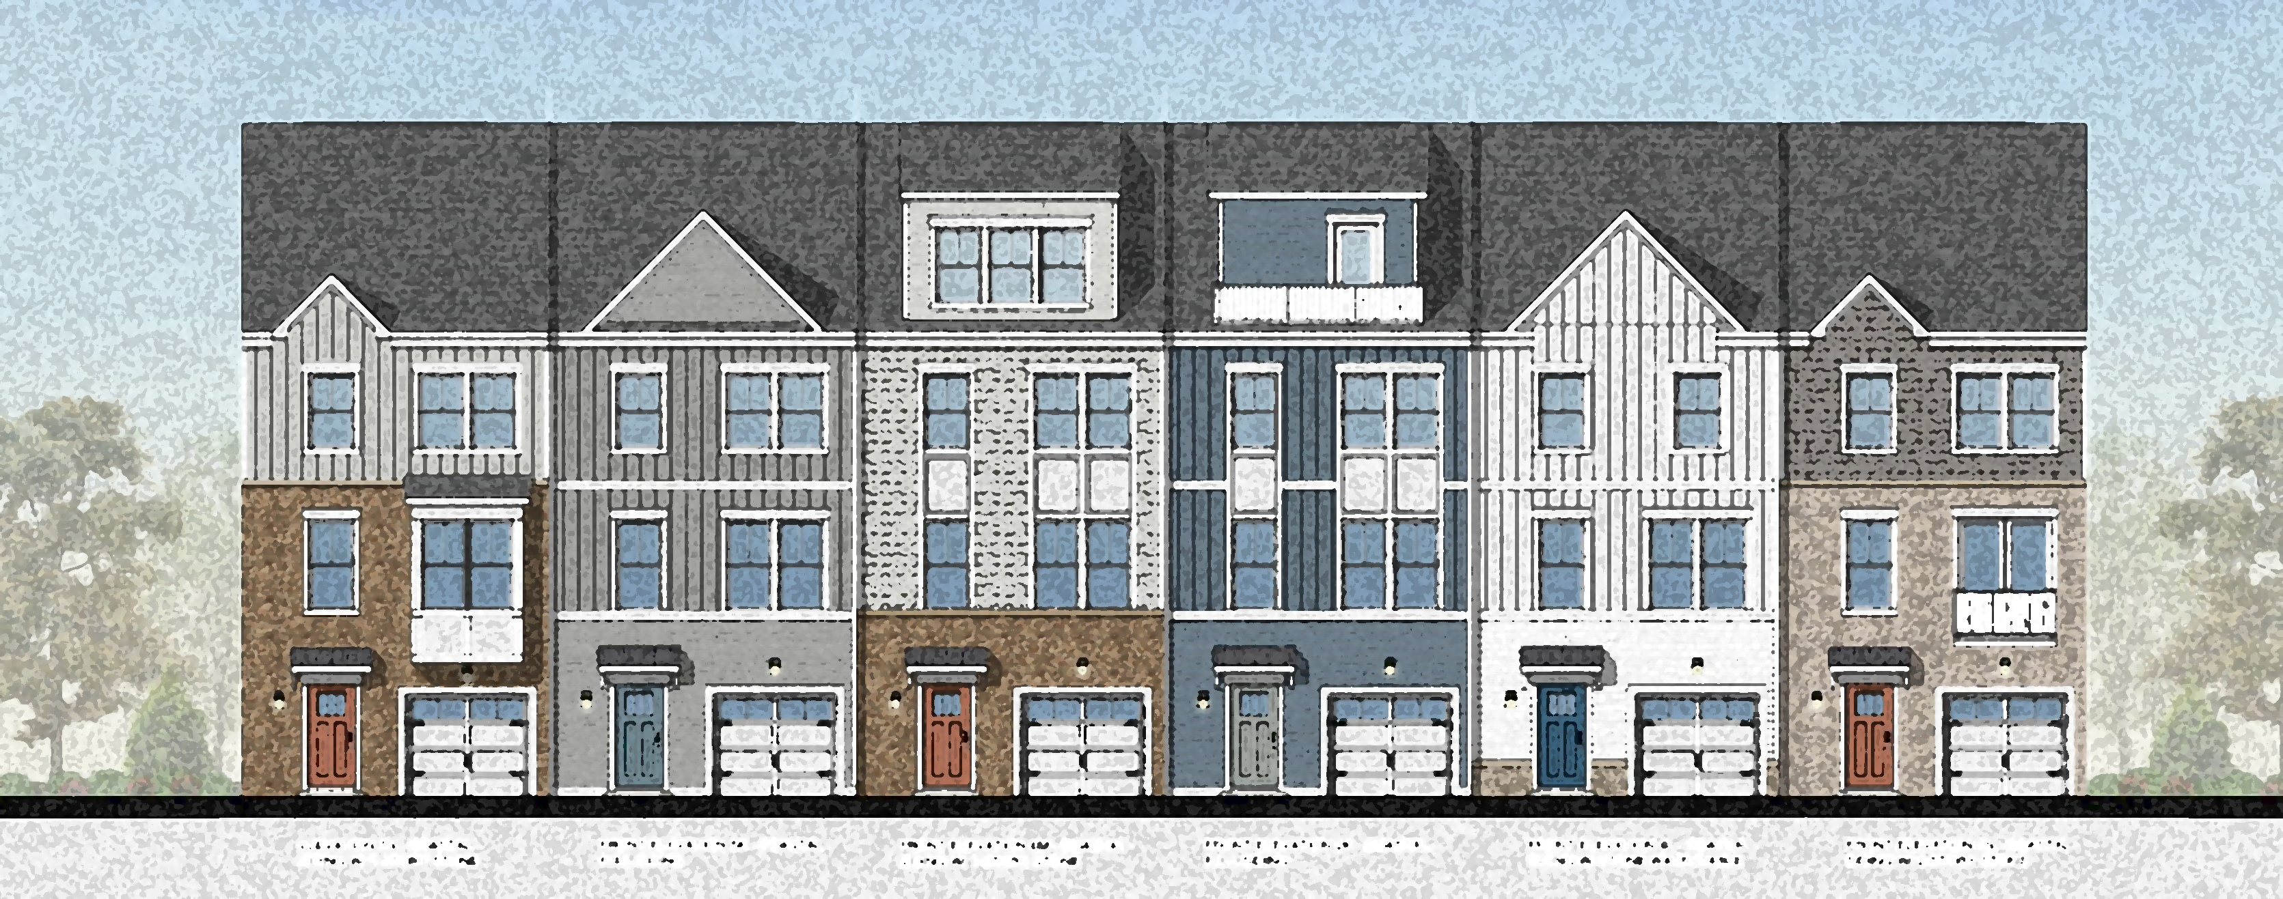
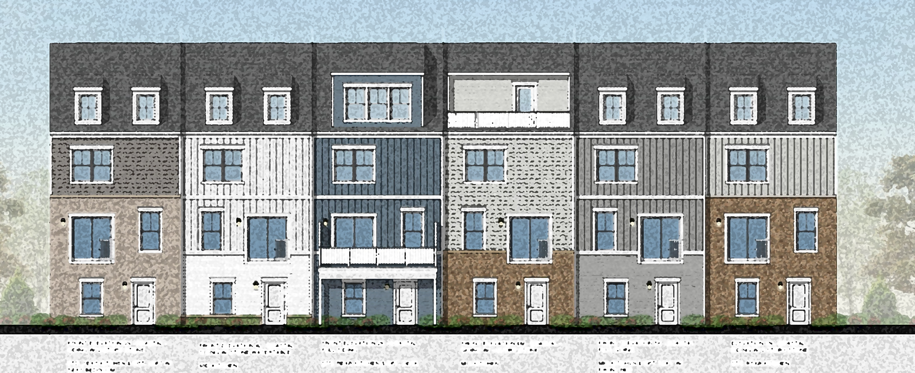
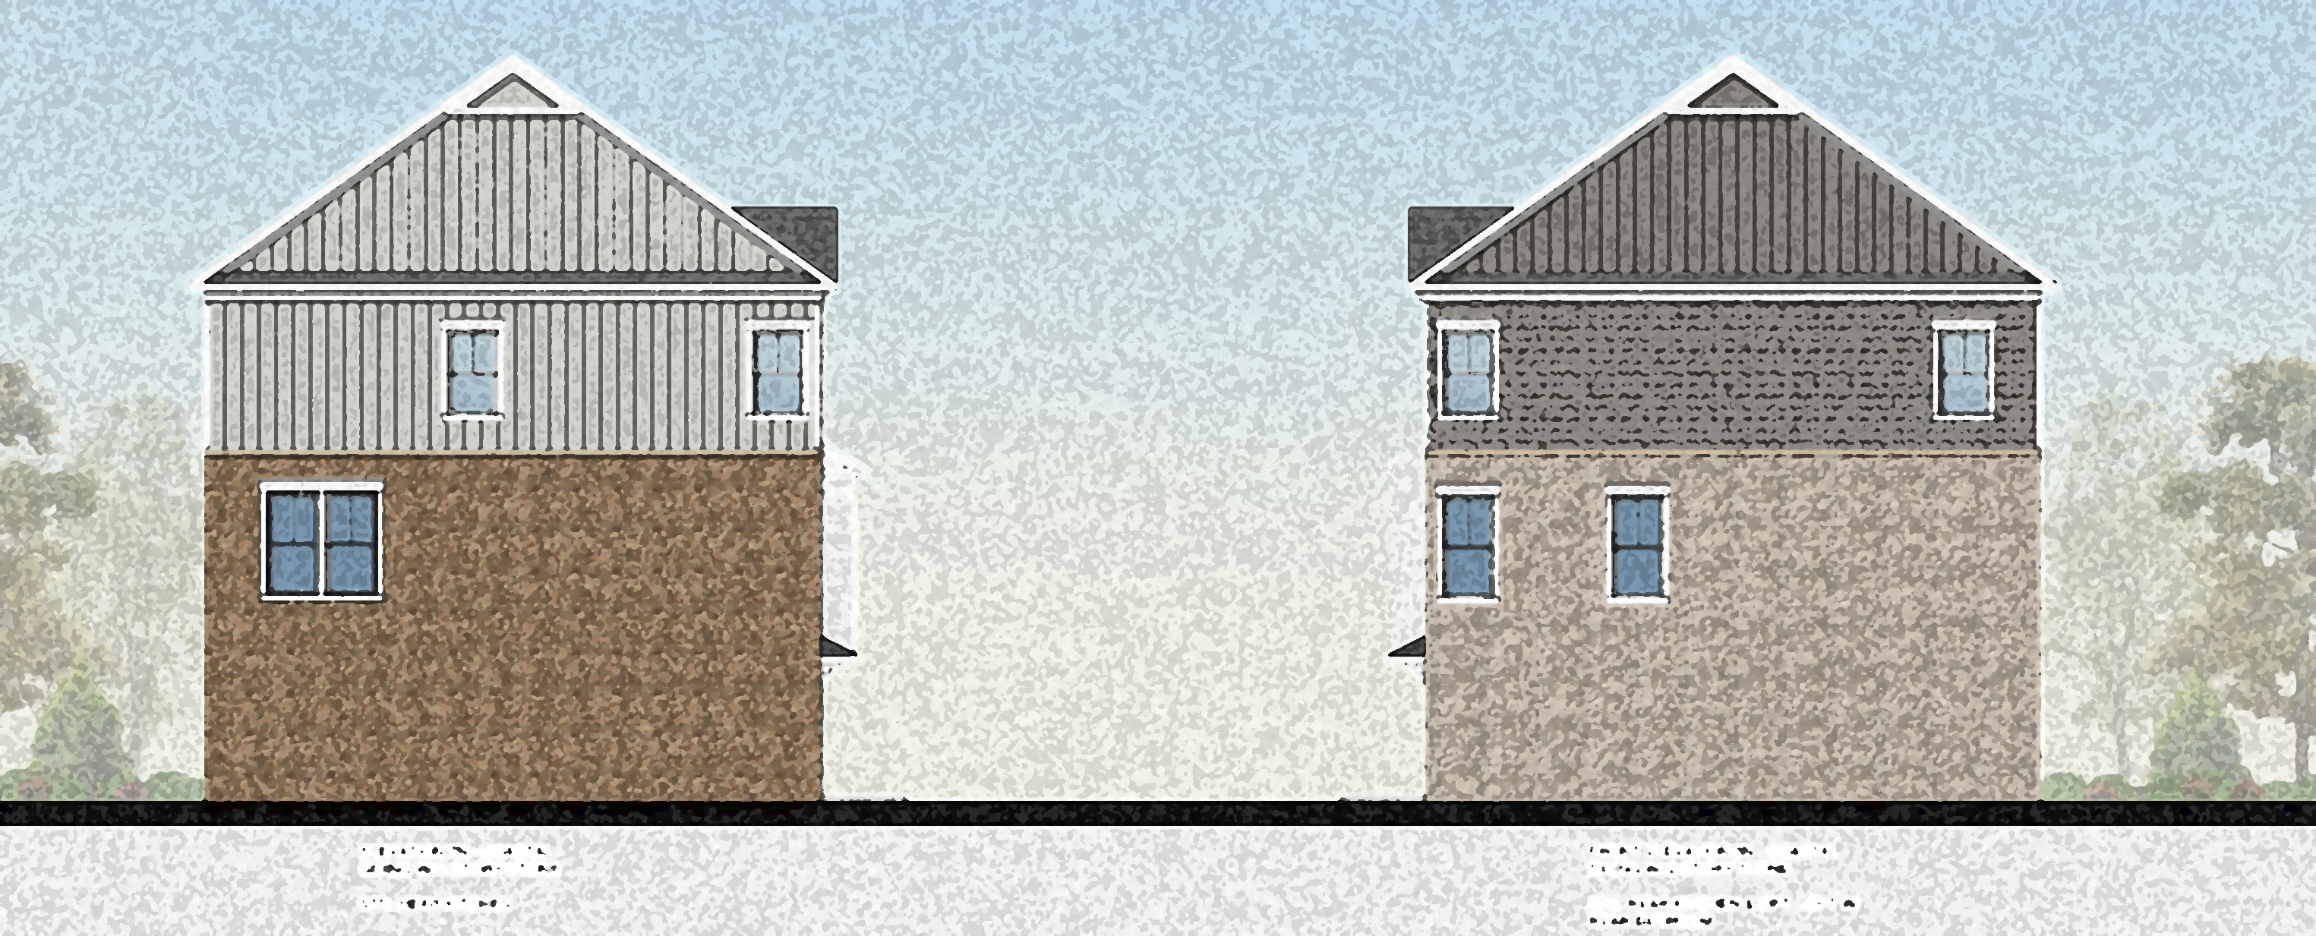
TOWNHOUSE BUILDING
ALT. 1
IRON RIDGE DEVELOPMENT
FRONT ELEVATION
REAR ELEVATION
SIDE ELEVATION

Slide 11
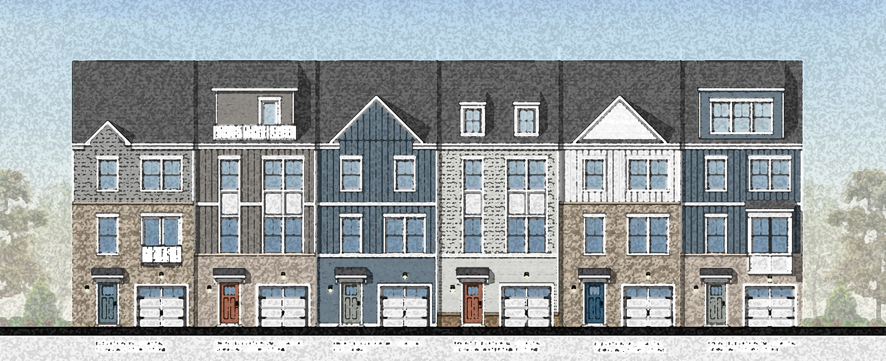
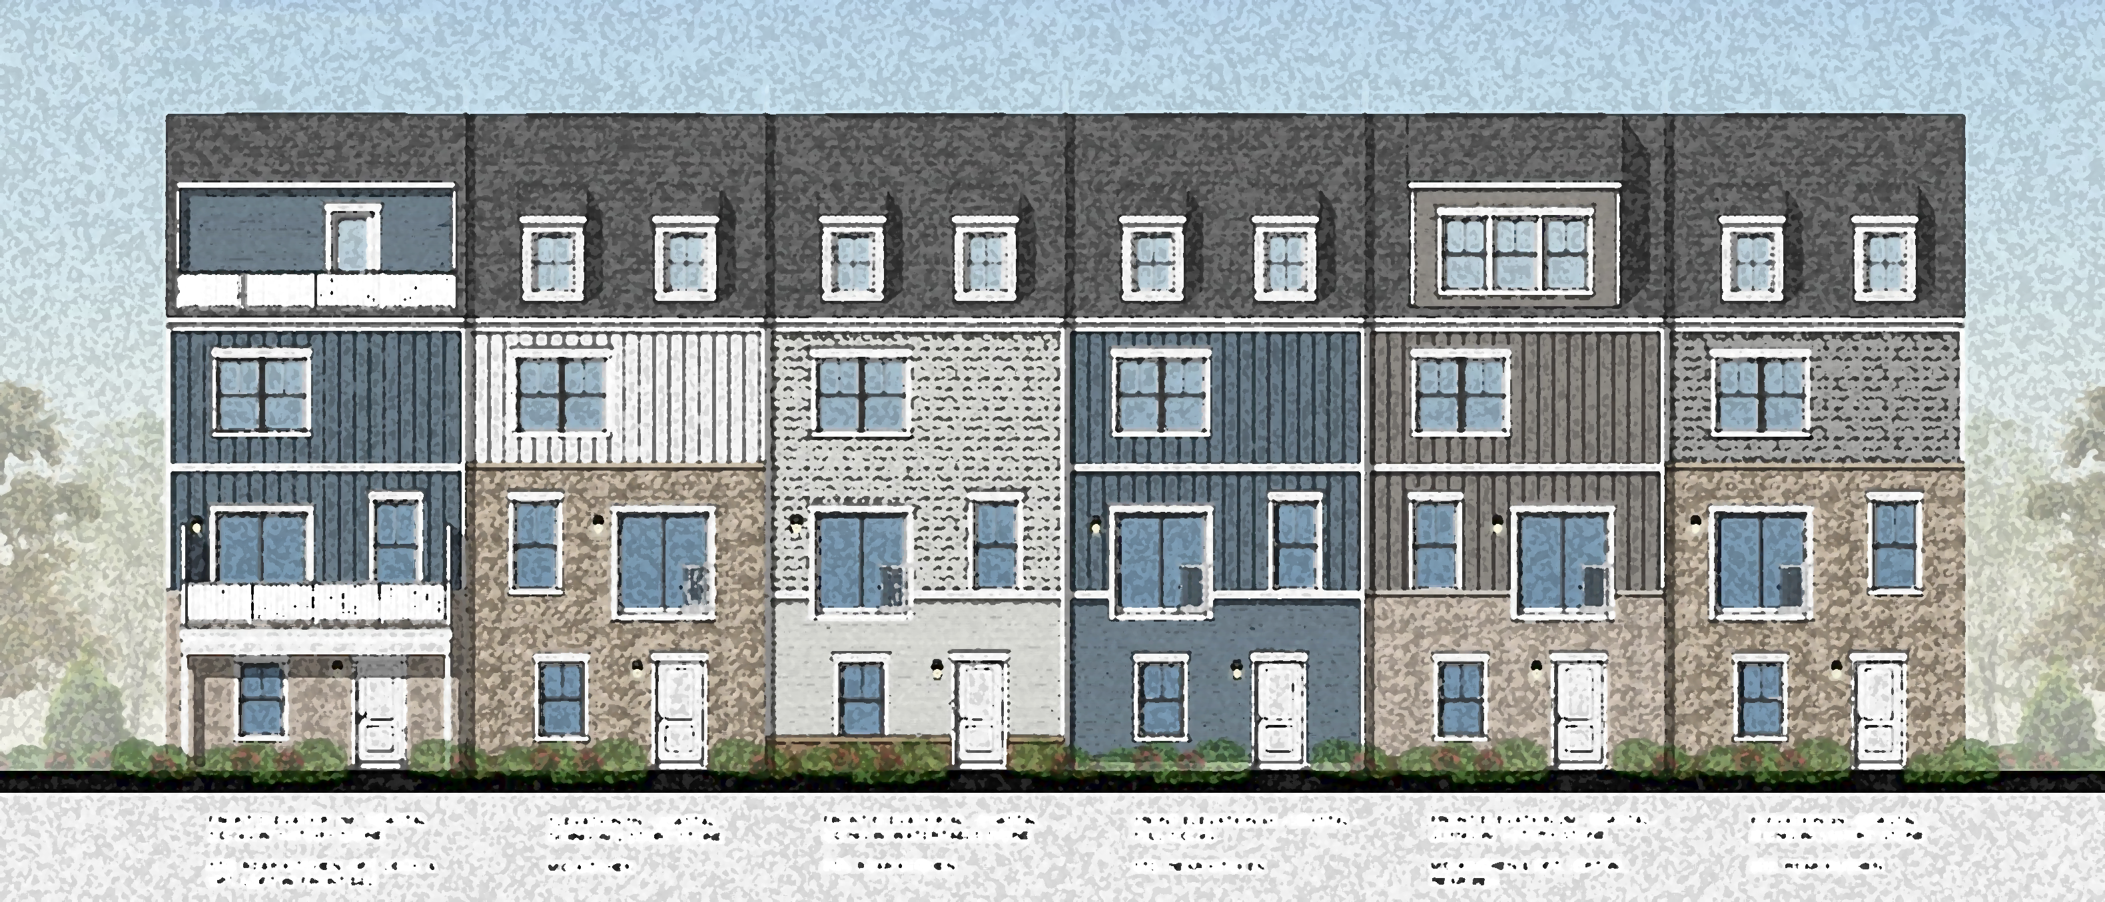
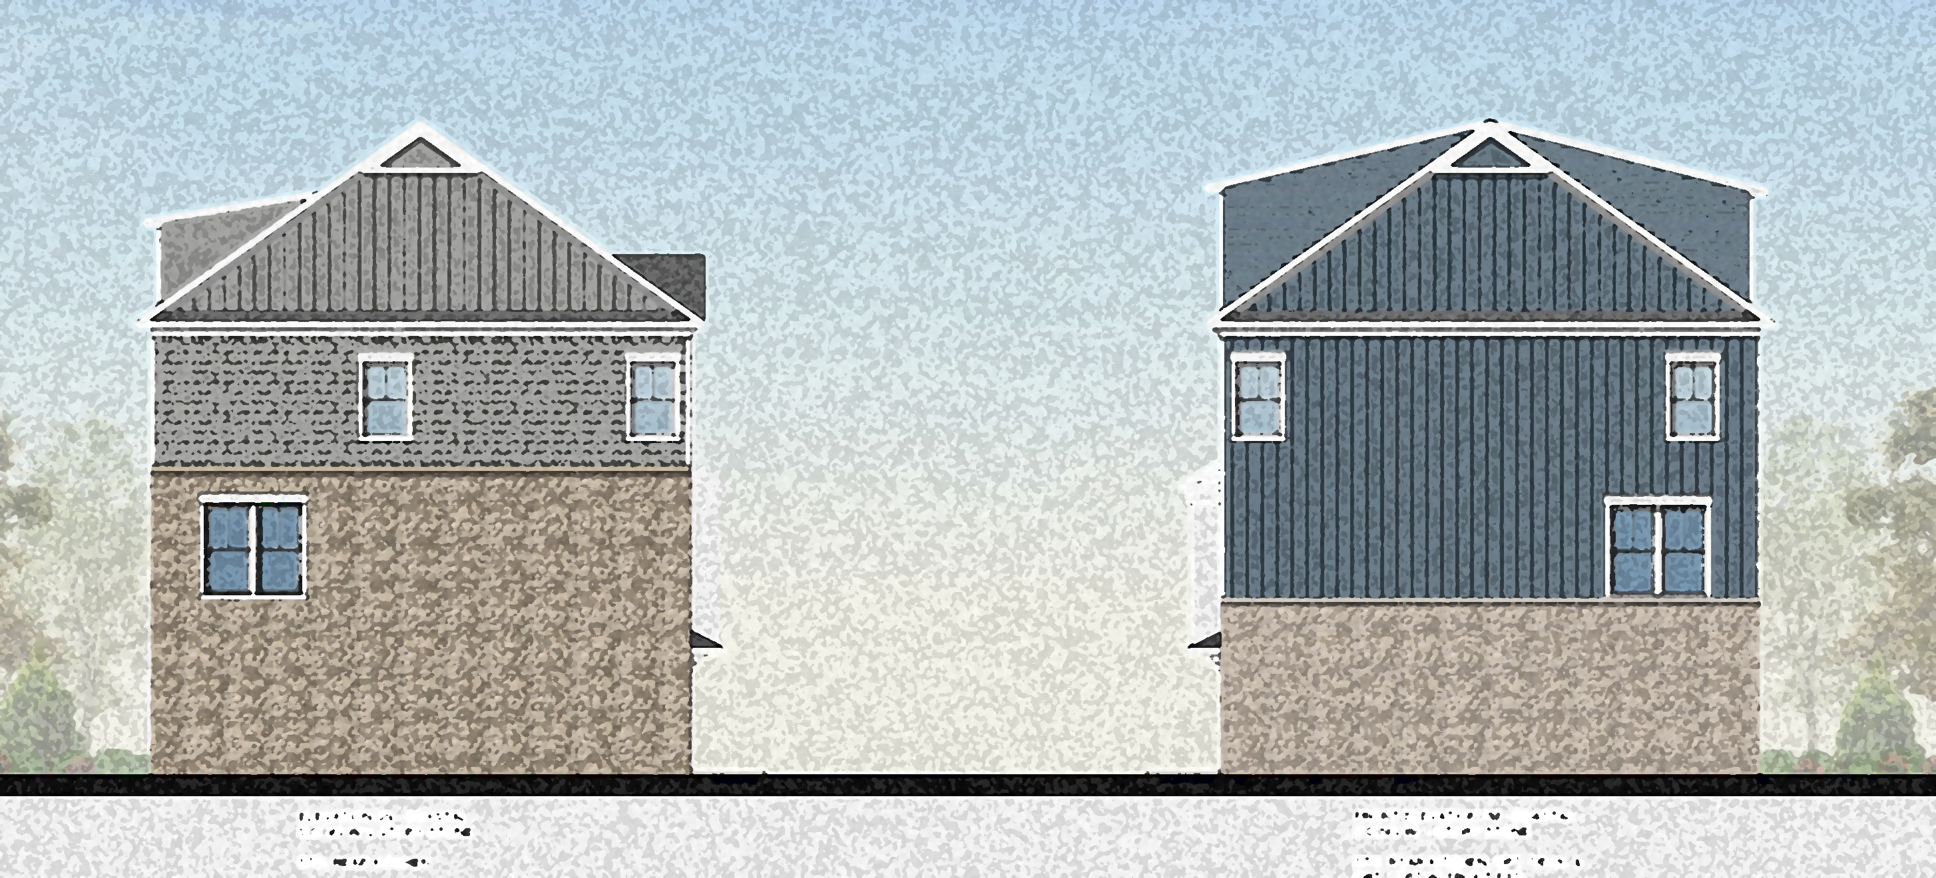
TOWNHOUSE BUILDING ALT. 2
IRON RIDGE DEVELOPMENT
FRONT ELEVATION
REAR ELEVATION
SIDE ELEVATION

Slide 12
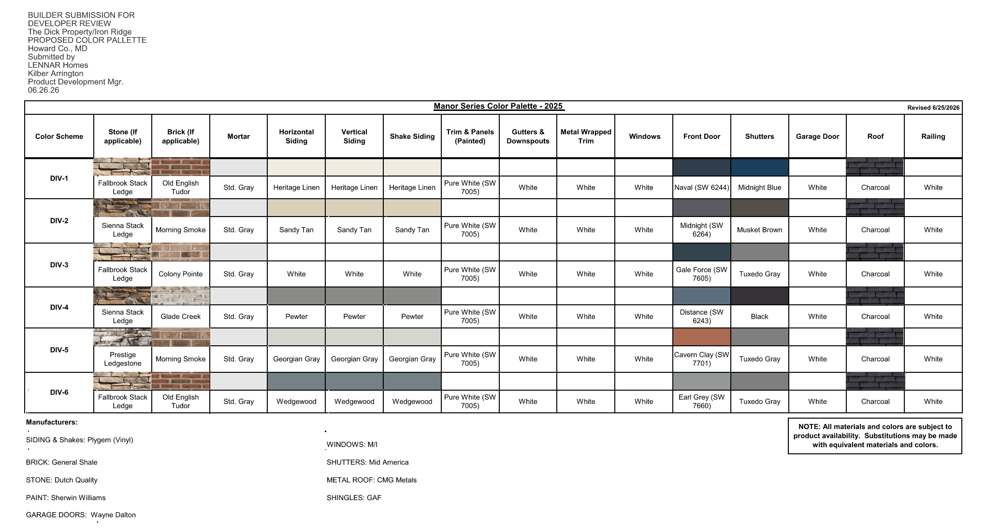
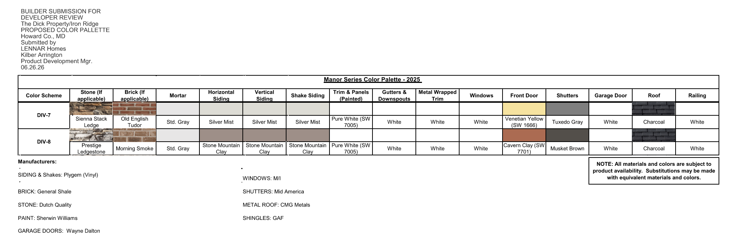
COLOR PALLETTES
IRON RIDGE DEVELOPMENT

Slide 13


