Slide 1
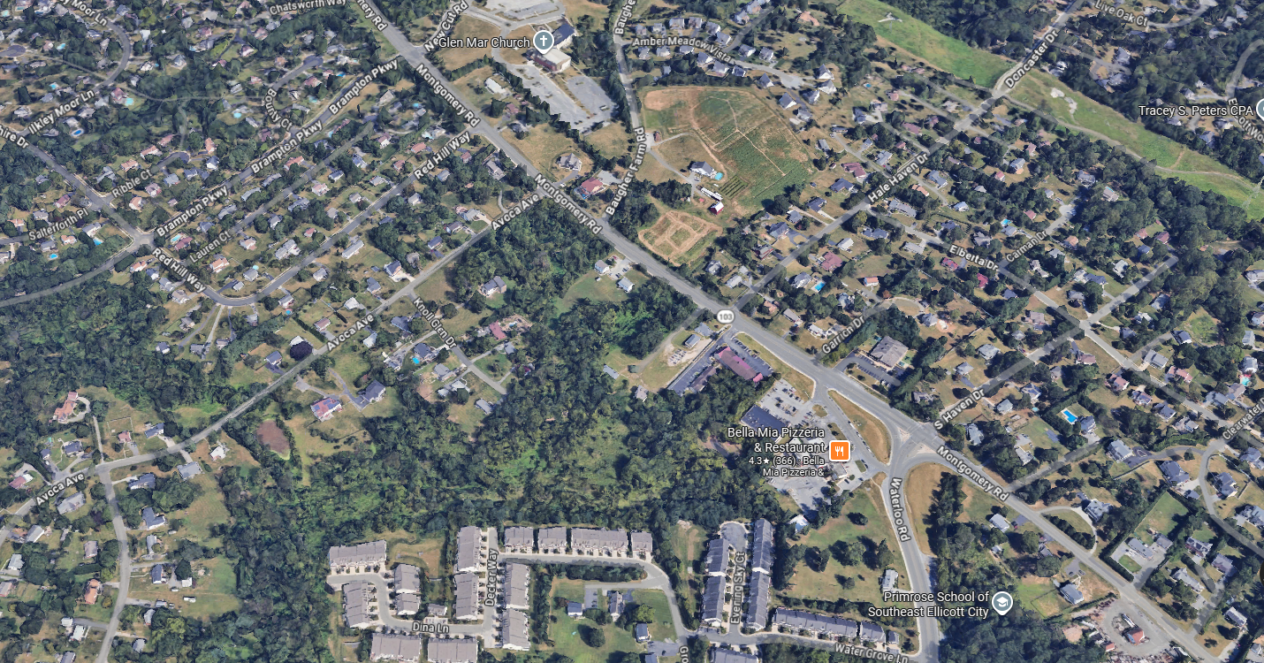

PRESENTATION TO THE HOWARD COUNTY DESIGN ADVISORY PANEL
MONTGOMERY ROAD ACTIVE ADULT
JULY 23, 2026
MONTGOMERY AA, LLC

Slide 2
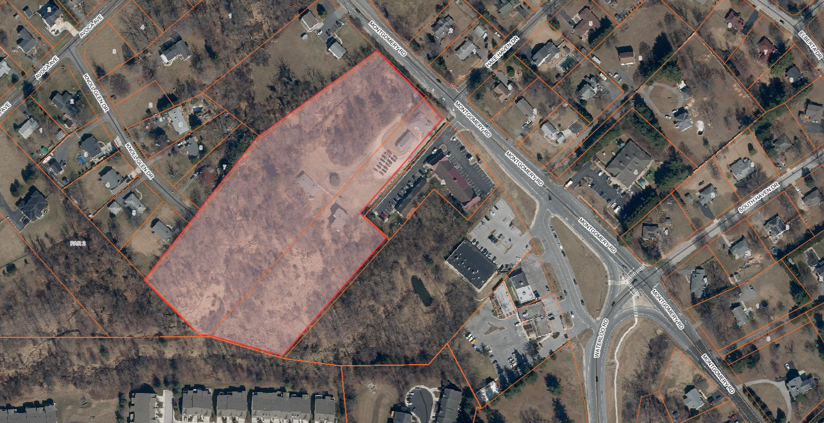
MONTGOMERY ROAD ACTIVE ADULT
EXISTING LOCATION MAP
1500’ SIDEWALK TO PEDESTRIAN CROSSING
GLEN MAR UNITED METHODIST CHURCH
DUNKIN DONUTS
CHILDTIME
LEARNING
CENTER
MIKE’S MUSIC
VETERINARIAN
SITE
WATERMONT
PLAZA
KNOLLVIEW
SHOPPING
CENTER
HEARTHSTONE AT ELLICOTT MILLS
PHASES 1 & 2
(AGE RESTRICTED ADULT HOUSING)
THE COURTYARDS OF ELLICOTT MILLS
(AGE RESTRICTED ADULT HOUSING)
MONTGOMERY AA, LLC

Slide 3
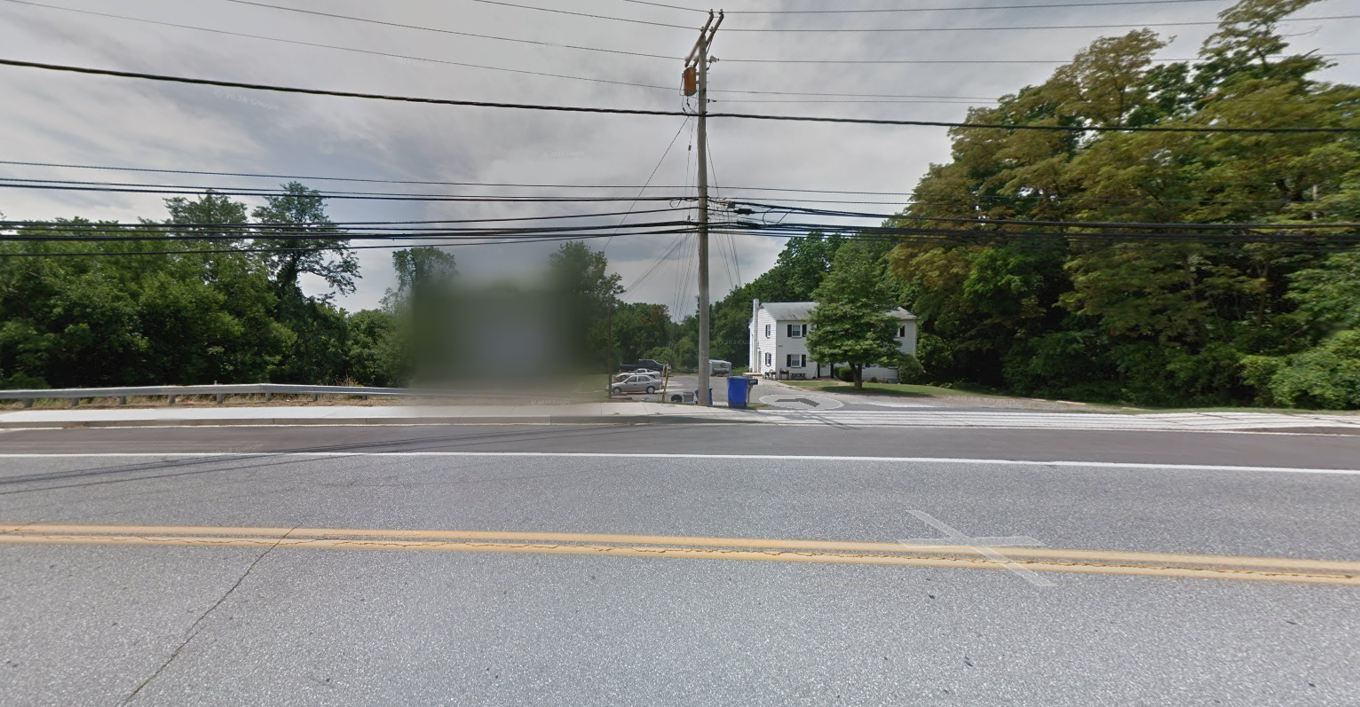
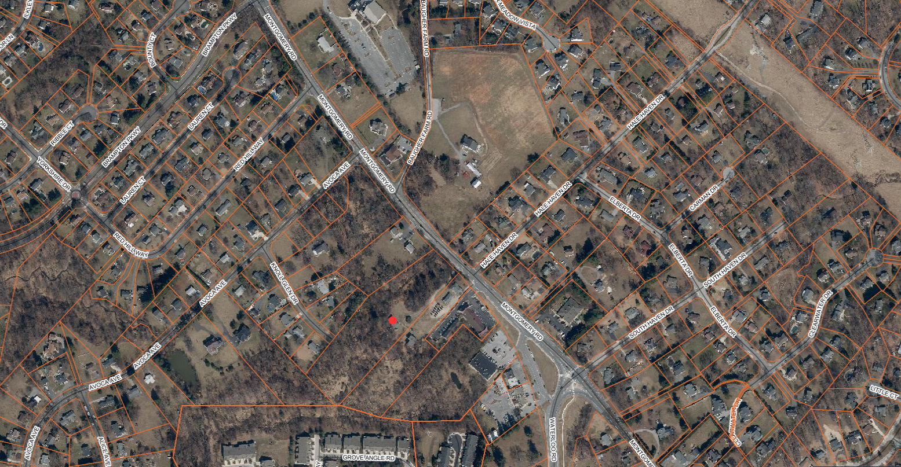
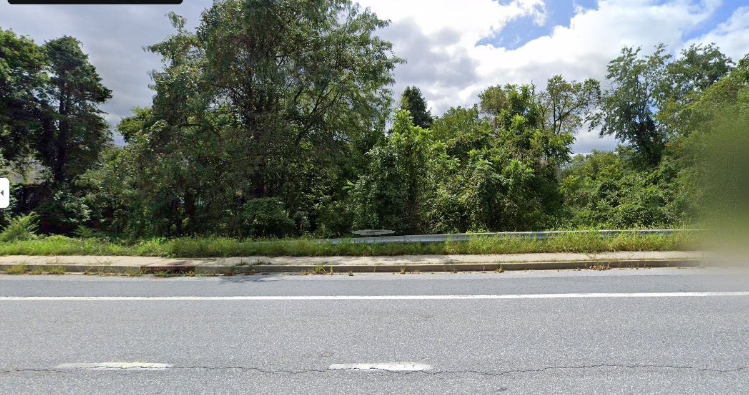
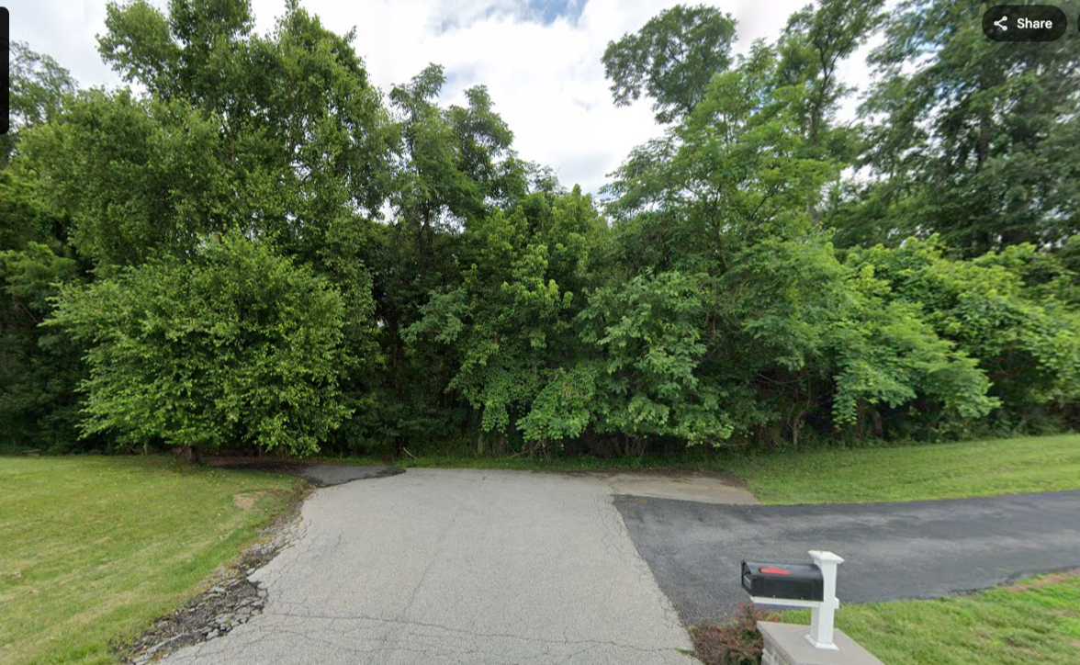
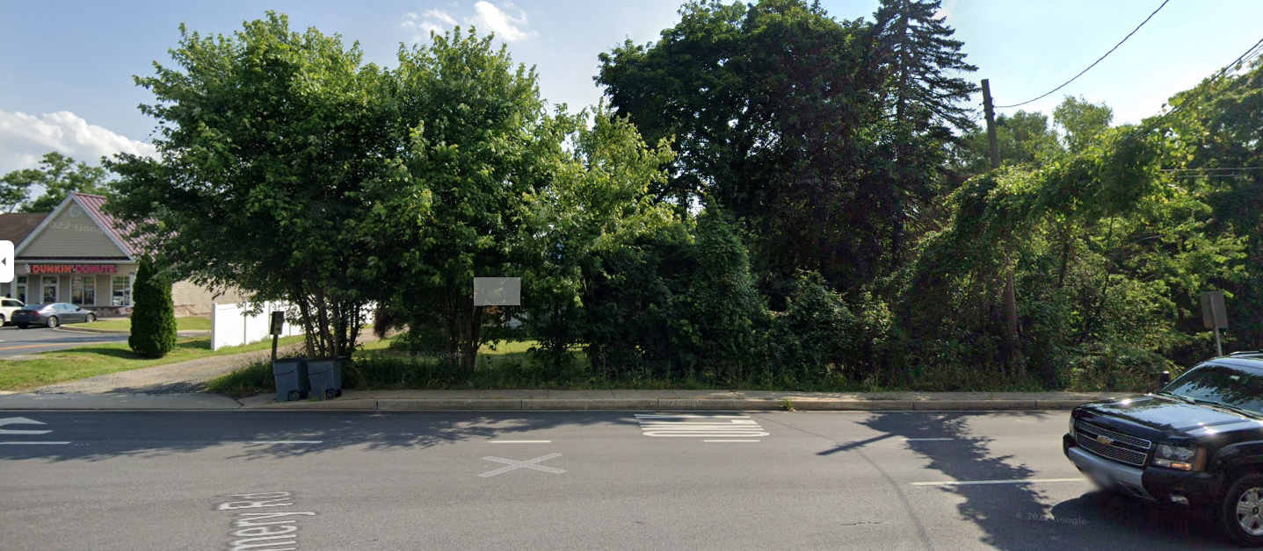
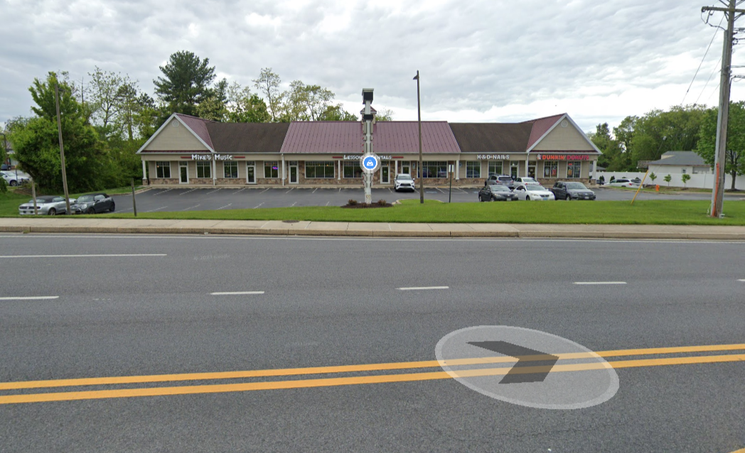
MONTGOMERY ROAD ACTIVE ADULT
EXISTING VICINAL PICTURE MAP
SITE
MONTGOMERY AA, LLC

Slide 4
MONTGOMERY ROAD ACTIVE ADULT
RENDERING OF OVERALL PLAN
MONTGOMERY AA, LLC

Slide 5
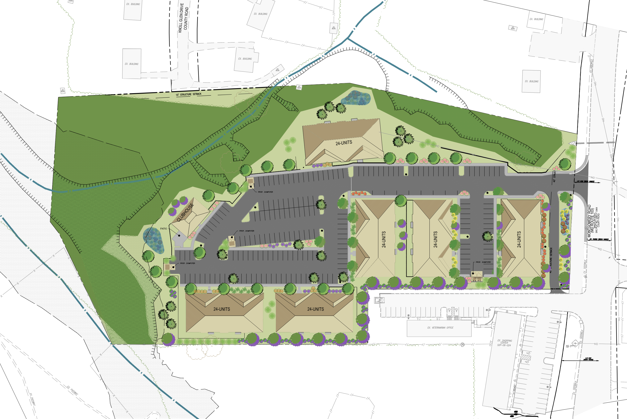
MONTGOMERY ROAD ACTIVE ADULT
RENDERING OF OVERALL PLAN
MONTGOMERY AA, LLC

Slide 6
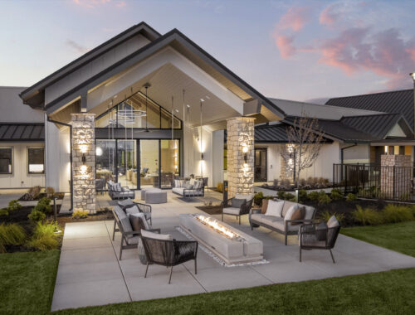

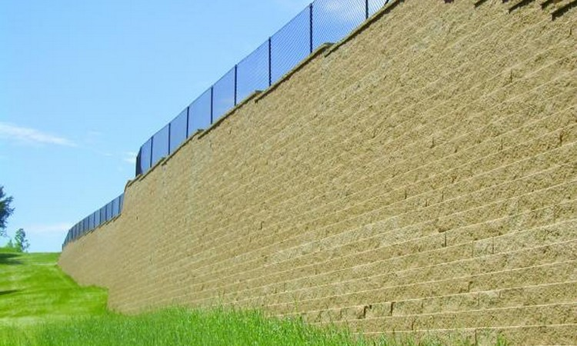


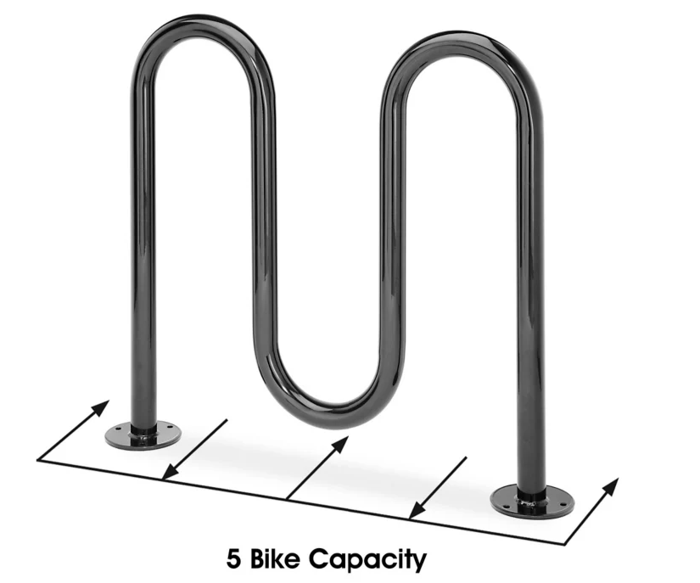
MONTGOMERY ROAD ACTIVE ADULT
AMENITIES
14’ LIGHT POLE LIGHT TO BE SHIELDED AND DIRECTED DOWN AND AWAY FROM ADJACENT PROPERTIES.
MONTGOMERY AA, LLC

Slide 7
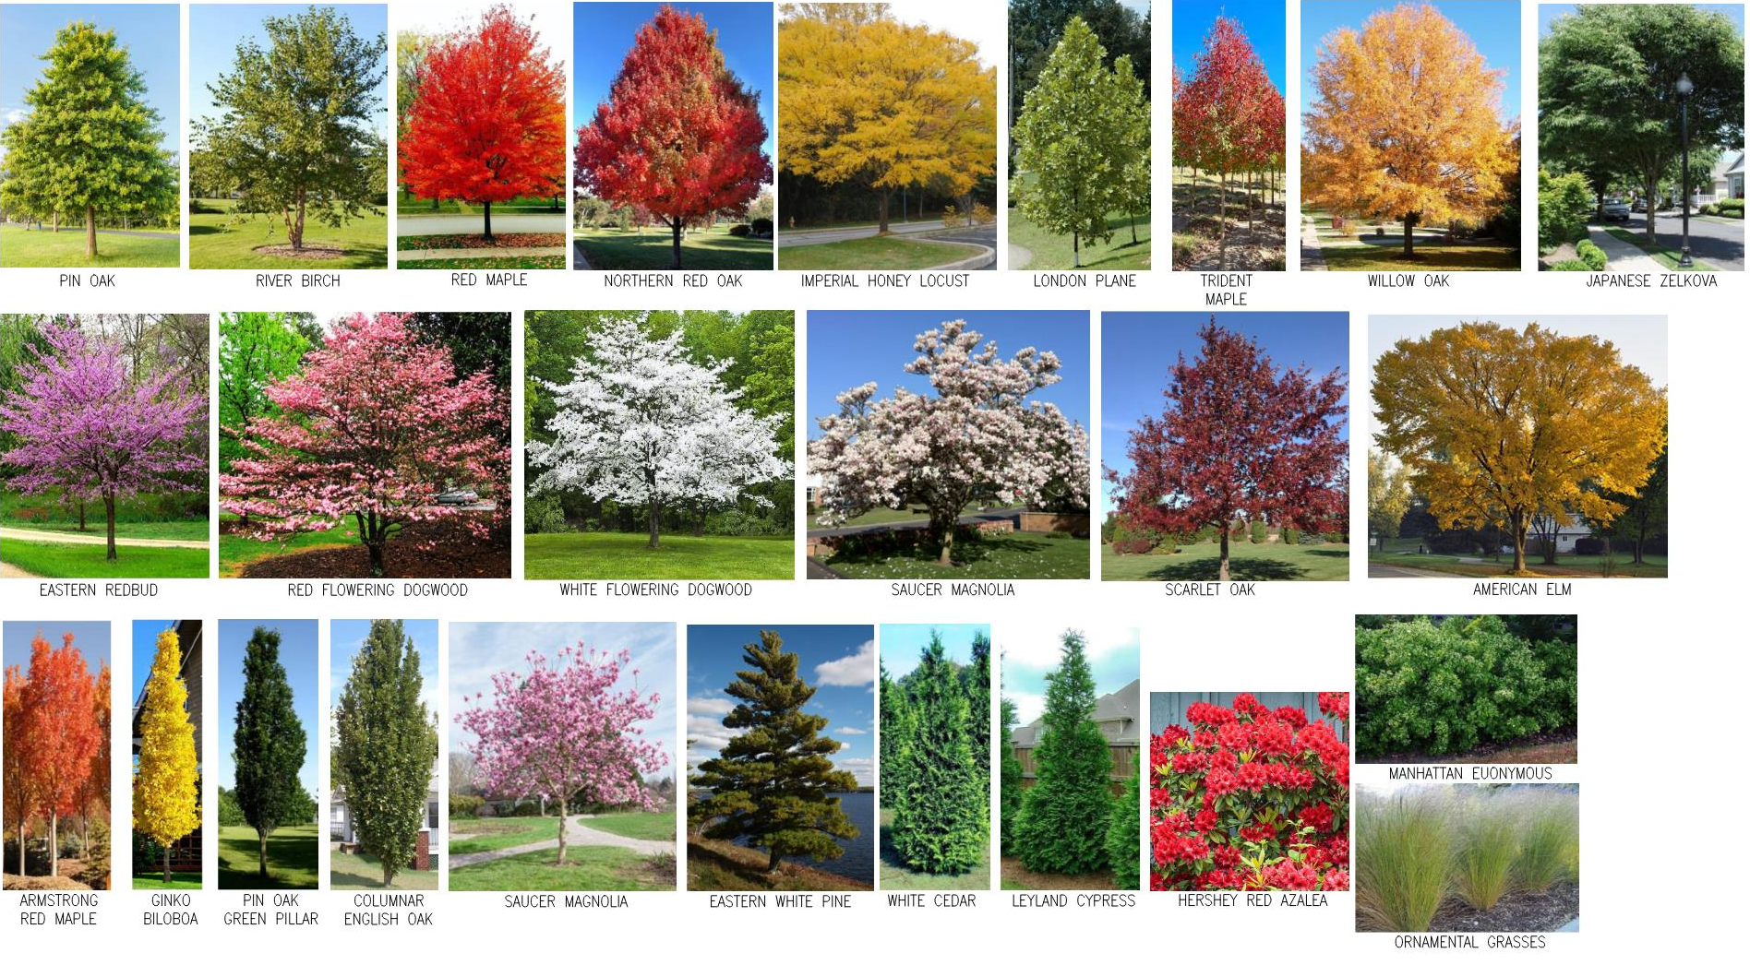
LANDSCAPING AT
MONTGOMERY ROAD ACTIVE ADULT
MONTGOMERY AA, LLC

Slide 8
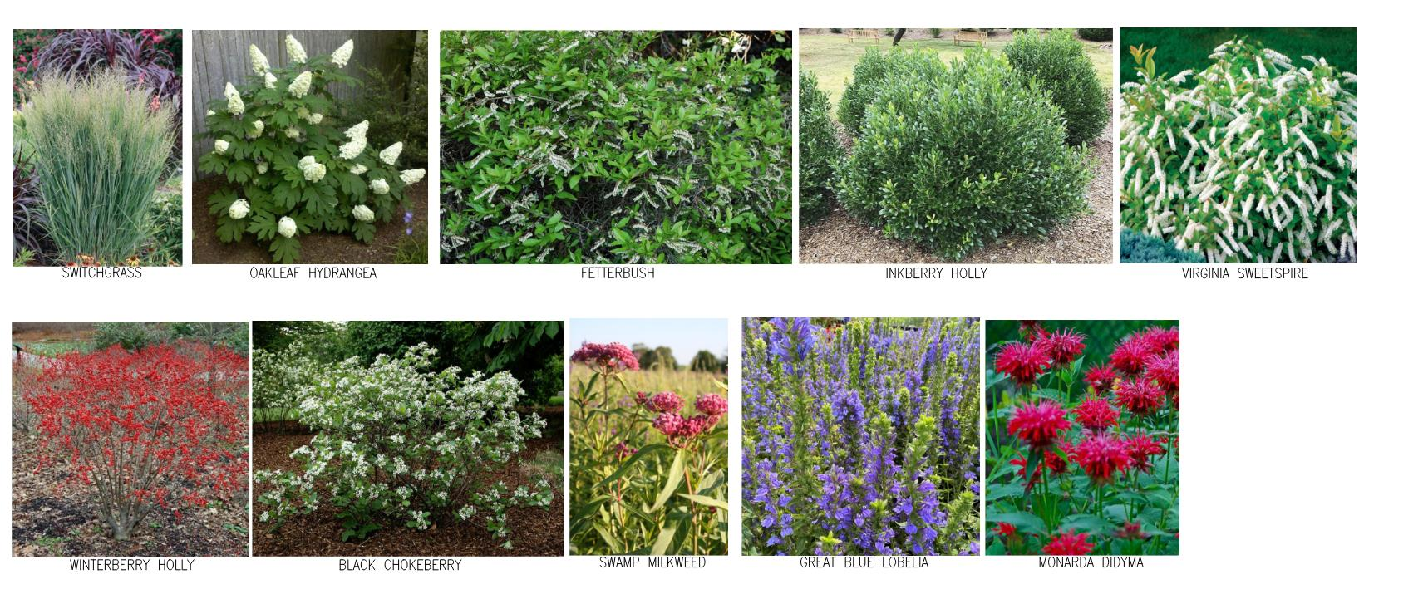
MICRO-BIORETENTION PLANTINGS
MONTGOMERY ROAD ACTIVE ADULT
MONTGOMERY AA, LLC

Slide 9
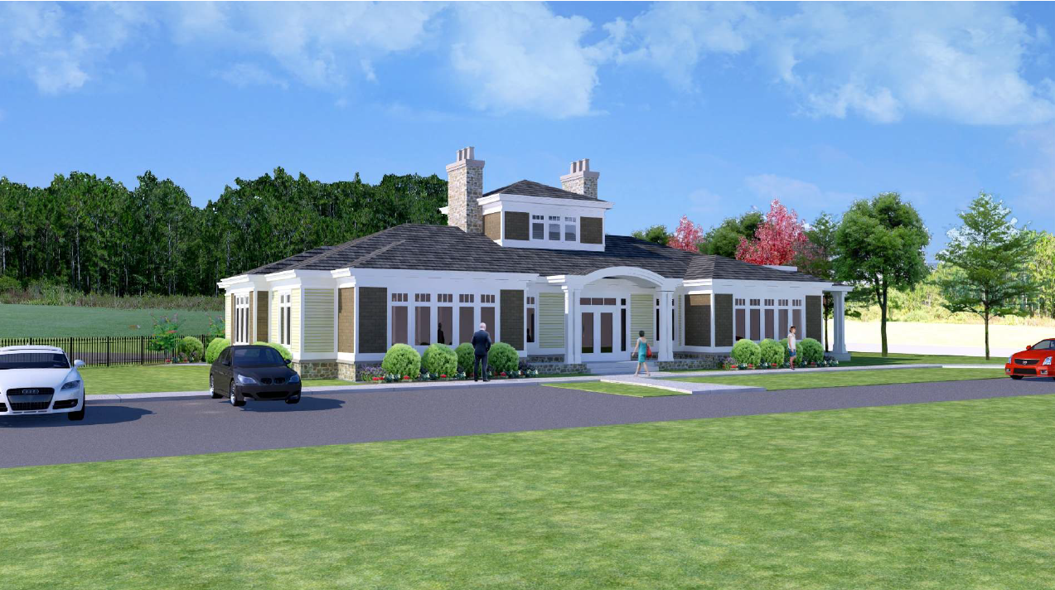
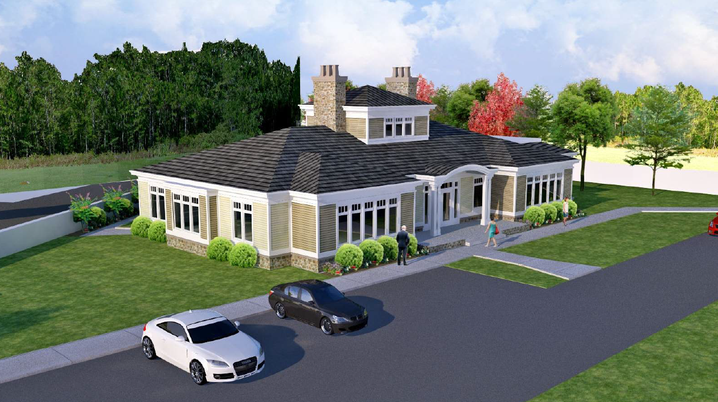
CLUBHOUSE SCHEMATIC DESIGN
MONTGOMERY AA, LLC

Slide 10
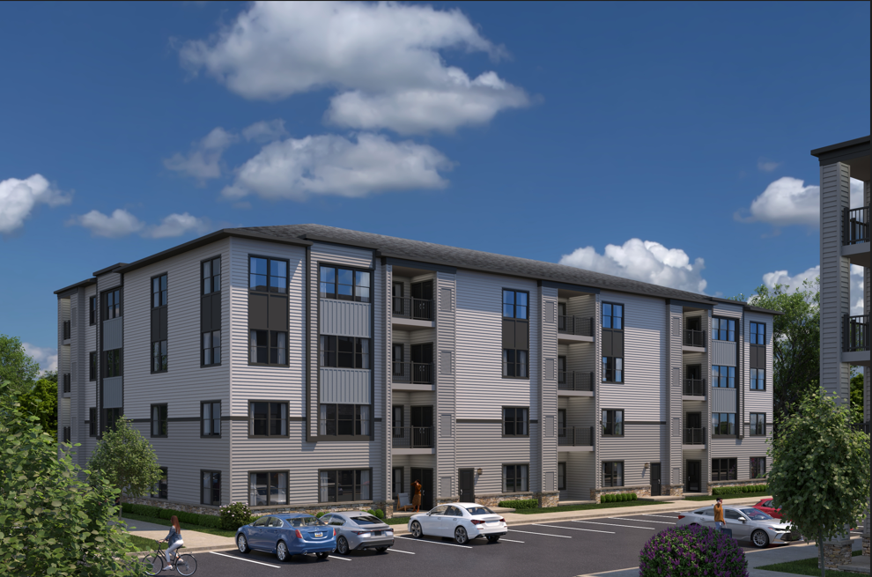
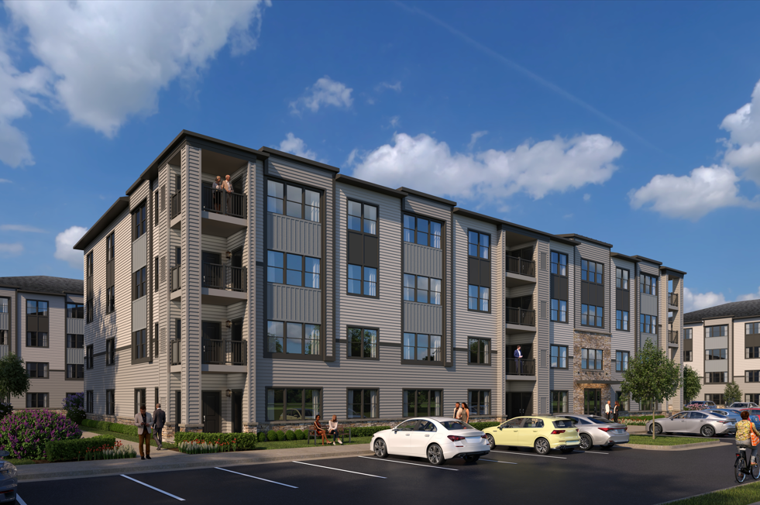
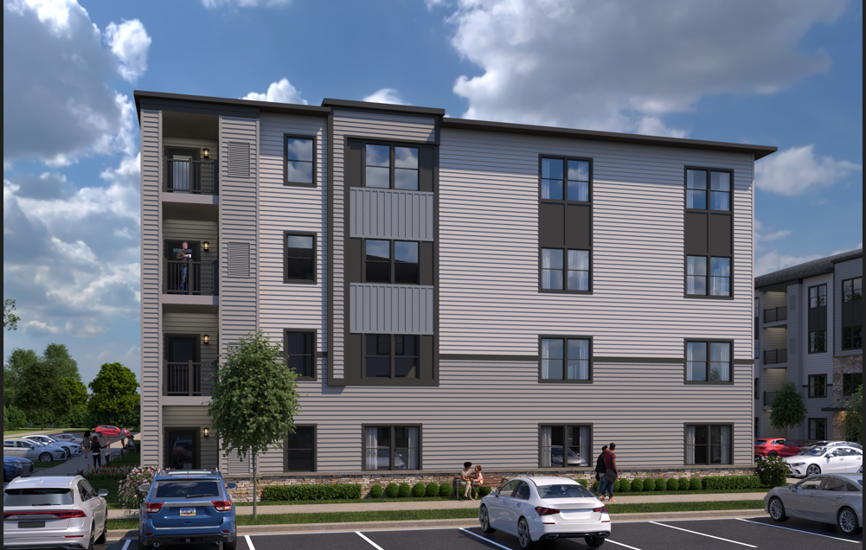
BUILDING ELEVATIONS
MONTGOMERY AA, LLC

Slide 11
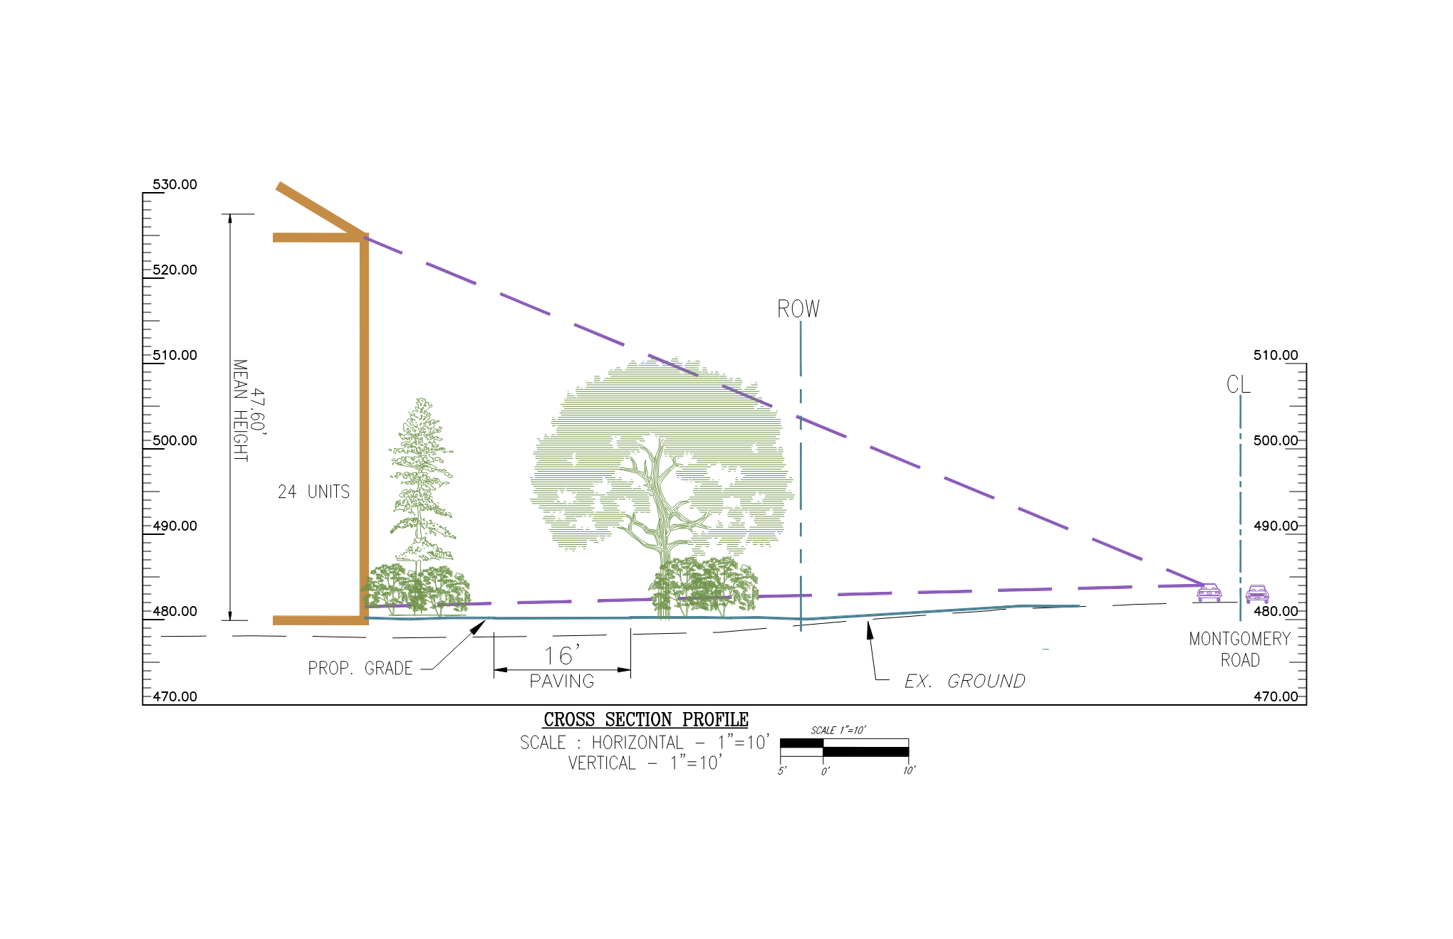
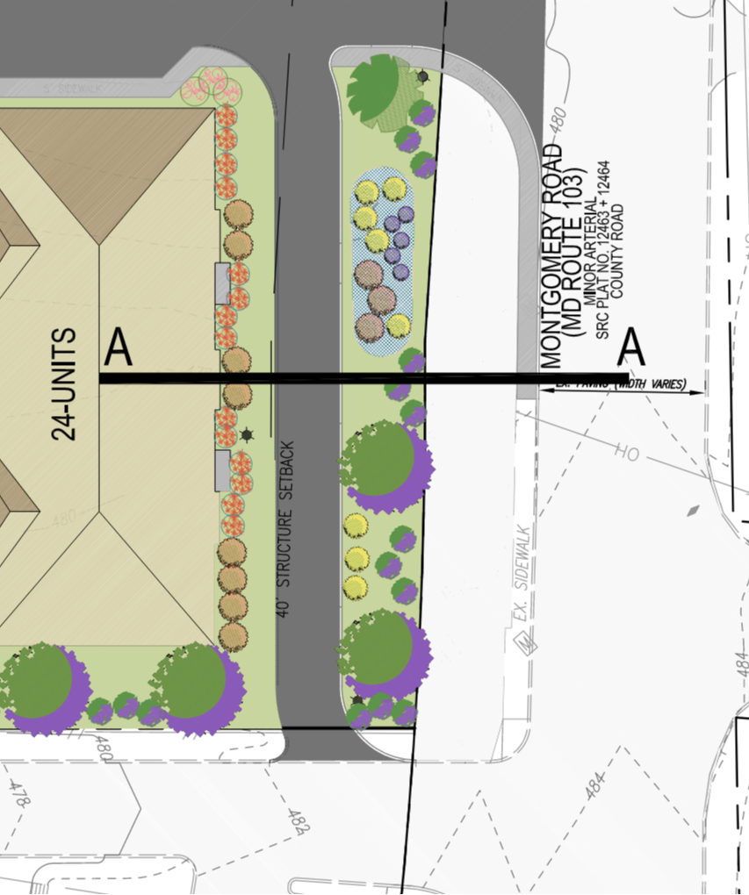
CROSS SECTION FROM MONTGOMERY ROAD
MONTGOMERY AA, LLC

Slide 12
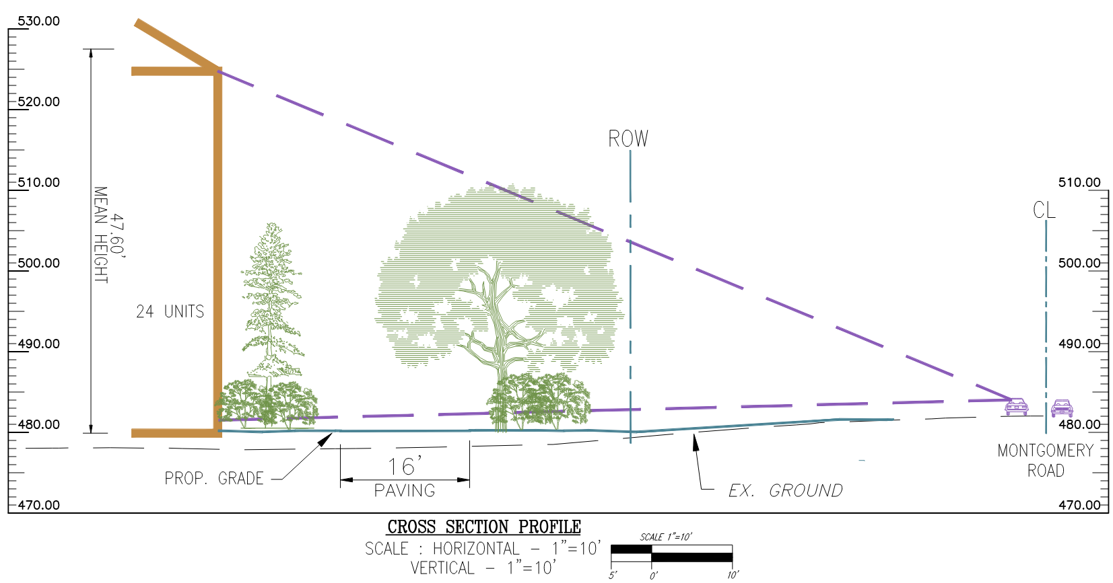
CROSS SECTION FROM MONTGOMERY ROAD
MONTGOMERY AA, LLC

Slide 13
QUESTIONS?

