Slide 1
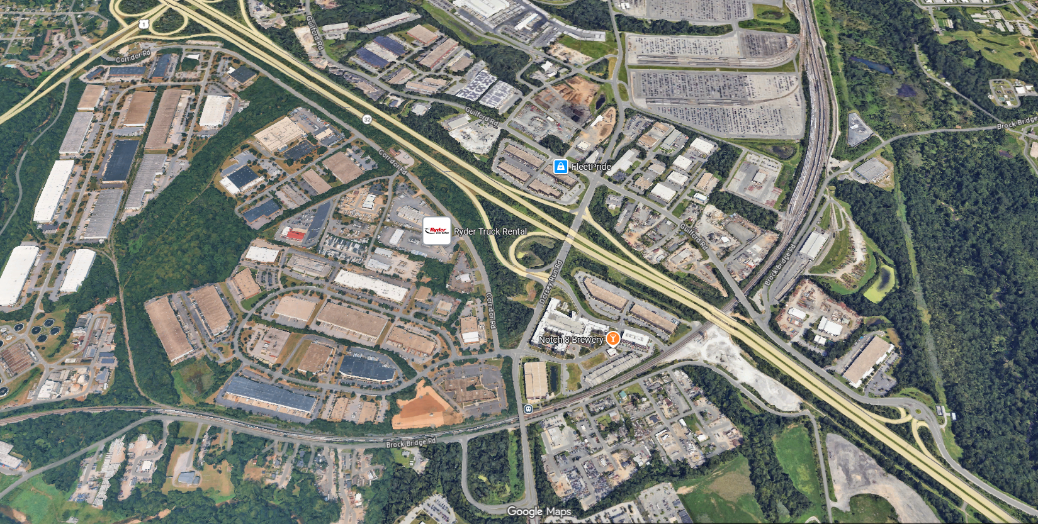


PRESENTATION TO THE HOWARD COUNTY DESIGN ADVISORY PANEL
STATION OVERLOOK
AUGUST XX, 2026

Slide 2
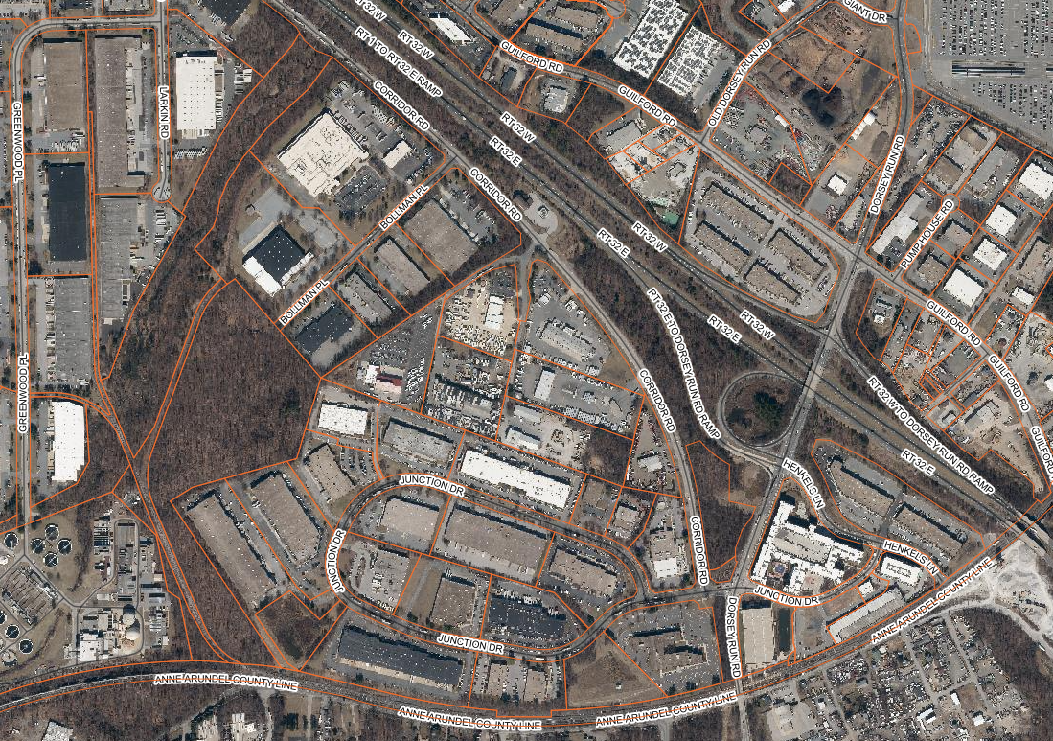
STATION OVERLOOK
EXISTING LOCATION MAP
Dorsey Run Business Center
Fitness
FedEx Freight
SITE
Truck Rental
SITE
Christ Embassy
Annapolis Junction
Apartments
Bureau of Utilities
Taylor Farm
Savage Station

Slide 3
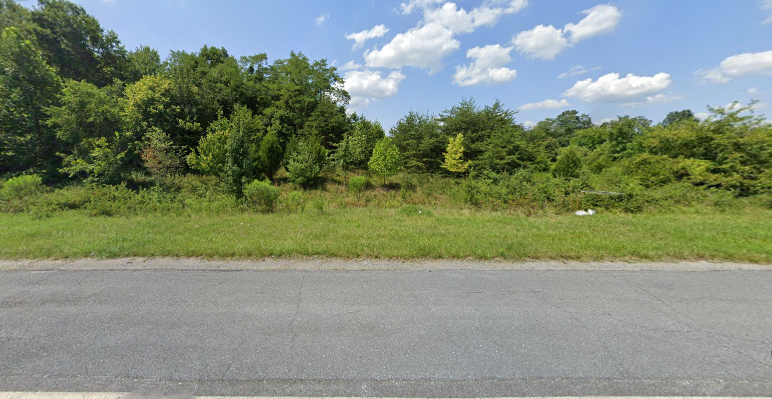
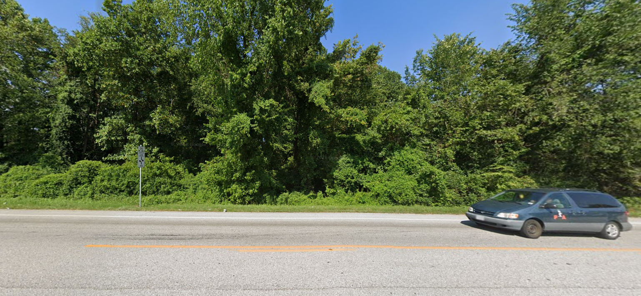
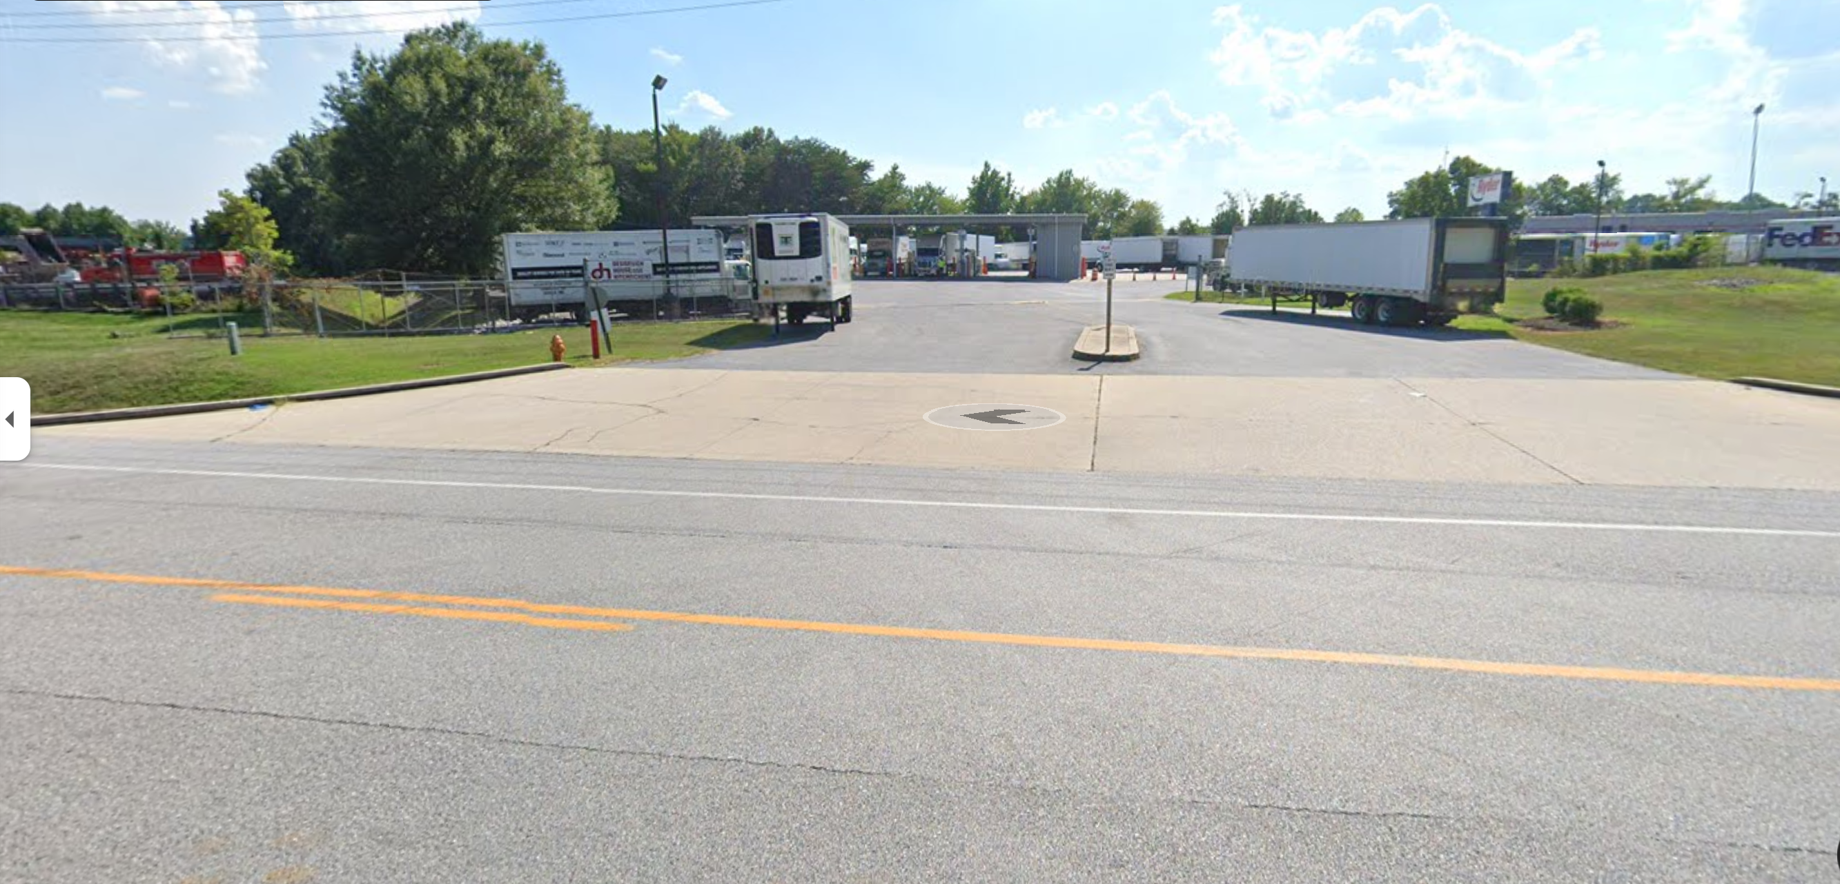
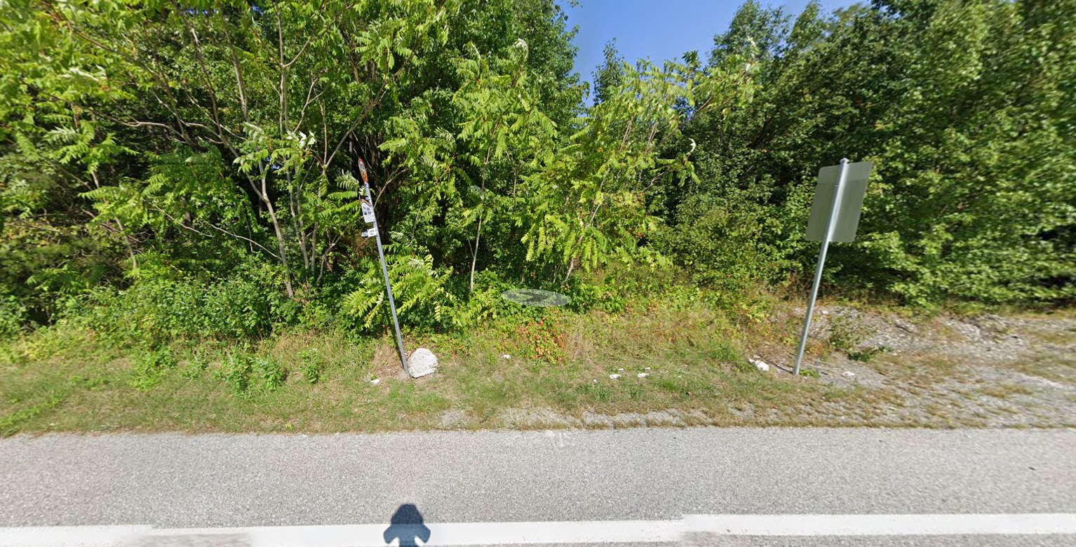
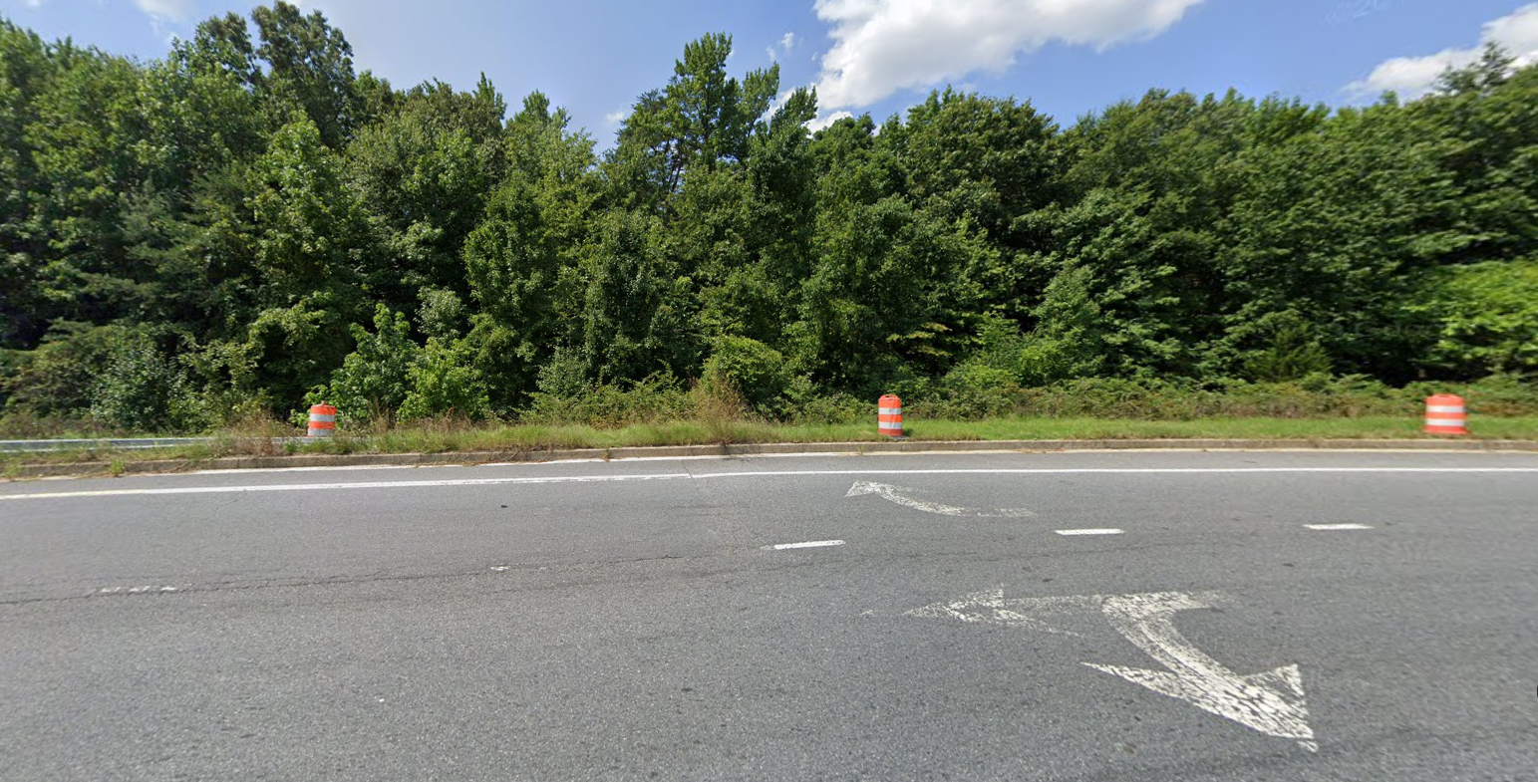
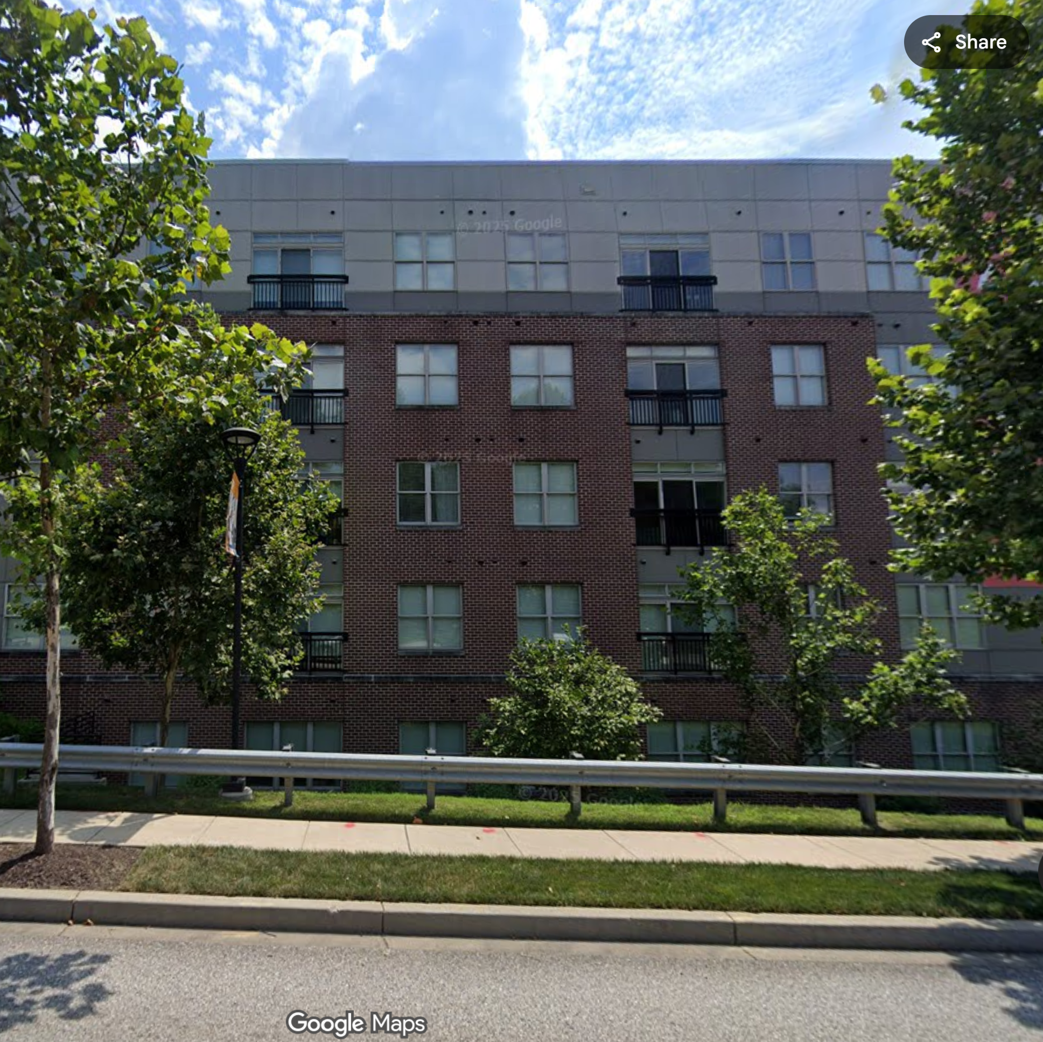
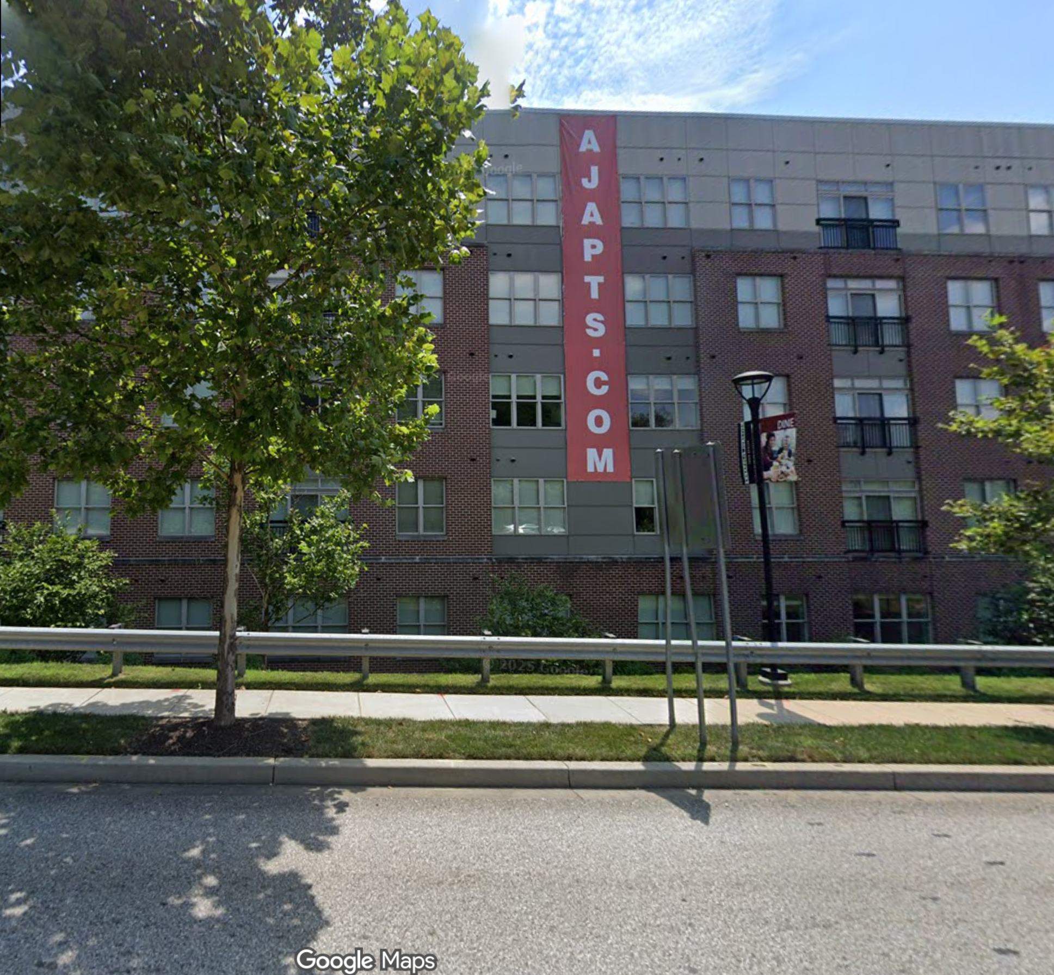
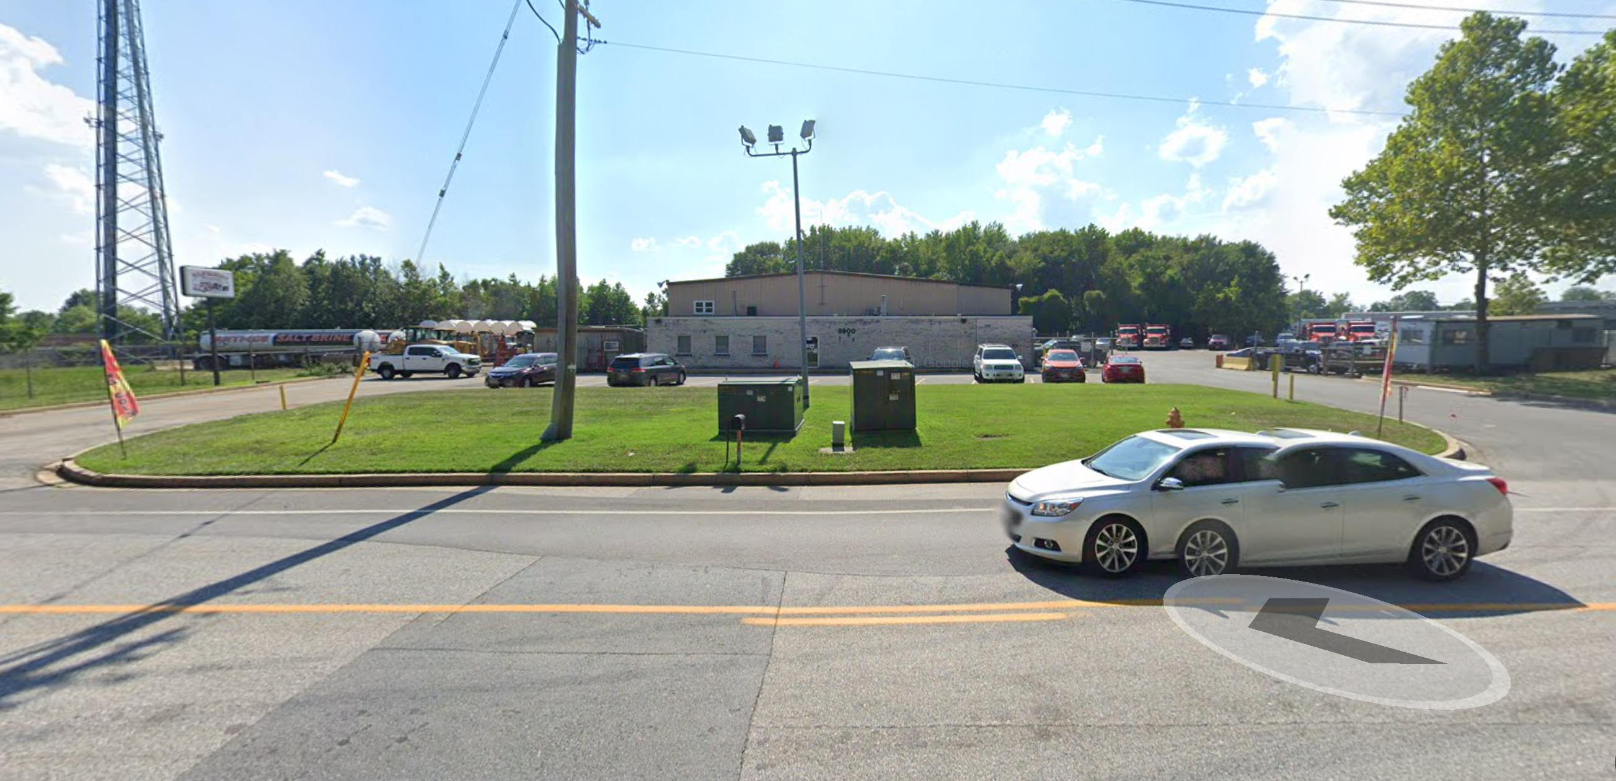
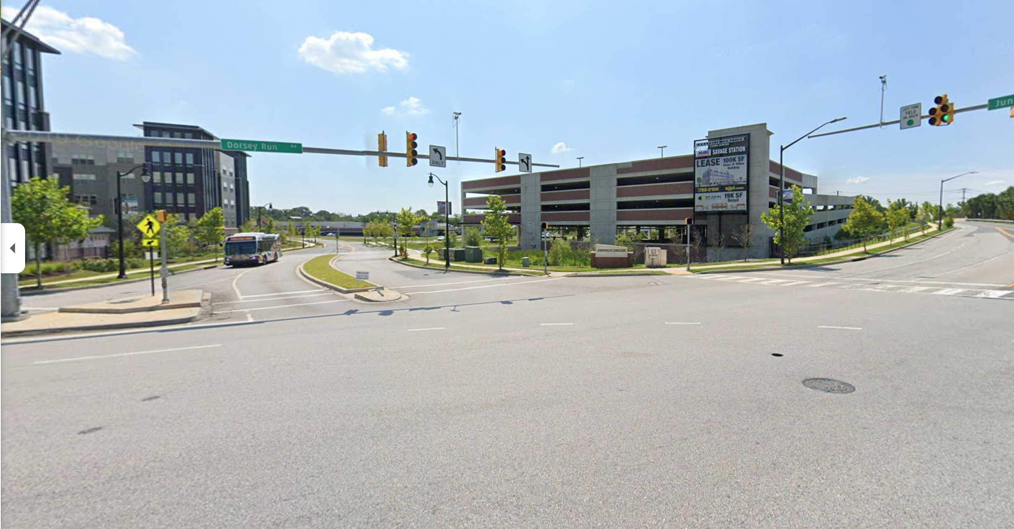
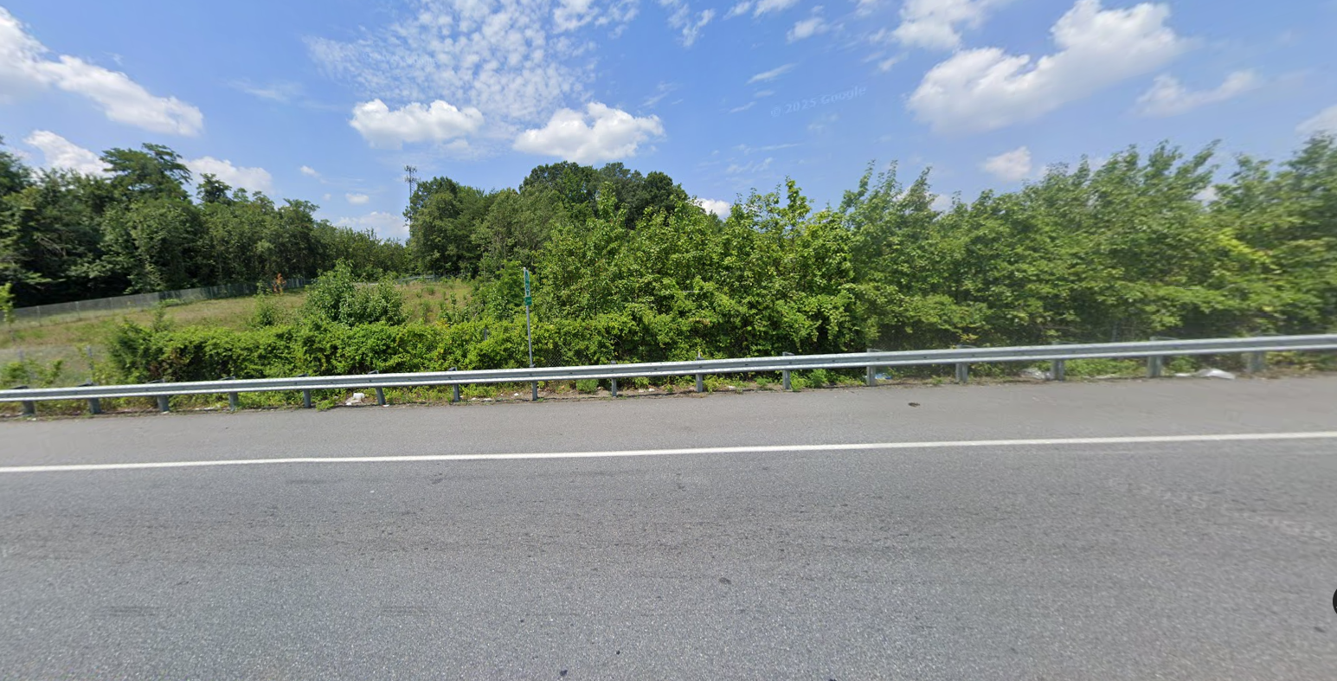
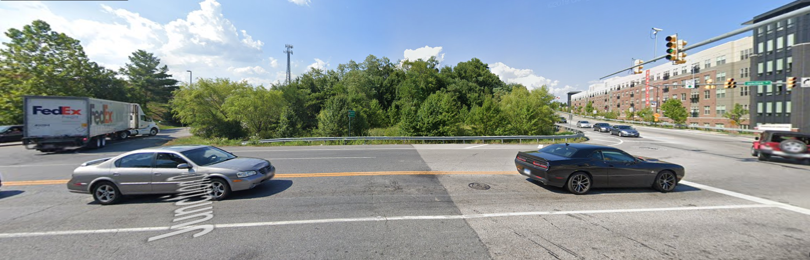
STATION OVERLOOK
EXISTING VICINAL PICTURE MAP
BUS STOP
SITE
SITE
Annapolis Junction
Apartments
Bureau of Utilities
Savage Station

Slide 4
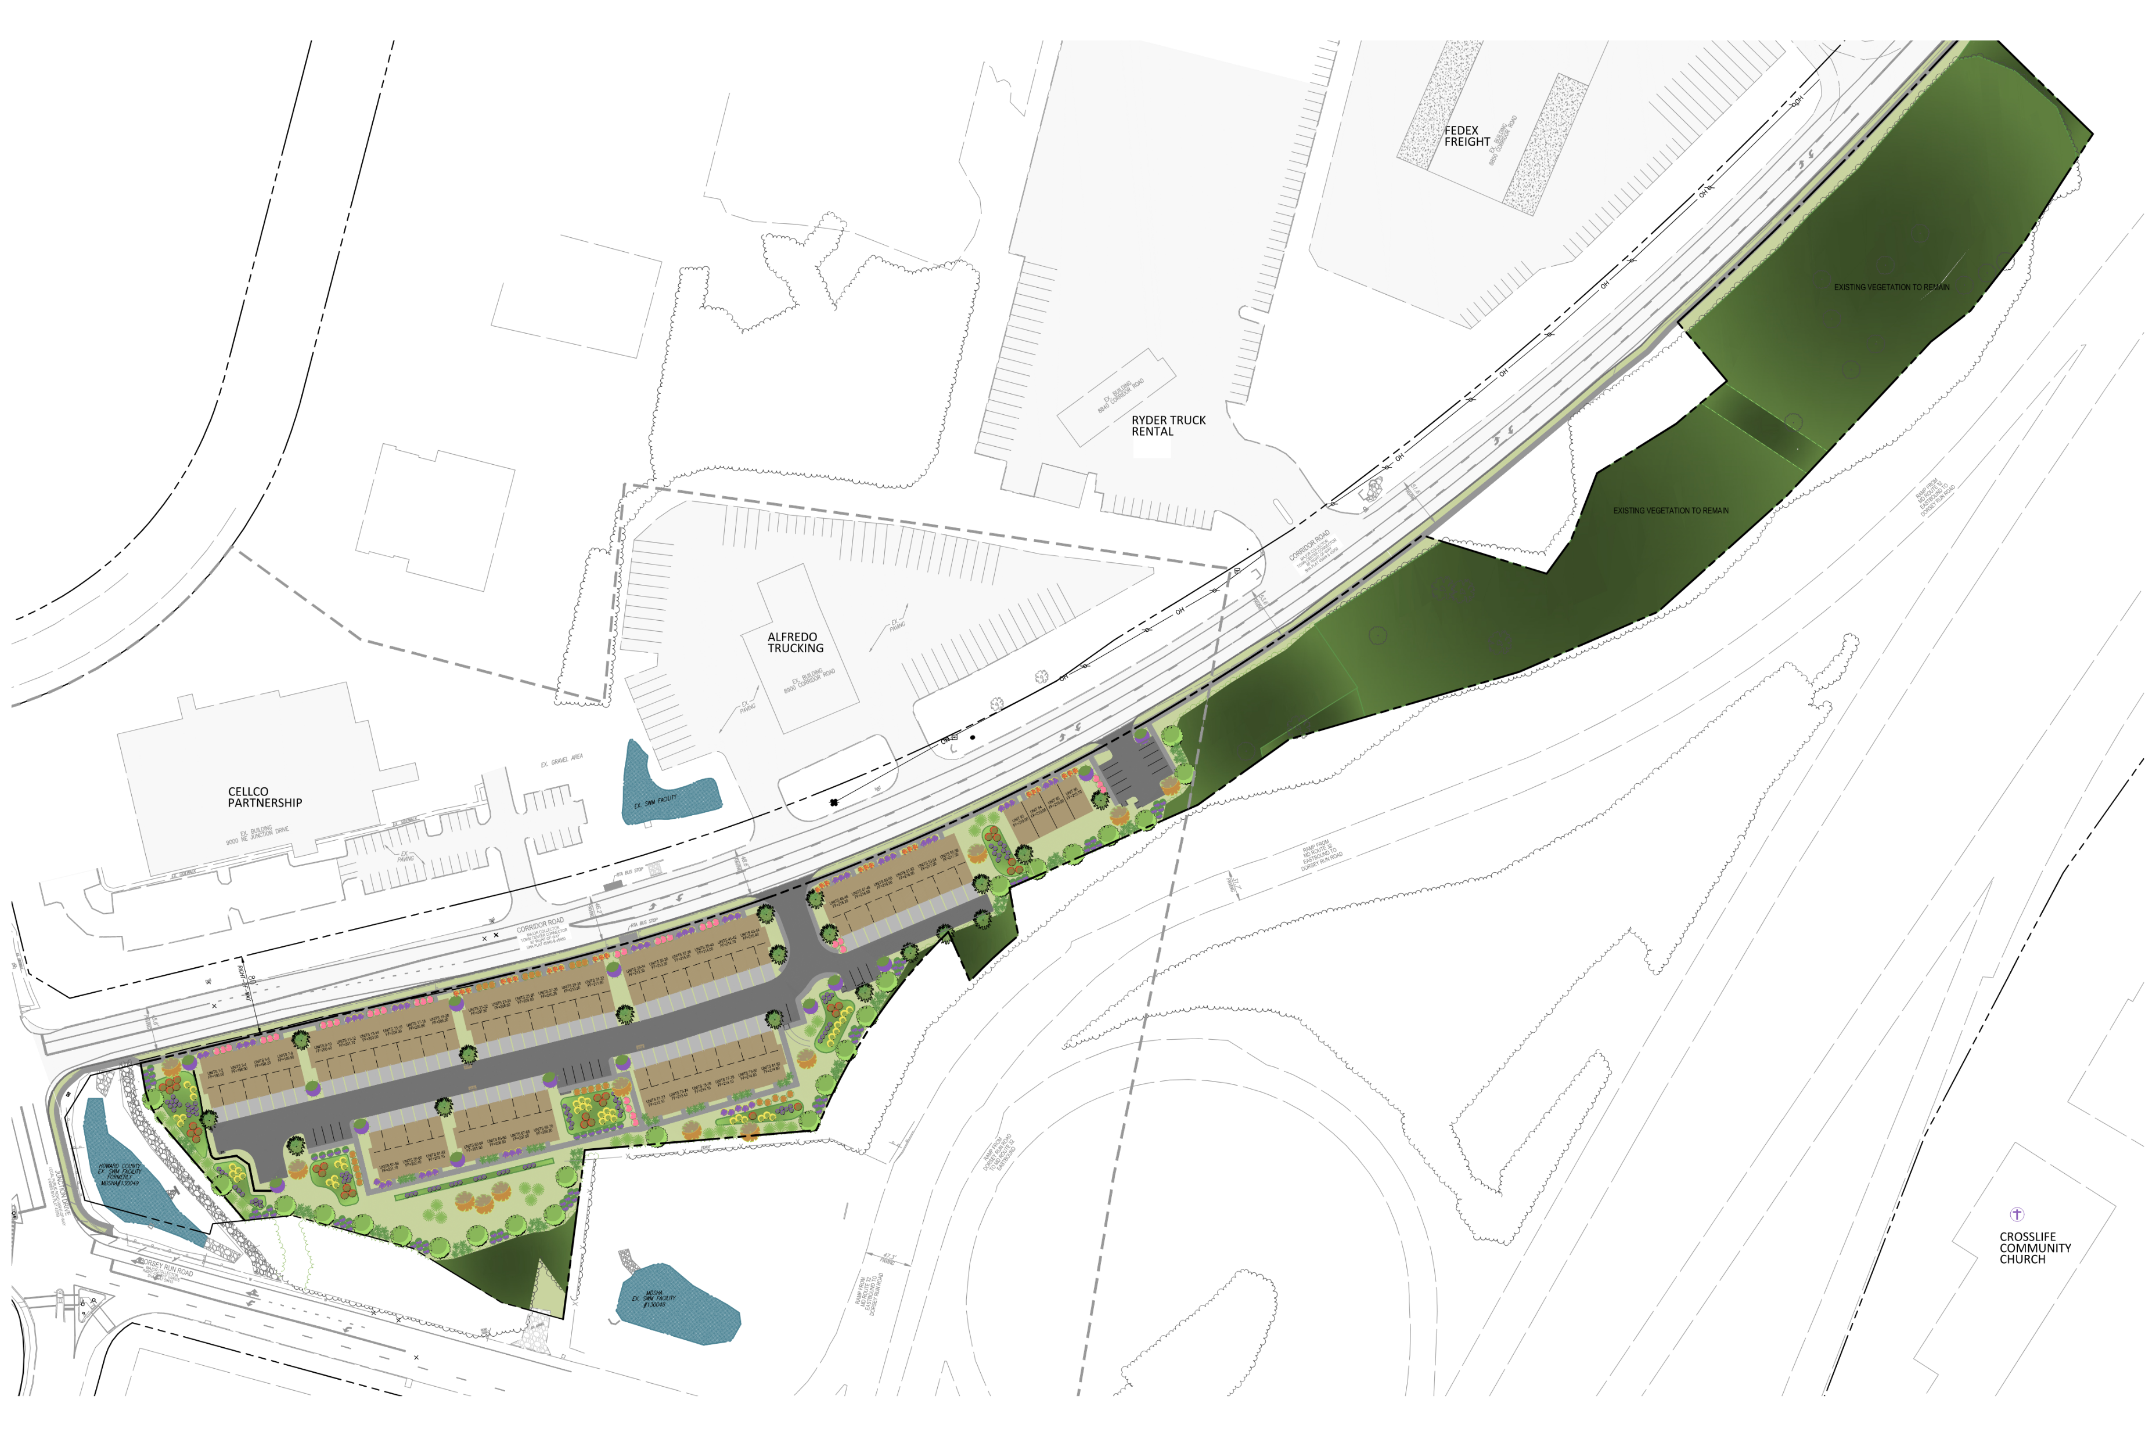

STATION OVERLOOK
RENDERING OF OVERALL PLAN

Slide 5
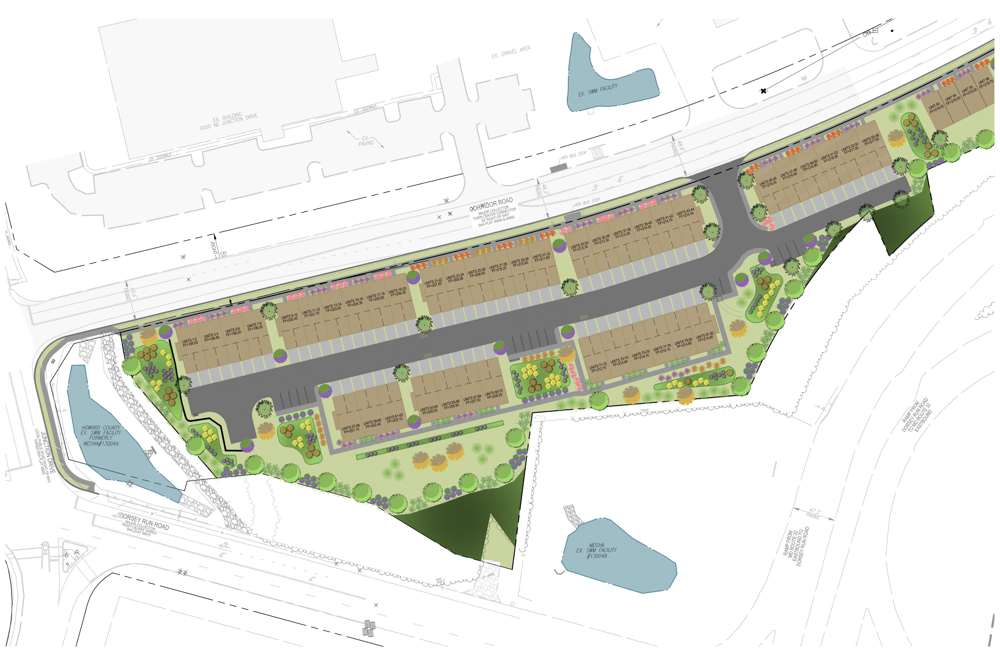
STATION OVERLOOK
RENDERING OF OVERALL PLAN

Slide 6
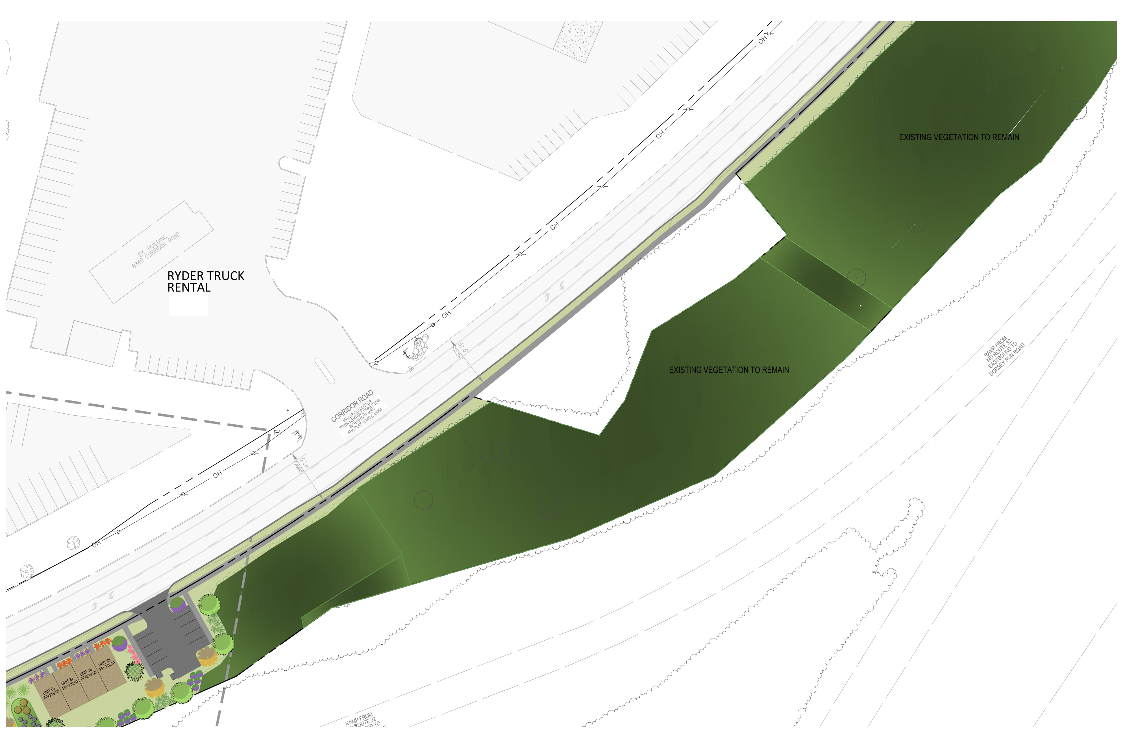
STATION OVERLOOK
RENDERING OF OVERALL PLAN

Slide 7




STATION OVERLOOK
AMENITIES
14’ LIGHT POLE LIGHT TO BE SHIELDED AND DIRECTED DOWN AND AWAY FROM ADJACENT PROPERTIES.

Slide 8
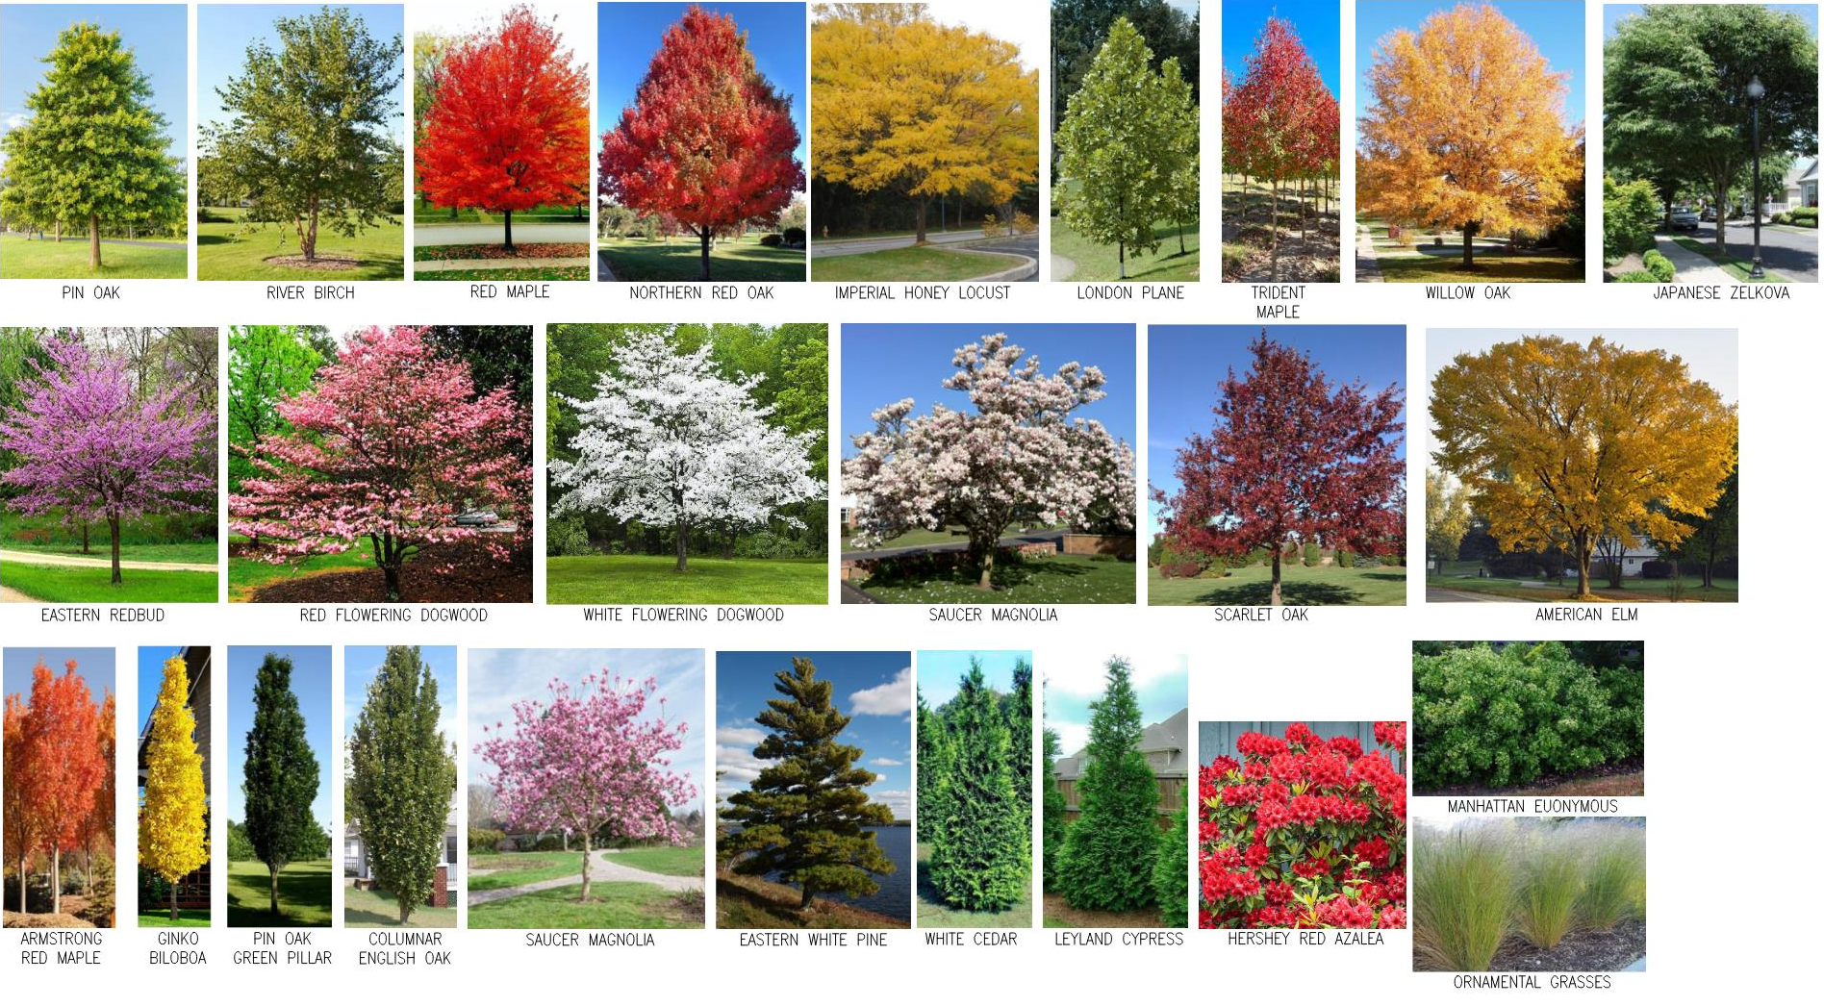
LANDSCAPING AT
STATION OVERLOOK

Slide 9
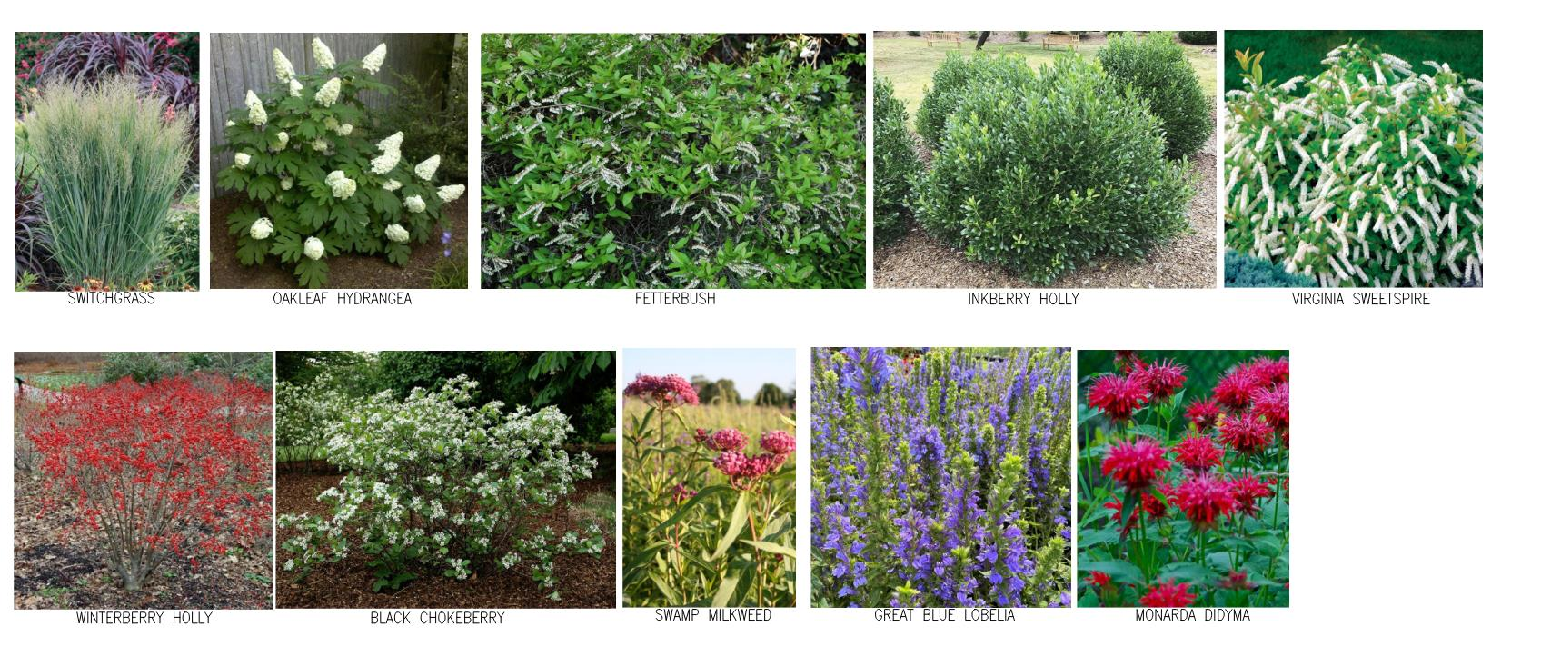
STATION OVERLOOK
MICRO-BIORETENTION PLANTINGS

Slide 10
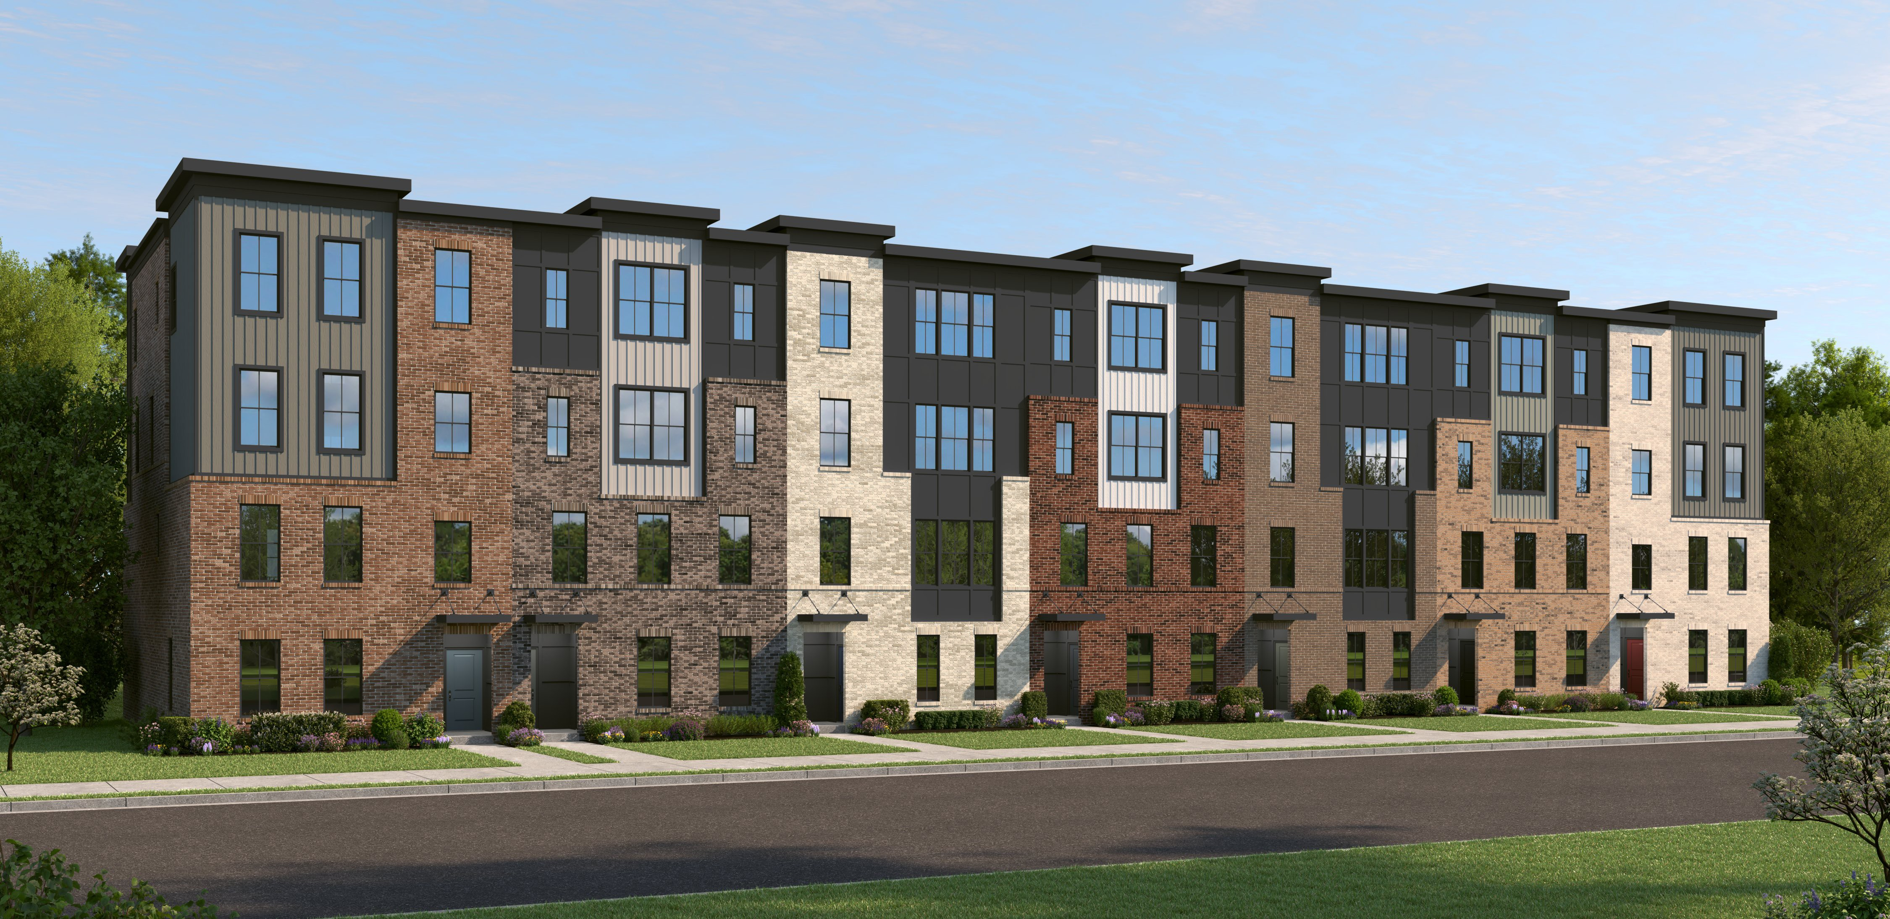
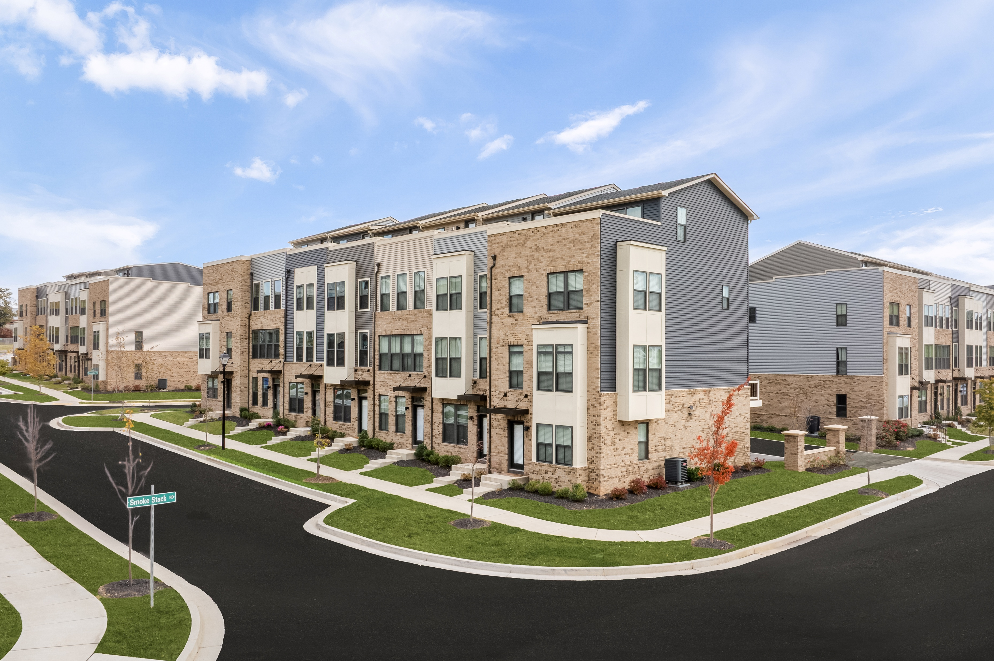
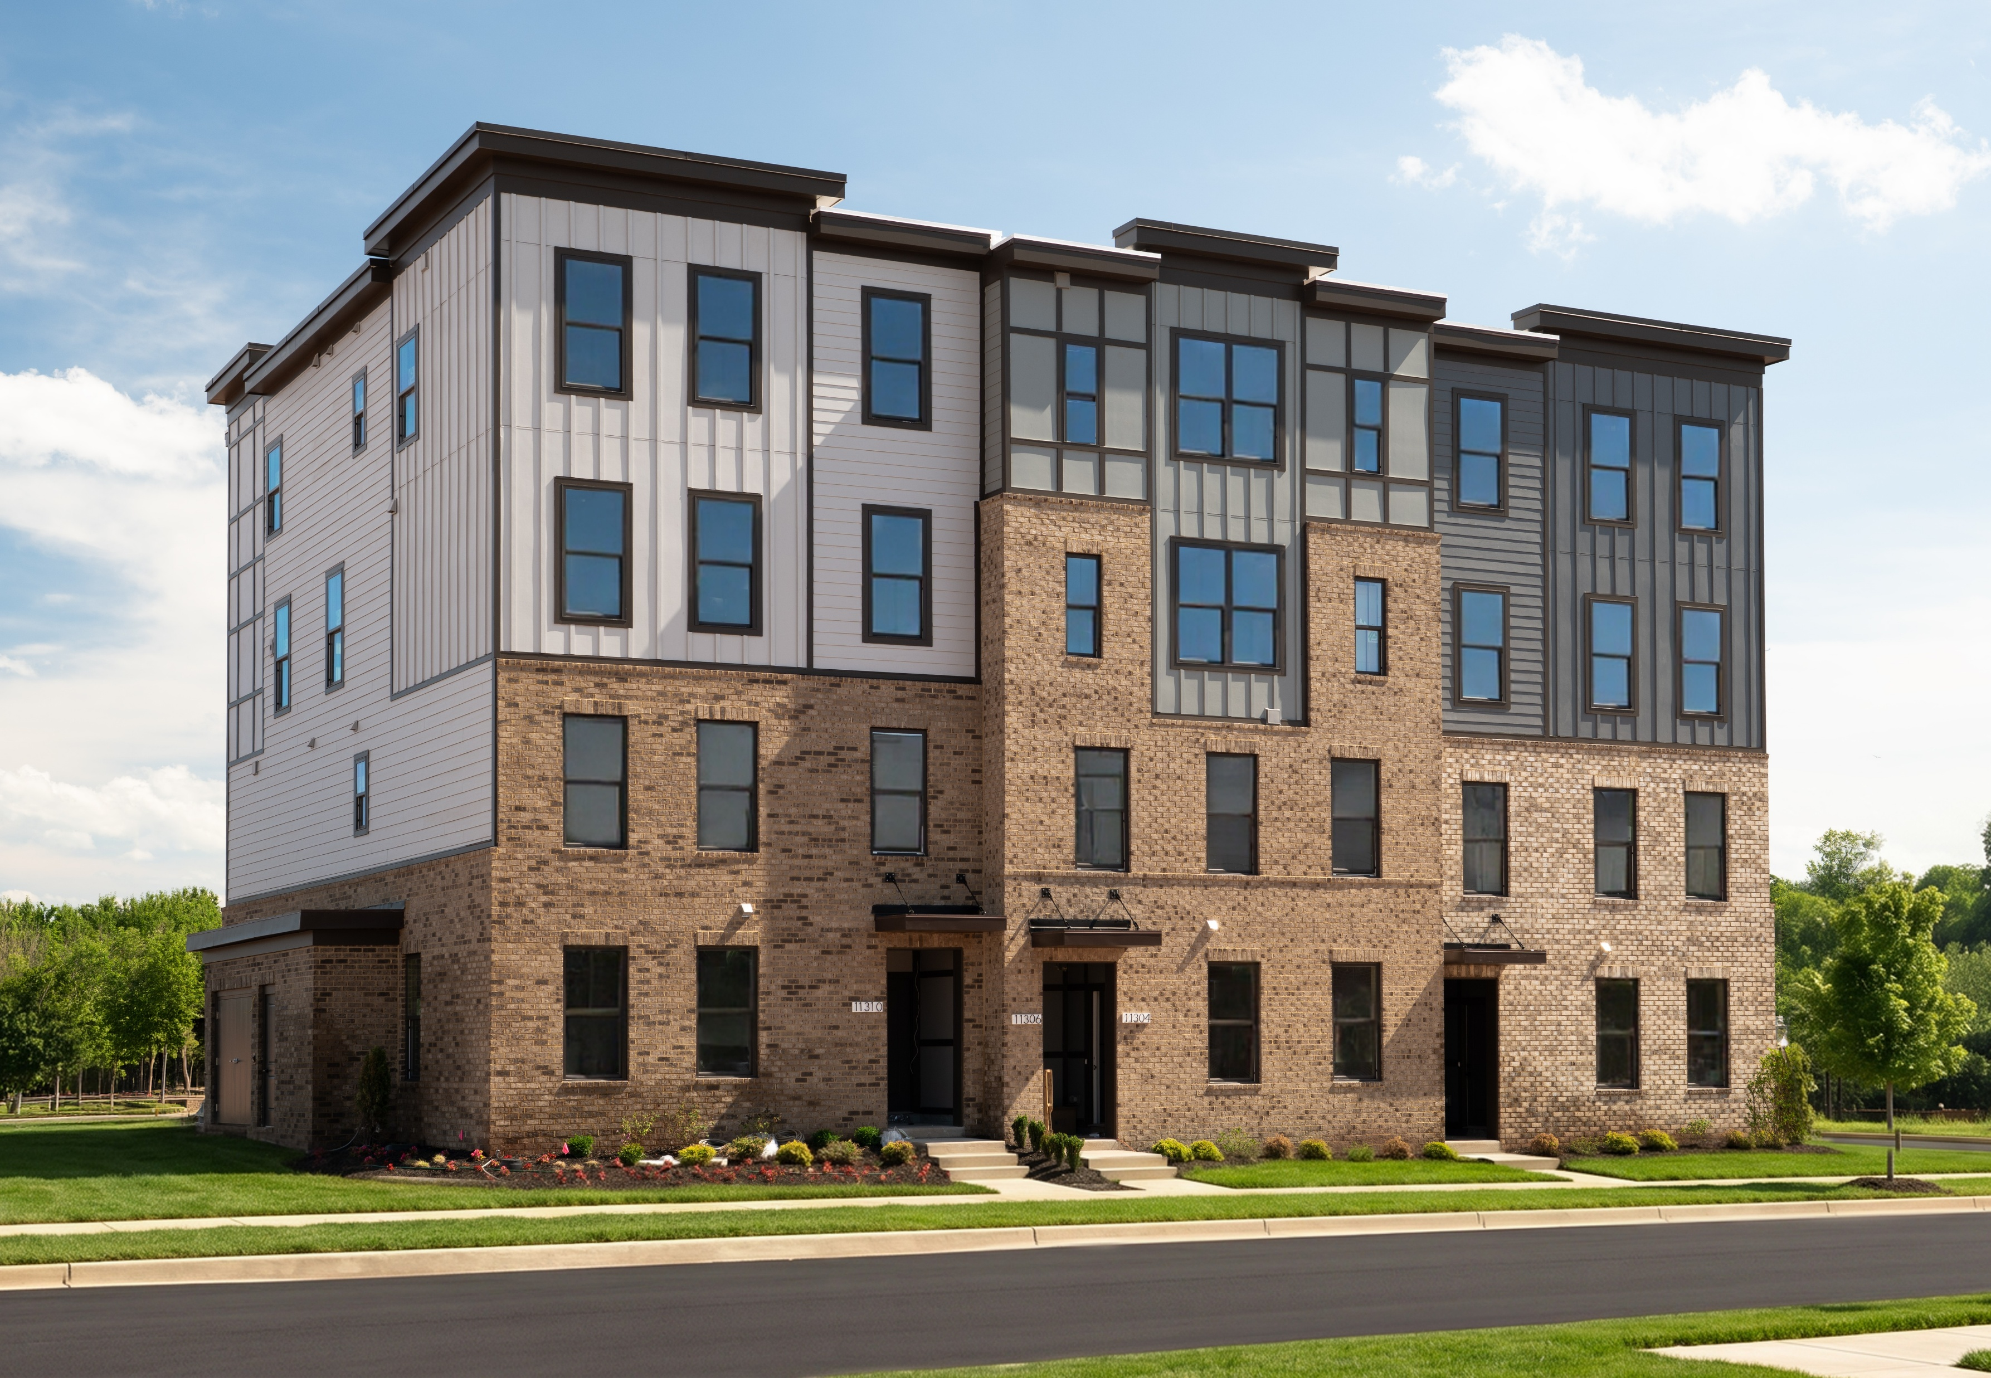
BUILDING ELEVATIONS
3 & 4 STORIES

Slide 11
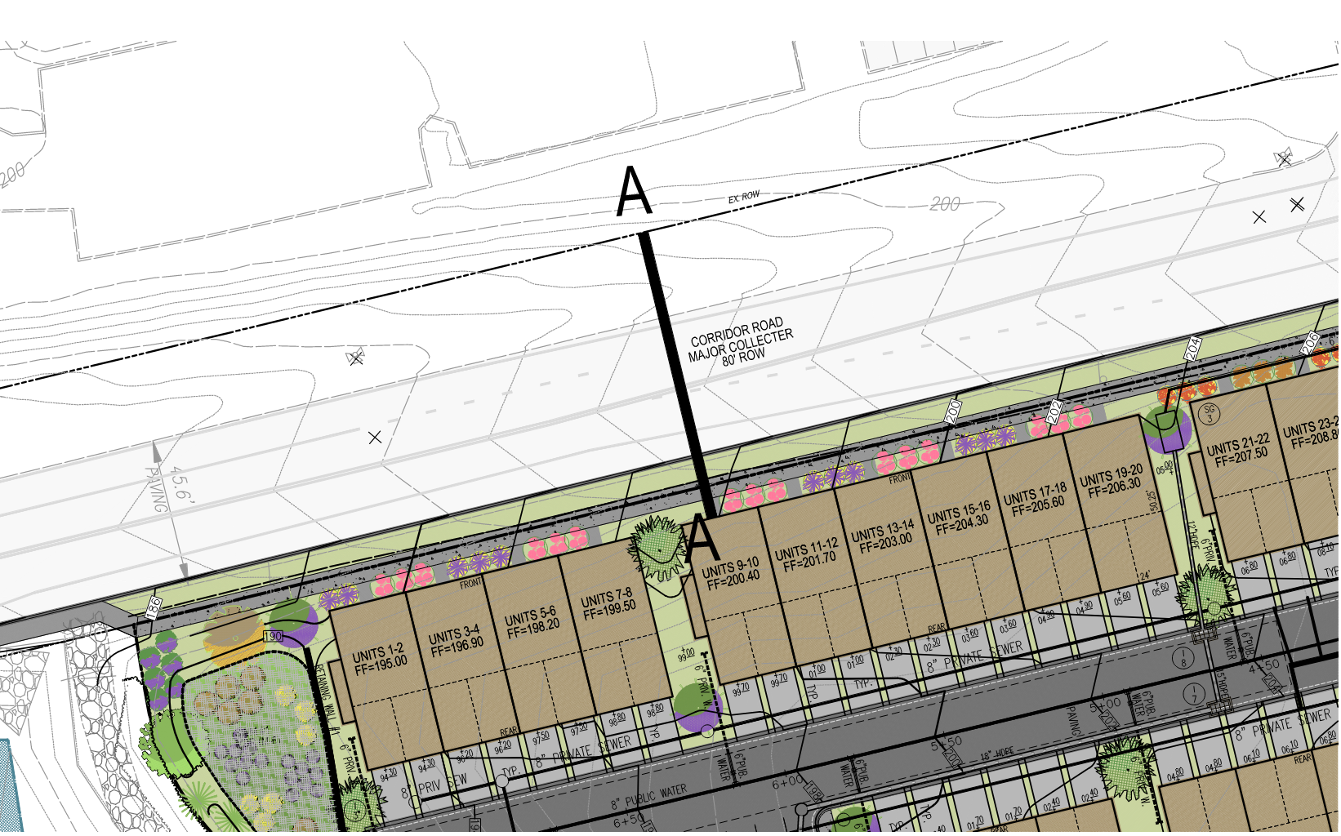
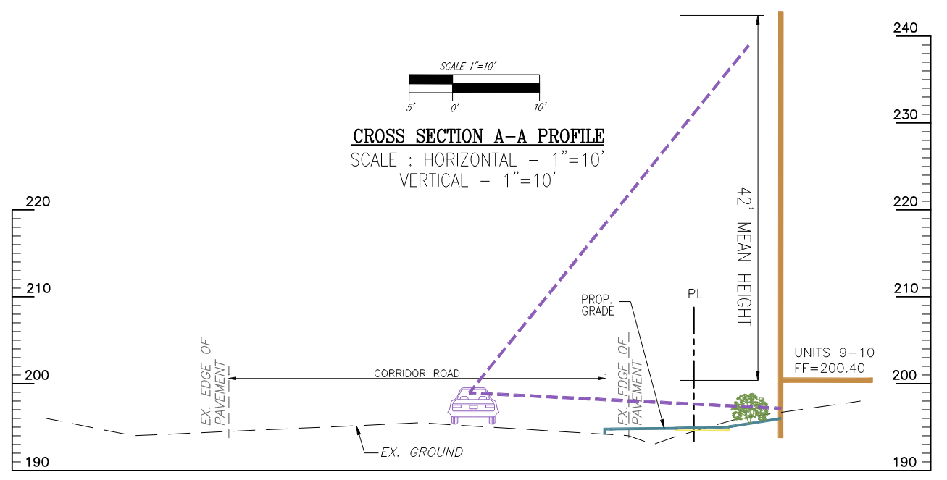
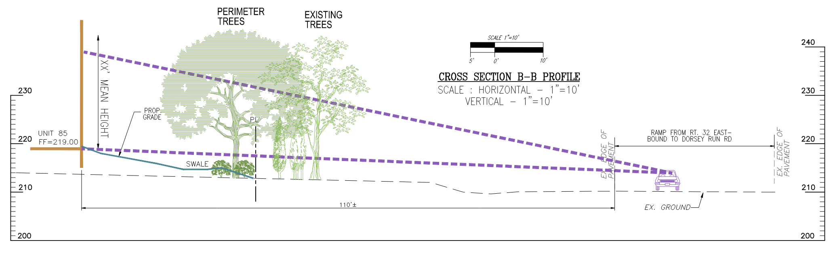
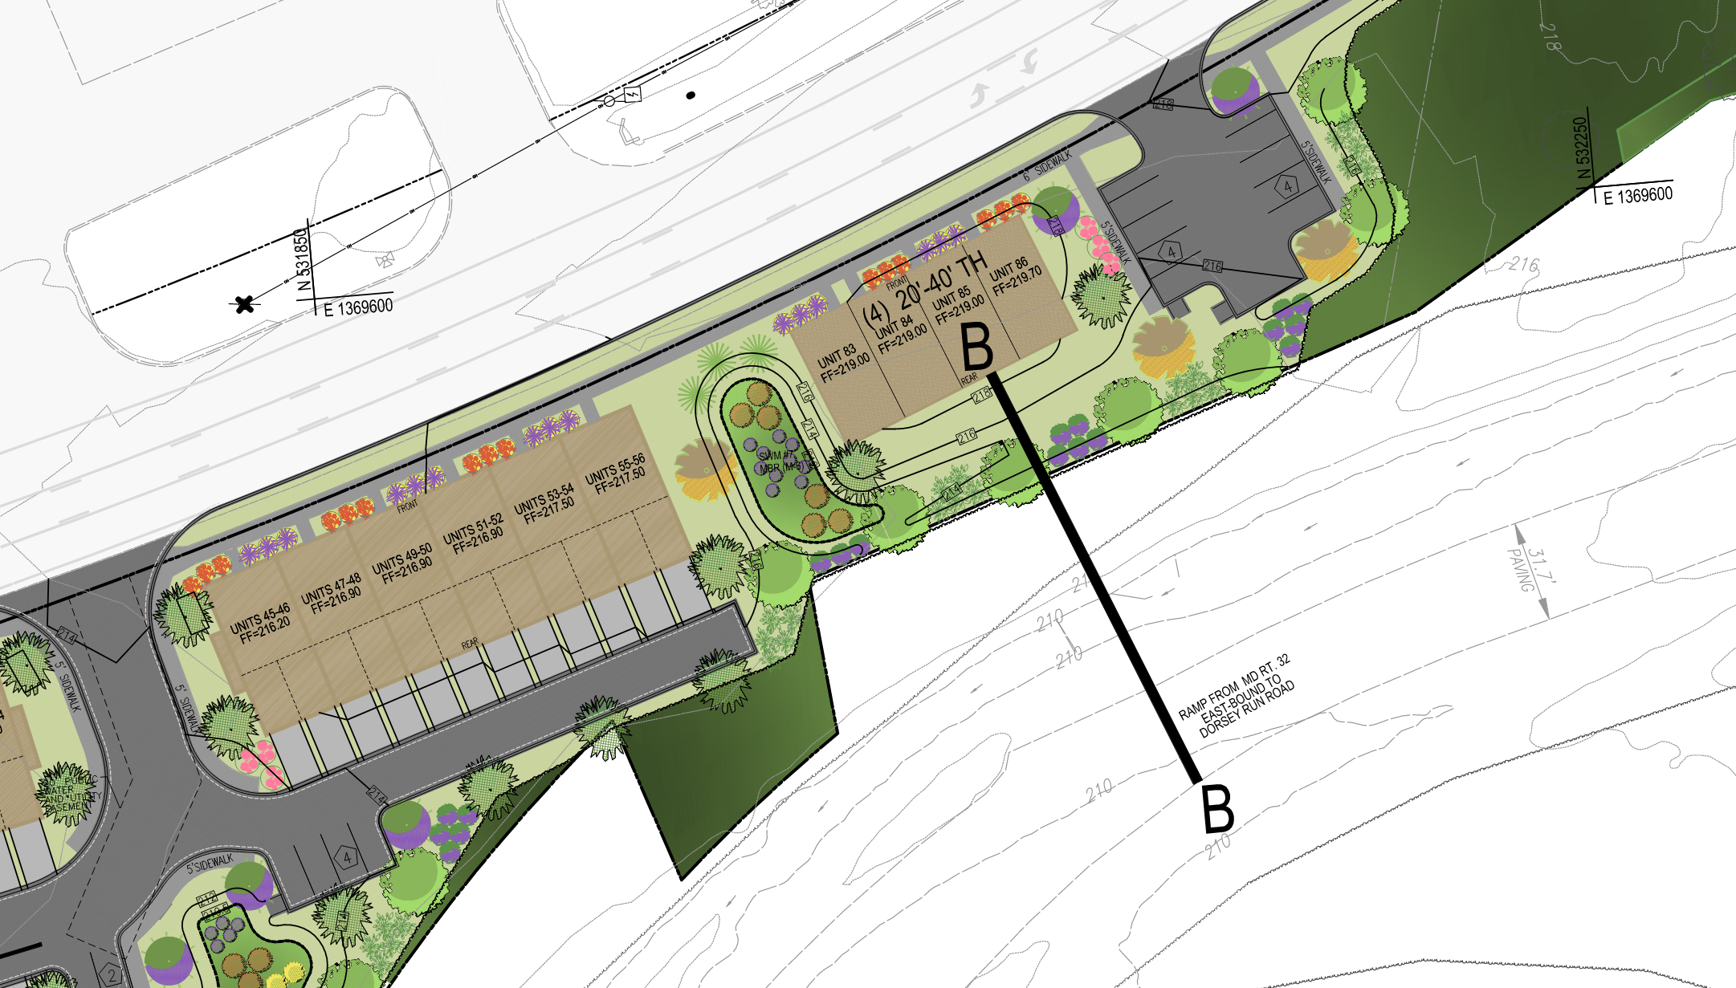
CROSS SECTIONS
NTS
NTS

Slide 12
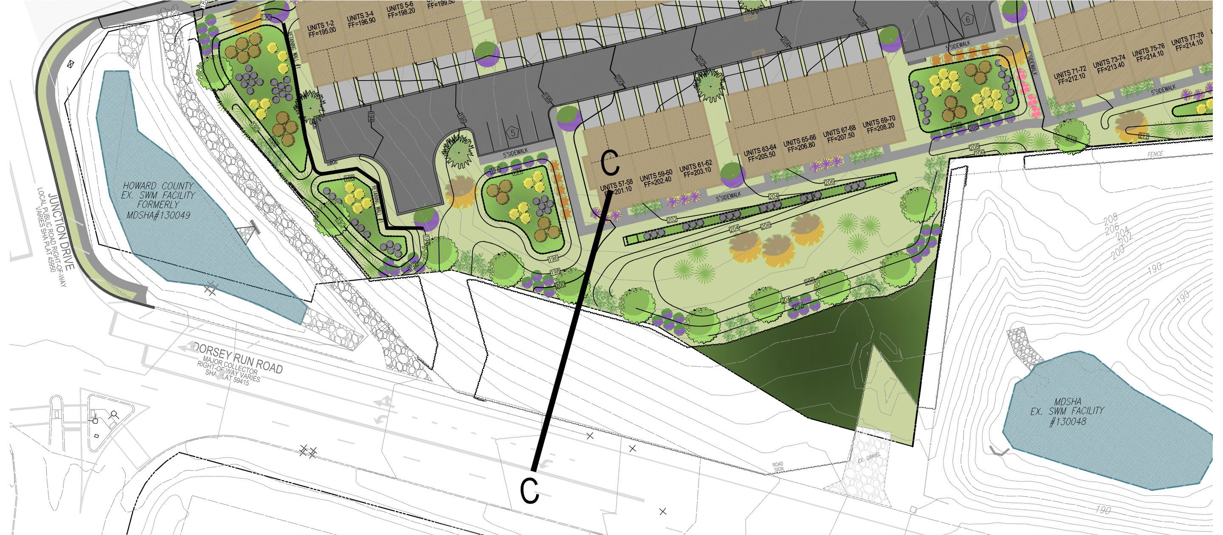
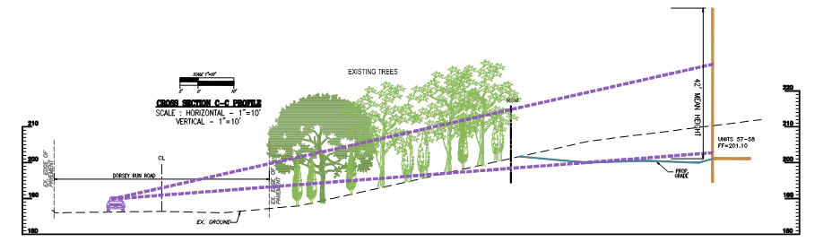
CROSS SECTIONS
NTS

Slide 13


QUESTIONS?

